Slide 1
Passage of magnetostatic waves through the lattice on the basis of the magnon crystal.
Performed by
Lanina Mariya,
III year student, Faculty of Nonlinear Processes, Saratov State University.
Supervisor:
Ph.D. Sharaevsky J.P., Head of the Department of Nonlinear Physics, Faculty of Nonlinear Processes, Saratov State University
5th Helmholtz International Summer School - Workshop
Dubna International Advanced School of Theoretical Physics - DIAS TH
Calculations for Modern and Future Colliders
July 23 - August 2, 2012, Dubna, Russia

Slide 2
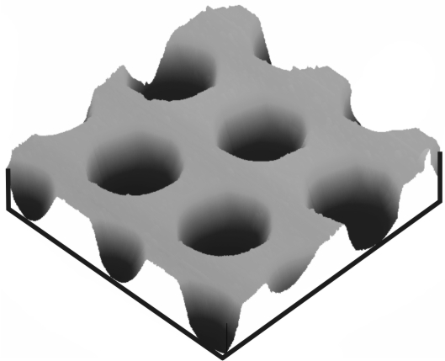
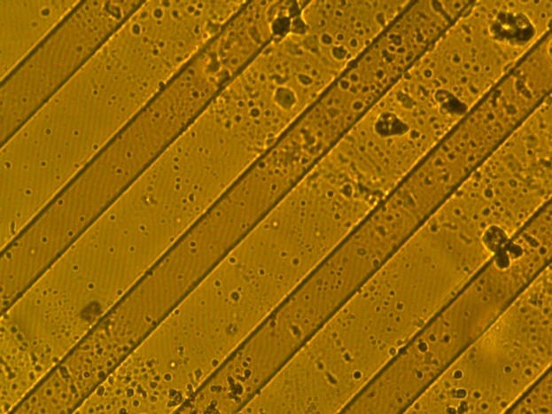
Magnon crystals are the structures, similar to photonic crystals, but created on the basis of magnetic materials in which propagating waves are spin waves.
In terms of application - the development of tunable magnetic field devices of information processing in the microwave range.
Examples of 1-D and 2-D
magnon crystals

Slide 3
The purpose :
Building a model based on the method of coupled modes for the description of the propagation of magnetostatic waves through the lattice on the basis of one-dimensional analysis of the magnon crystal and the reflectivity of the lattice, depending on the geometry of the structure.
The contents of the report:
1. The scheme of analysis and the basic relations.
2. The calculation of the reflectivity of the crystal lattice
on the magnon crystal.
3. Comparison with the experiment.
4. Nonlinear properties of the magnon crystal.

Slide 4
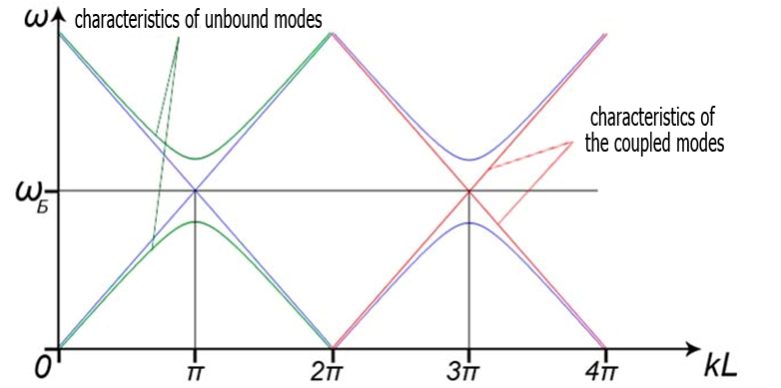



Brillouin diagram:
Bragg condition:
where - Bragg frequency corresponding to
the center frequency of the band gap.
,

Slide 5
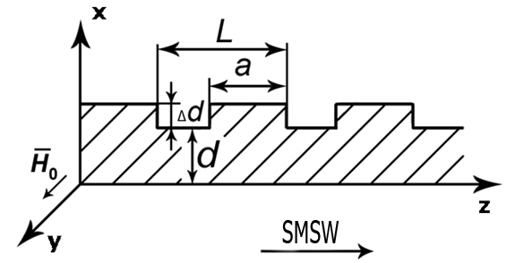





Diagram of the structure:
– period,
– width of the protrusion,
- film thickness,
– height of the projection.
The dispersion equation for SMSW:
,
where and ( - gyromagnetic ratio;
- the saturation magnetization);
-frequency; - the propagation constant of SMSW.

Slide 6





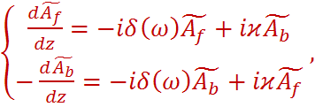


The equations for the forward and backward waves :
The distribution of the magnetostatic potential :
- slowly varying amplitudes of forward and backward waves, respectively.
where
и
The Fourier component of the magnetostatic potential:
synchronism condition:
and
- detuning from the Bragg wave number.
- the coupling coefficient.

Slide 7
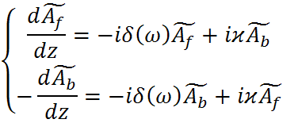


Coupled-mode equations :
,
looking for the solution
of the system in the form :
dispersion equation :
If
is real
passband
If
is imaginary
band gap

Slide 8




Basic relations:
Reflection coefficient:
Reflectivity:
Phase of reflection coefficient :
Transmittance :

Slide 9
Calculation of the reflectivity and phase

Slide 10
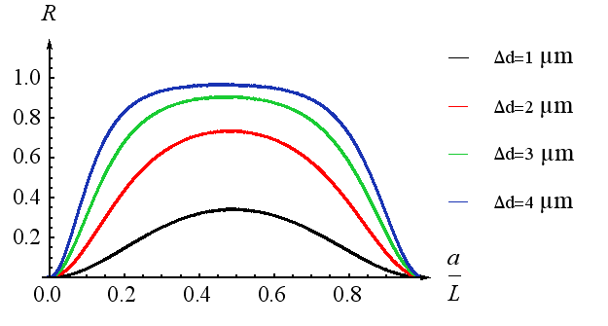





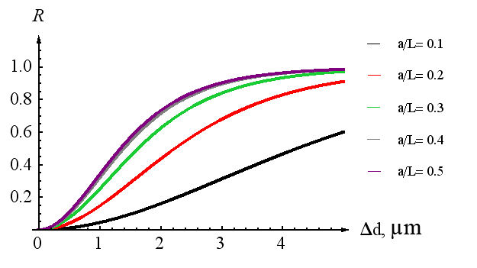
Calculation of the reflectivity
.

Slide 11
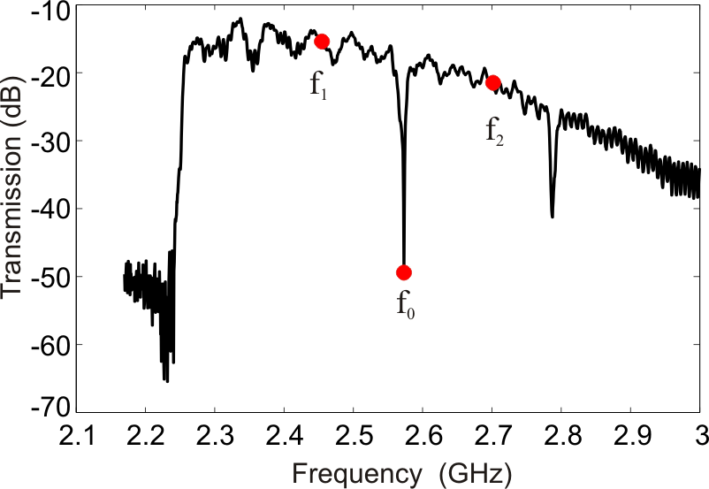







The experimental frequency response of
one-dimensional magnon
crystal
Theoretical dependence for
one-dimensional
magnon crystal

Slide 12
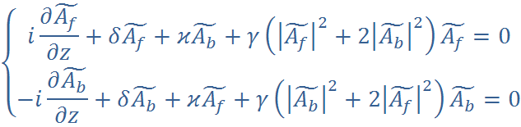







Nonlinear coupled-mode equations
,
where
- coefficient of nonlinearity.
We are searching for the solution of the form:
Introduce
- this parameter shows how the total power is
divided between direct and counter-propagating waves.
- backward wave dominates
- direct wave dominates
,

Slide 13






Slide 14

The conclusions are:
1. The analysis of the reflectivity of the lattice on the basis of one-dimensional magnon crystal and the reflection coefficient was calculated from the geometric dimensions of the structure in the excitation of surface magnetostatic waves. It is shown that even when the ratio of the structure to its period is greater than or equal to seven the reflection coefficient achieves the value one.
2. A comparison of calculated results with experimental data. A good qualitative agreement of the results.
3. It is shown that with increasing level of input power band gap shifts to lower frequencies.

Slide 15
Thank you
for your attention!

