Slide 1
Nuclear charge radii: experiment, data and systematics
Workshop on Precision Physics and Fundamental Physical Constants
(Dubna, 1-5 December, 2014)
Krassimira Marinova
Joint Institute for Nuclear Research,
141980 Dubna, Moscow region

Slide 2


Why atomic spectra supply information on nuclear structure?
Optical spectroscopy → main source of information on charge radii
Electromagnetic interaction: atomic nucleus I → electronic shell J
Hyperfine splitting
$\vec{F}=\vec{I}+\vec{J}$
Spin, magnetic and electric
moments , all nuclear
observables are extracted
without model dependence.
3p
²P_{3/2}
F_{j}
²P_{1/2}
3s
F_{i}
²S_{1/2}
Isotopic shift
Changes in nuclear charge
radii and sensitive to changes in dynamic nature and deformation as well as volume.
ppm shift
Δν^{A’A} =ν^{A}- ν^{A’} ∼δ<r²>^{A’A}

Slide 3

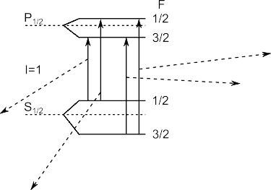
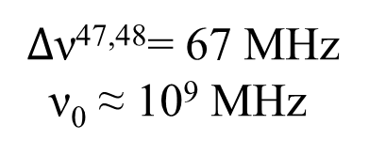
1-2 – splitting of P_{1/2}
3-4 – splitting of P_{1/2}
ΔF = 0, ±1
1
1-3 – splitting of S_{1/2}
2-4 – splitting of S_{1/2}
$∆\text{ν}$^{47,48}= 67 MHz
ν₀ ≈ 10⁹ MHz
1 2
3 4
Optical spectrum of ⁴⁸K recorded with 0.2 mW laser power. Also shown is the fitted hfs (blue solid line) and the hfs centroid (red vertical line) relative to the centroid of ⁴⁷K
K. Kreim et al, Phys. Lett. B 731 (2014) 97

Slide 4
Advantages of laser spectroscopy
High resolution: Δν_{L} ≤ Δν_{n}
ν_{L}=ν₀ σ(ν₀) ≈ 5×10⁻⁹ cm²
High intensity:
10 mW/cm² → I ≥ 10¹⁷ cm⁻²s⁻¹
Lasers:
w₁₂ = σ(ν₀) I ≥ 10⁸ s⁻¹ ≥ A₂₁ N₁ = N₂
Conventional light sources N₂ ≈ 10⁻⁵N₁
2
ν₀
w₁₂
A₂₁
Excellent collimation
1

Slide 5
The Dream Common to Studies of Nuclear Ground State Properties and of Fundamental Interactions and Symmetries
The techniques applied to the study of unstable nuclei
should be
∗ ultra-resolving (hyperfine splitting, ground and isomeric state)
∗ ultra-accurate (statistical error only)
∗ ultra-fast (half-lives of milliseconds and below)
∗ ultra-efficient (high transmission, detection efficiency)
∗ ultra-sensitive (one-ion experiments)
and all these nice features
should be available simultaneously !

Slide 6

CS
RIS
Mainz
CS
RIS
Jyväskylä
MO
KVI
CS
RIS
MOT
TRIUMF
•
RIS, MOT
GANIL
•
RIS
Gatchina
MOT
Argonne
FS
RIKEN
•
•
•
•
•
•
RIS
Leuven
•
CS
GSI
•
•
•
CS
RIS
(Anti-H)
CERN
MOT
LBL
RIS
ORNL
MOT
Legnaro
CS: collinear spectroscopy, RIS: resonance ionization spectroscopy
MOT: spectroscopy in a magneto optical trap, FS: fluorescence spectroscopy

Slide 7
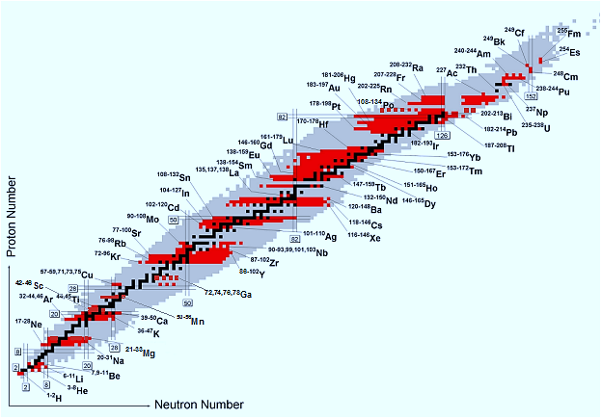




Achievements of laser spectroscopy
Black squares represent stable nuclei. The grey area indicates those nuclei which are known to exist. The neutron and proton shell closures are marked by double straight lines. Red squares represent those isotopes which have been investigated by optical spectroscopy in long isotopic chains. Status till the end of 2012.

Slide 8




Charge radii extraction
Isotopic shift
$$∆ν^{A^{′}A}=Δν_{FS}^{A^{′}A}+{Δν}_{MS}^{A^{′}A}$$
Field shift Mass shift
$Δν_{FS}^{A′A}$=Fδ<r²>^{A’A} $Δν_{MS}^{A′A}=MS\frac{mA−mA′}{mAmA′}$
with δ<r²>^{A’A} = R²(A) - R²(A’)
Light elements $Δν_{FS}^{A′A}≪Δν_{MS}^{A′A}$
Heavy elements $Δν_{FS}^{A′A}≫Δν_{MS}^{A′A}$
$∆ν^{A^{′}A}$ depends on: level configuration, λ

Slide 9

EXAMPLES: from light to heavy elements
isotope shifts, mass shifts and charge radii changes
el | A’,A | δν_{IS, exp} (MHz) | δν_{MS} (MHz) | δν_{FS} (MHz) | Δ<r²>^{A’,A} (fm² )
₃Li | 6,8 | 20 089.735(50) | 20 087.802(5) | 1.933 | -1.230(32)
₁₀Ne | 20,21 | 1663.58(17) | 1650.7(1.7) | 12.88 | -0.321(4)
₃₆Kr | 86,94 | -432(3) | 165(18) | -597.0 | 0.989(4)
₆₃Eu | 145,151 | -4170(6) | 97(48) | -4267.4 | 0.8538(11)
₈₀Hg | 198,202 | -10103(4) | 64.4(32.2) | -10167.4 | 0.1981(1)
₈₇Fr | 212,220 | -20806.8(5) | 39(19) | -20845.8 | 0.86725(2)
10⁻⁶ → 10⁻³
10⁻⁷ → 0.5
Statistical errors
d(δν_{FS} ) = d(δν_{IS} )
dδ<r²> = d(δν_{IS} ) /F < d(δν_{FS} )
δν_{IS, exp} to Δ<r²>^{A’,A}
10⁻⁶ → 10⁻³ – 10⁻²

Slide 10
Systematic errors of δ<r²>
● d(Δν_{MS})
10^{-6 →} ≥ 50%
dδ<r²>_{MS} = d(Δν_{MS})/F
● dF
0.01% → ≤ 10%
● experimental method,
fundamental constants

Slide 11
Absolute values of nuclear charge radii
● Absolute values R - muonic spectra and electronic scattering experiments
→ applicable to stable elements only
→ (mu) model dependent
 | R_{exp}, fm
⁶Li | 2.5700(1500) 2.5100(300) 3.1000(800) | el el mu
²⁰Ne | 3.0400(250) 3.0800(800) 3.0060(41) | el mu mu
²²Ne | 3.0400(250) 3.0700(800) | el mu
⁸⁶Kr | 4.1840(72) 4.1870(100) | mu mu
¹⁵¹Eu | 5.0300(1500) 4.9980(1000) | mu mu
²⁰²Hg | 5.4830(150) 4.4910(150) | mu mu
● Changes δ<r²>^{A’A} - optical isotope shifts, long isotopic chains
R²(A) = R²(A’)+δ(r²)^{A’A}
combined analysis of two types of experimental data
The extraction of R in long isotopic sequences - meets with serious statistical and computational problems in cases where there exist data on R(A) for many
isotopes and especially on δ<r²> in long isotopic chains
Two different algorithms of analysis are used
E. Nadjakov, K. Marinova, Yu. Gangrsky: ADNDT 56 (1994) 133-157
I. Angeli, ADNDT 87 (2004) 185-206

Slide 12
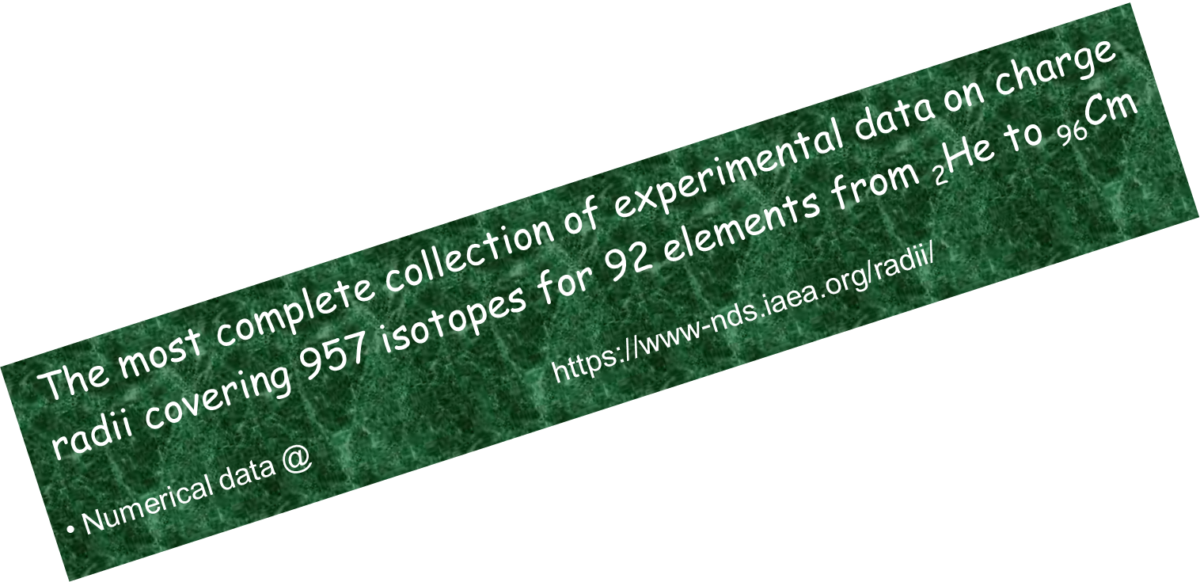
Table of experimental nuclear charge radii
I. Angeli &K. Marinova, ADNDT 99 (2013) 69
The table combines the results of two working groups in a single data set
includes data till the end of 2013
accounts for statistical and systematic errors of both types of source data
RESULTS
increases the accuracy of the already known R
predicts R-values in long isotopic chains
self-consistent set of R values

Slide 13
Examples and comparison
element | A | δ<r²>, fm² | R _{adopted}, fm | R_{exp}, fm
Li | 6 |  | 2.589(39) | 2.589(39)
 | 8 | -1.230(32)[0.0001] |  | 2.339(44)
Ne | 20 |  | 3.0046(48) | 3.0055(21)
 | 22 | -0.321(4)[43] | 2.9544(35) | 2.9525(33)
Kr | 86 |  | 4.1840(36) | 4.1835(21)
 | 94 | 0.989(4)[26] |  | 4.3002(129)
Eu | 145 |  |  | 4.9663(91)
 | 151 | 0.8538(11)[43] | 5.0440(53) | 5.0522(46)
Hg | 198 |  | 5.4480(69) | 5.4463(31)
 | 202 | 0.1981(1)(440) | 5.4670(66) | 5.4648(32)
Fr | 212 |  | 5.5915(176) | 5.5915(176)*
 | 220 | 0.86725(2)[0.088] |  | 5.6688(176)
Accuracy changes – several % to part of the percent

Slide 14
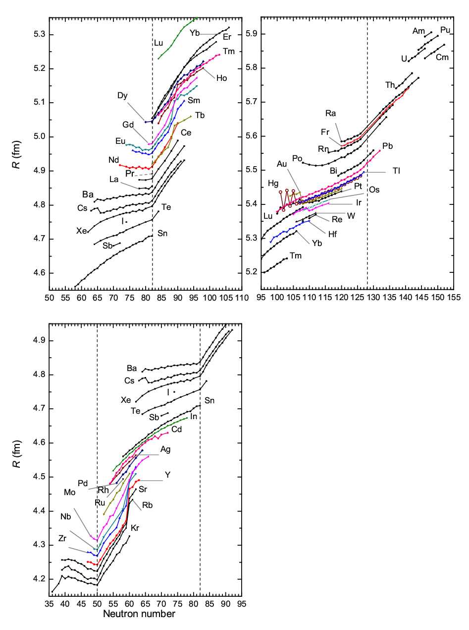
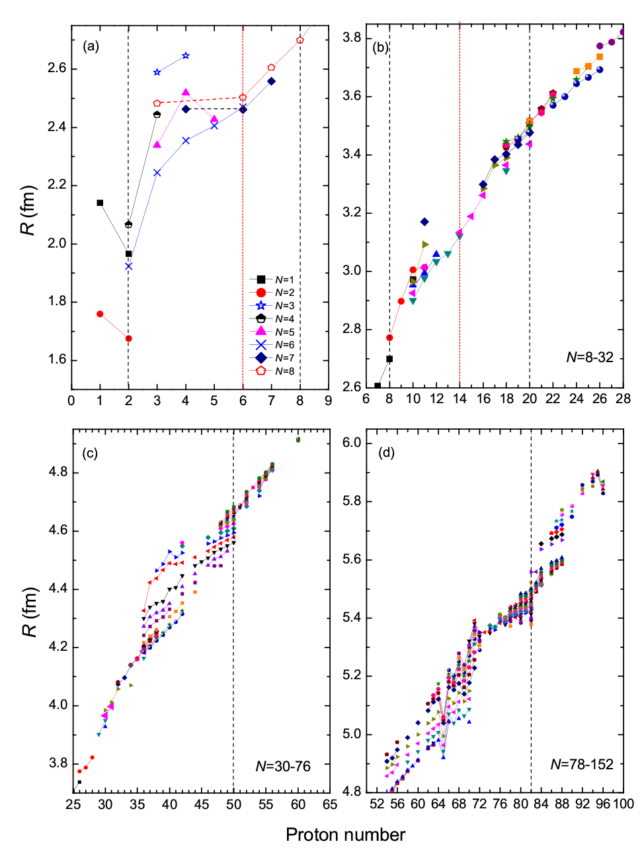
N and Z dependence of nuclear charge radii

Slide 15

Isotonic behavior
106-120
62-74
30-42
16-30
$$R_{nor }\left(Z\right)=R_{0 } {\left(\frac{A}{A_{0}}\right)}^{1/2}$$

Slide 16
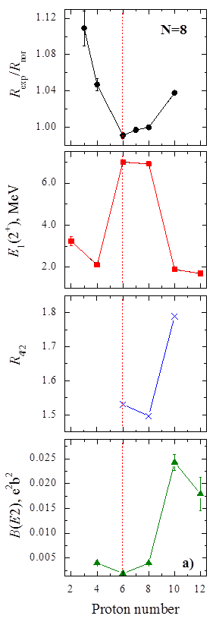

Correlations of R with other shell closure signature – isotonic behaviour
Shell closure signatures:
E₁(2⁺) → maximum
→
minimum
→
minimum
rms charge radii can be considered as an additional signature for shell closures

Slide 17



Possibility of analyzing not only isotopic, but also isotonic behavior of nuclear charge radii
Allows searching for correlations between nuclear charge radii R and other nuclear observables - indication of pronounced nuclear structure changes
Can be used in data handling and theoretical calculations as well as a test for the nuclear theory

Slide 18
THANKS

Slide 19
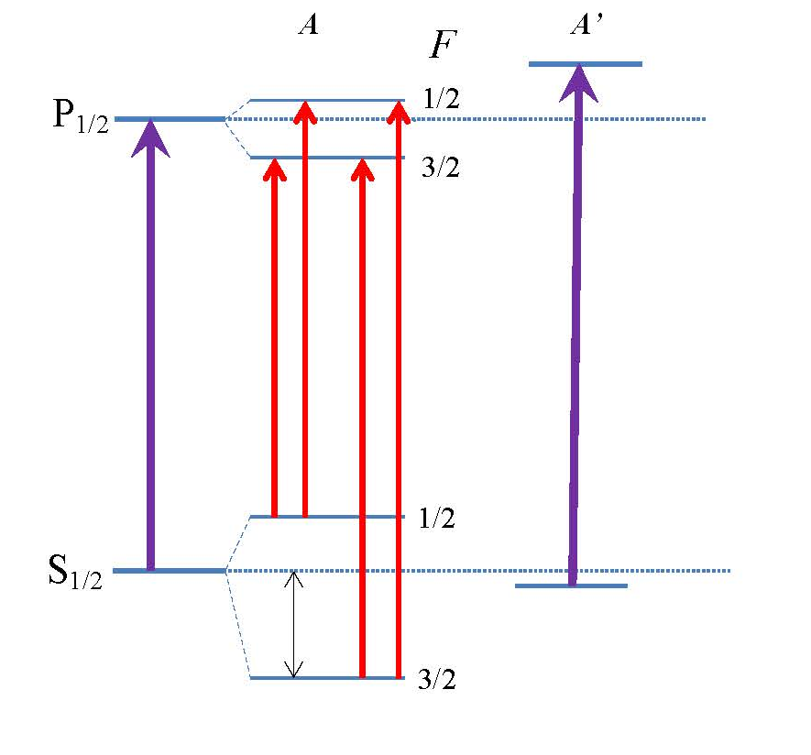
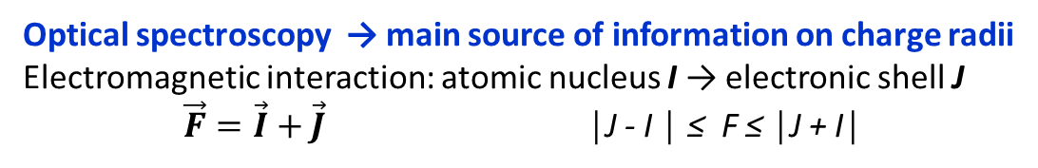
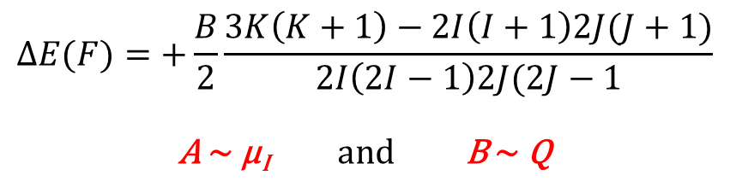
Why atomic spectra supply information on nuclear structure?
Optical spectroscopy → main source of information on charge radii
Electromagnetic interaction: atomic nucleus I → electronic shell J
$\vec{F}=\vec{I}+\vec{J}$ │J - I │ ≤ F ≤ │J + I│
Hyperfine splitting
$$∆E(F)=+\frac{B}{2}\frac{3K\left(K+1\right)−2I\left(I+1\right)2J(J+1)}{2I\left(2I−1\right)2J(2J−1}$$
A ∼ μ_{I} and B ∼ Q
Isotopic shift
Δν^{A’A} =ν^{A}- ν^{A’} ∼δ<r²>^{A’A}
Optical transitions → ΔF = 0, ±1

Slide 20

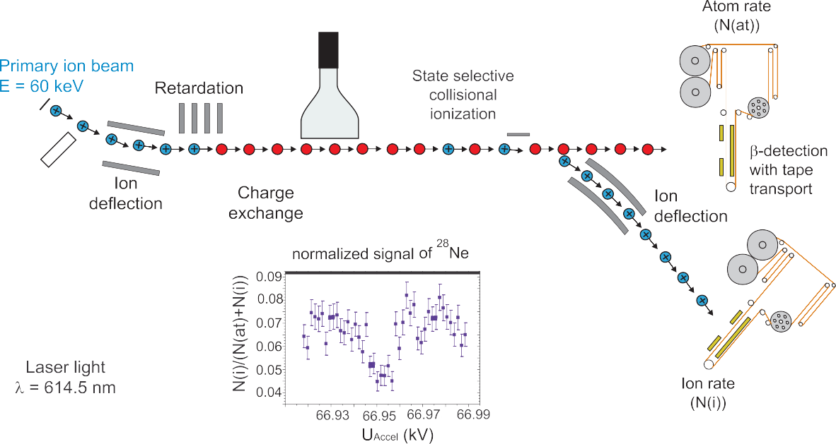
Collinear laser spectroscopy
ΔE=const=δ(¹/₂mv²)≈mvδv
T = 2000 K and U = 60kV
Doppler-compression:
GHz → MHz (~nat. linewidth)
Charge
exchange
Ion
Source
Separator
electrostatic
acceleration
Applied Doppler
tuning voltage
PMT
For ionic spectroscopy
Doppler tuning voltage
applied to light collection
region
Measure spin, magnetic moment
quadrupole moment
and isotope shift (charge radii)
  of exotic isotopes (rate > 10⁴/s)
COLLAPS (CERN)
10 ms, rate ≈ 10 s⁻¹

Slide 21
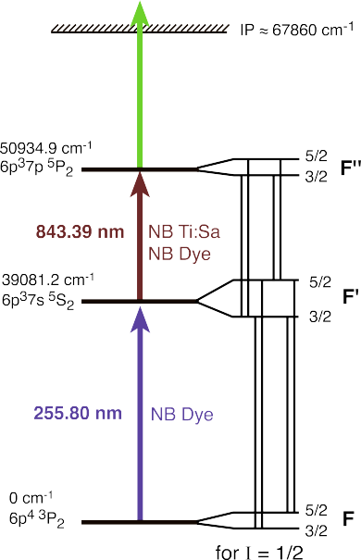

Resonance ionization spectroscopy
The lasers are tuned to resonantly excite the electronic population accross the atomic levels until the electron is close to or beyond the ionization potential.
The efficiency ranges from 1% to 40%.
Measuring the ion flux as a function of the laser frequency yields the resonance spectrum.

Slide 22
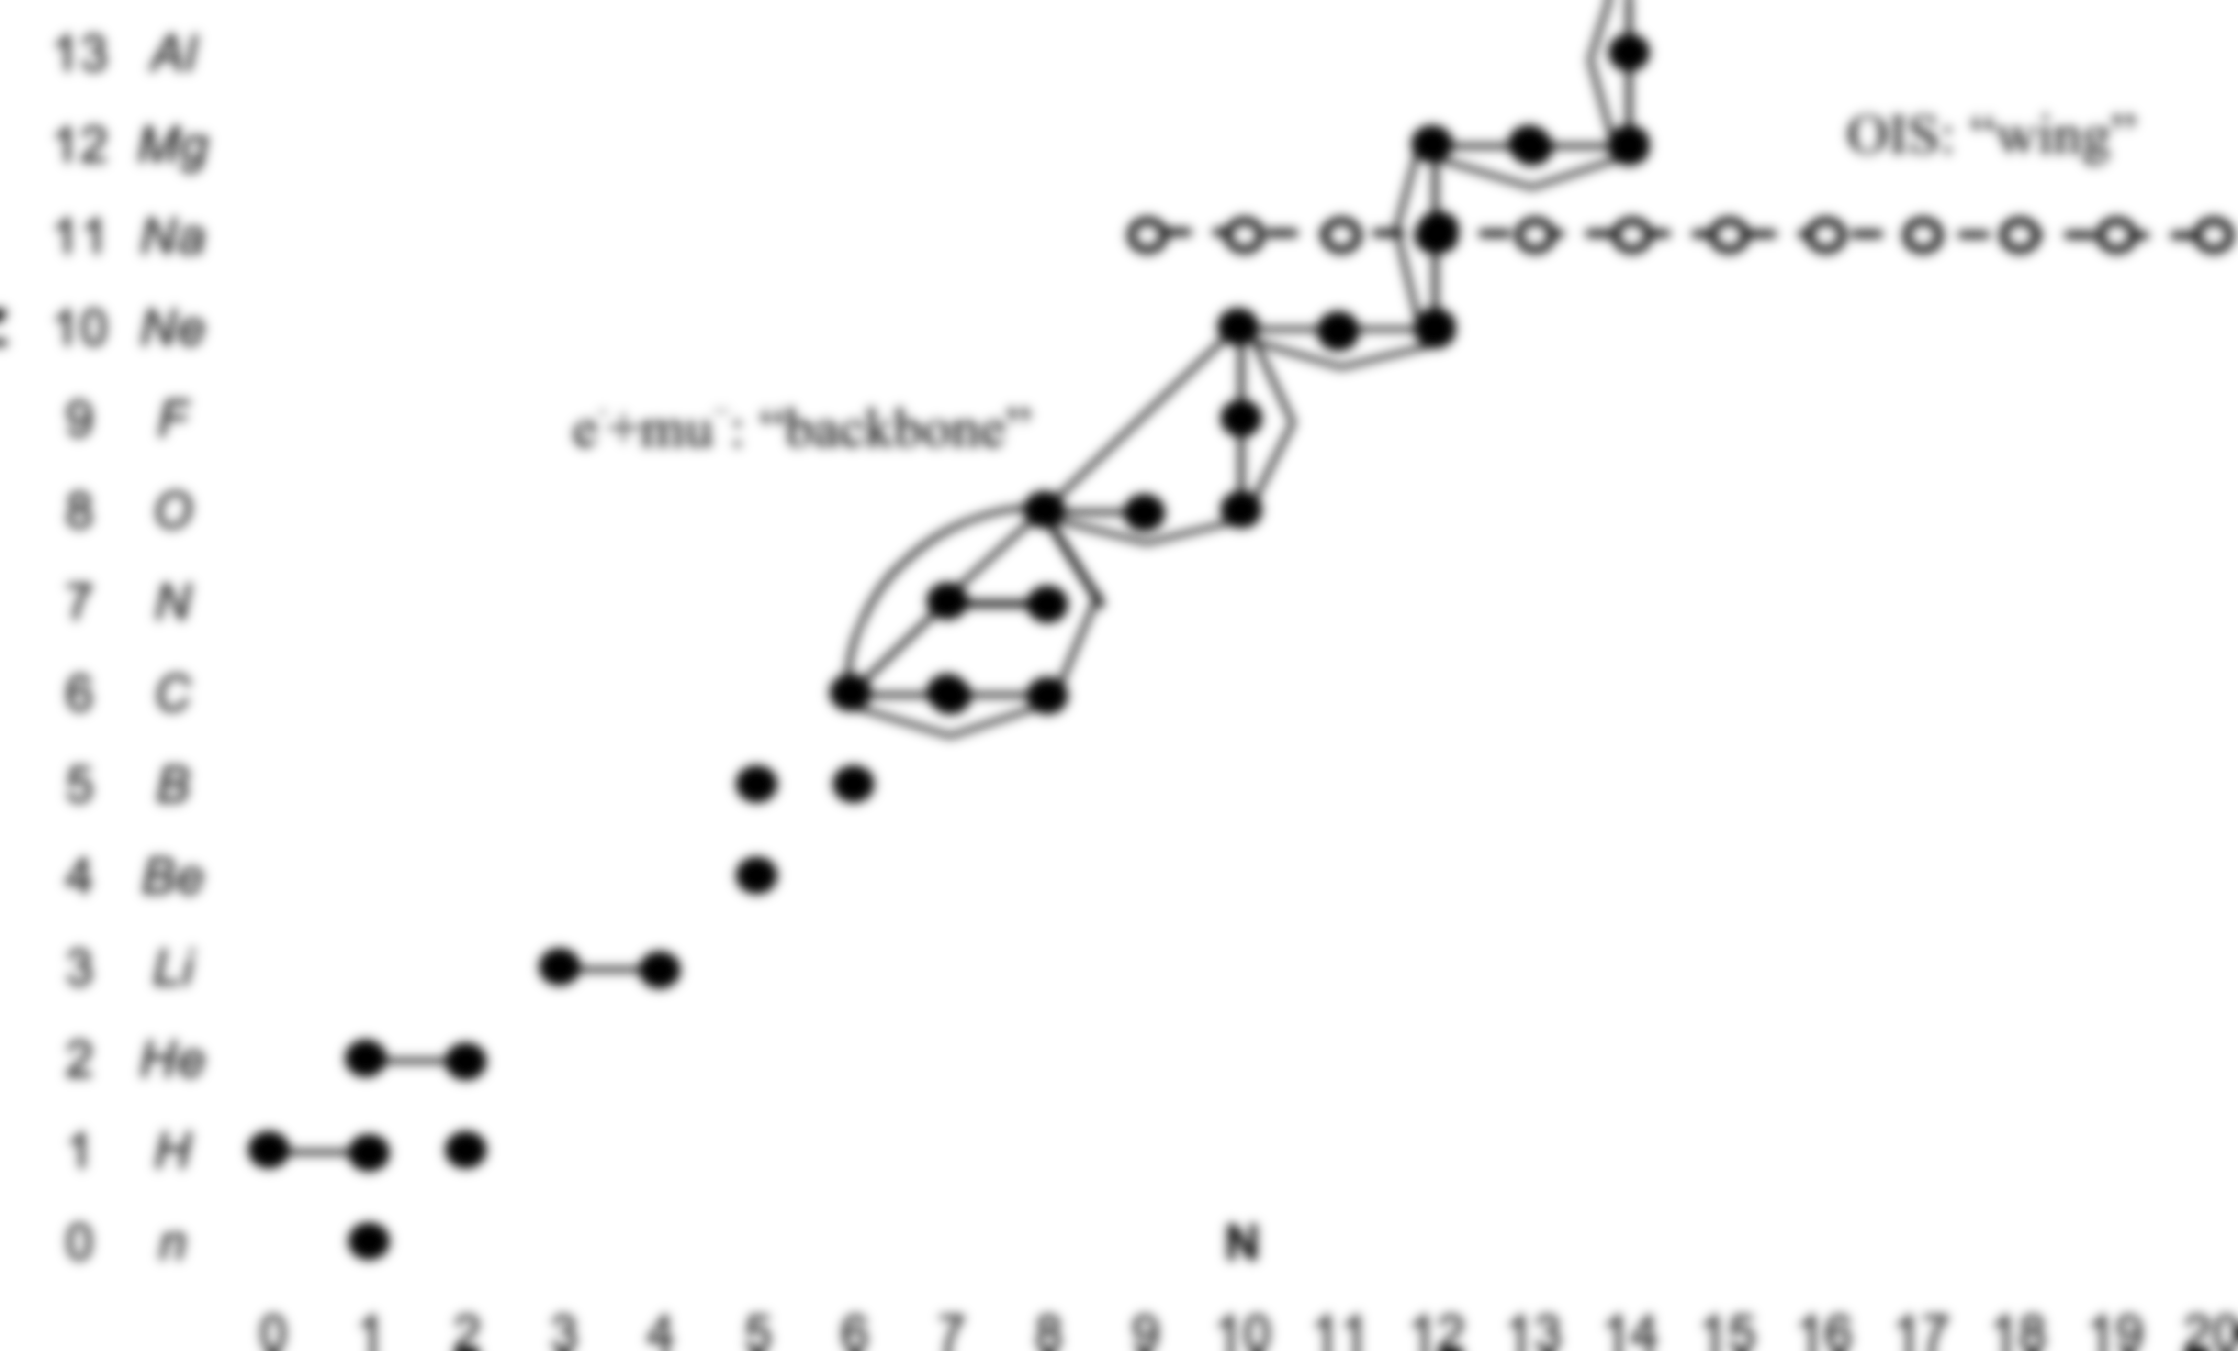
Filled circles denote experimental rms radius data, continuous lines mark radius differences measured by electron scattering or muonic atom X-rays. These links are used as constraints to improve the input data and to search for inconsistencies (see Section 2). Broken lines denote differences from optical isotope shifts

