Slide 1
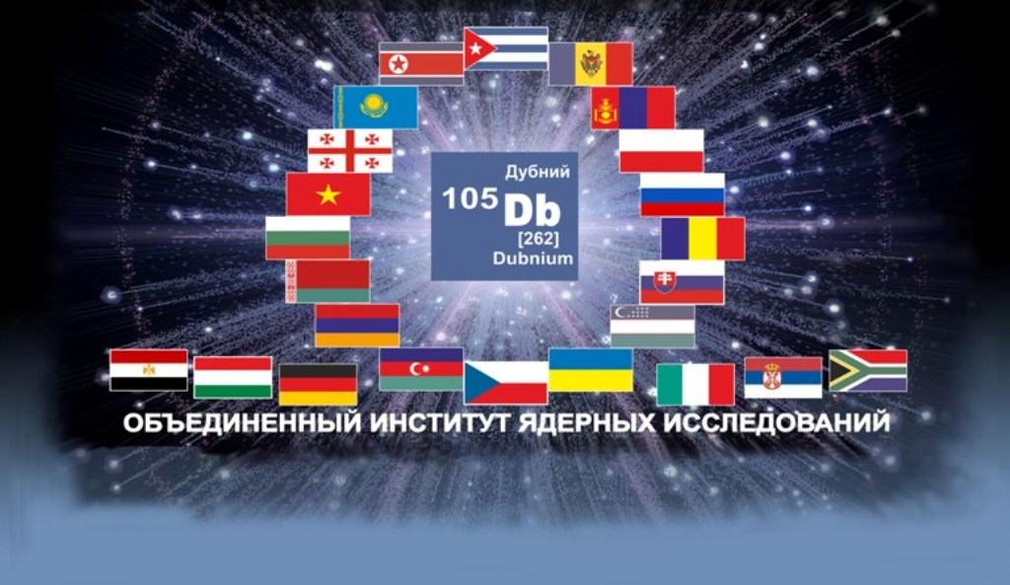
Controllable narrowing of
magnetic Feshbach resonances
in atomic traps
V.S.Melezhik
BLTP JINR, Dubna
Дубна, 3 декабря 2014

Slide 2
Results were obtained in collaboration with
Peter Schmelcher (ZOQ,Hamburg)
Panagiotis Giannakeas (ZOQ,Hamburg)
Shahpoor Saeidian (IASBS,Zanjan,Iran)
Innsbruck experiment:
Elmar Haller
Hans-Chrisroph Nagerl
..

Slide 3
Outline
Ultracold atoms and molecules in confined geometry of optical traps
Why it is interesting, peculiarities
Magnetic Feshbach resonances (MFR)
Shifts of MFR in confining traps (simple model)
Shifts and widths of MFR in atomic waveguides (quantitative analysis)
Outlook

Slide 6


Slide 7
motivation in brief
Shifts and widths of spectral lines in confining traps

Slide 8
motivation in brief
theoretical aspects

Slide 9
motivation in brief
theoretical aspects
3D free-space scattering theory is no longer valid
and development of low-dimensional theory
including influence of the trap is needed

Slide 10

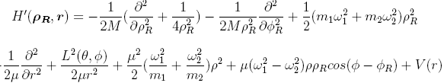

What happens if atoms scatter in confined geometry (quasi-1D) ?
E
What happens in collision of two distinguishable atoms
in harmonic trap, or identical atoms in anharmonic trap
?
non-separable two-body problem

Slide 11
motivation in brief
experimental aspects

Slide 12
motivation in brief
experimental aspects
control over: quantum states, particle number,
interaction

Slide 13
Feshbach resonances
phenomenon occurs when particles in an entrance channel resonantly couple to bound state
supported by the closed channel potential
H.Feshbach, Ann.Phys.5(1958);19(1961)
( nuclear reactions )
U.Fano, Phys.Rev.124(1961)
( atomic collisions )
the resonances occur when the scattering energy is varied

Slide 14
Magnetic Feshbach resonances
in ultracold gases scattering takes place in the zero-energy limit and
the resonances occur when an external field B tunes bound state near threshold
singlet
B
triplet

Slide 15
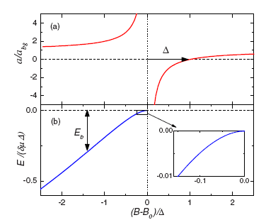
Magnetic Feshbach resonances
S.Innouye et. al. Nature 392 (1998): Observation of FR in BEC

Slide 16
Magnetic Feshbach resonances
S.Innouye et. al. Nature 392 (1998): Observation of FR in BEC
possibility to tune the interaction from
strong attraction to strong repulsion

Slide 17
Magnetic Feshbach resonances
S.Innouye et. al. Nature 392 (1998): Observation of FR in BEC
possibility to tune the interaction from
strong attraction to strong repulsion

Slide 18

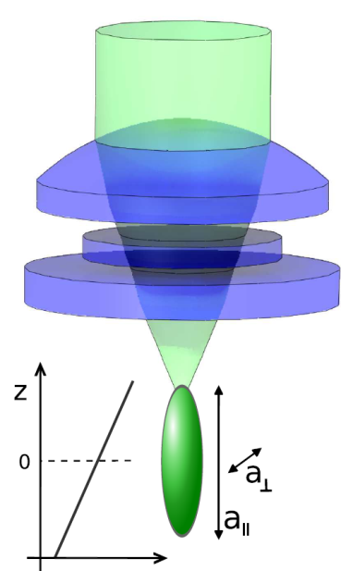


Tuning the interaction in 3D
3D
Feshbach resonance
single-channel pseudopotential
strong confinement
1D
Confinement induced resonance
single-channel pseudopotential with
renormalized interaction constant
M. Olshanii, PRL 81, 938 (1998).
Notes:
18

Slide 19
Tuning the interaction in 3D
3D
Feshbach resonance
single-channel pseudopotential
strong confinement
1D
Confinement induced resonance
single-channel pseudopotential with
renormalized interaction constant
M. Olshanii, PRL 81, 938 (1998).
Notes:
19

Slide 20
Tuning the interaction in 1D: B and ω
3D
Feshbach resonance
single-channel pseudopotential
strong confinement
1D
Confinement induced resonance
single-channel pseudopotential with
renormalized interaction constant
M. Olshanii, PRL 81, 938 (1998).
Notes:
20

Slide 21
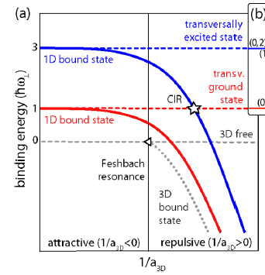
Tuning the interaction in 1D: B and ω
3D
Feshbach resonance
single-channel pseudopotential
strong confinement
1D
Confinement induced resonance
single-channel pseudopotential with
renormalized interaction constant
M. Olshanii, PRL 81, 938 (1998).
Notes:
21

Slide 22

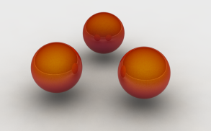
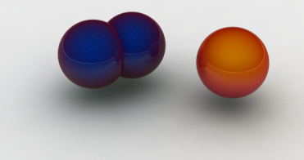
E.Haller, M.J. Mark, R. Hart, J.G. Danzl, L. Reichsoellner, V.Melezhik, P. Schmelcher and
H.-C. Naegerle, Phys.Rev.Lett. 104 (2010)153203
three atoms
molecule + atom

Slide 23
E.Haller, M.J. Mark, R. Hart, J.G. Danzl, L. Reichsoellner, V.Melezhik, P. Schmelcher and
H.-C. Naegerle, Phys.Rev.Lett. 104 (2010)153203

Slide 24

E.Haller, M.J. Mark, R. Hart, J.G. Danzl, L. Reichsoellner, V.Melezhik, P. Schmelcher and
H.-C. Naegerle, Phys.Rev.Lett. 104 (2010)153203
When s-wave atom-atom scattering length approaches the length scale of the transversal confinement, atom-atom scattering is substantially modified.
It was detected by characteristic minimum of the number of atoms ( confinement-induced resonance) in the 1D tubes

Slide 25
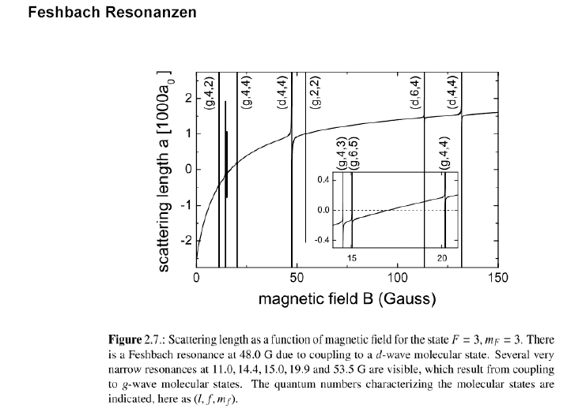
tensorial structure of the interatomic interaction V(r)

Slide 26
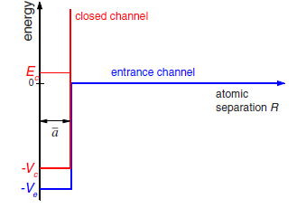
two-channel problem
II

Slide 27
two-channel problem
d
s
g
tensorial sructure of molecular state
II

Slide 28

two-channel problem
d
s
g
tensorial sructure of molecular state
II
Innsbruck experiment with Cs atoms:

Slide 29
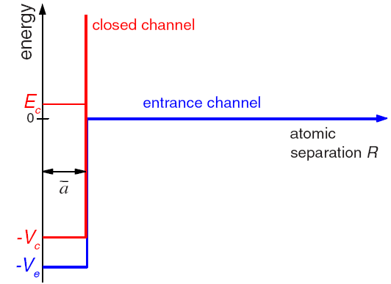




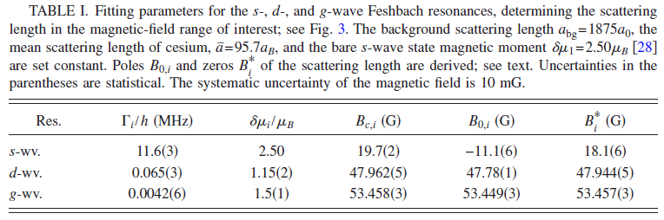
two-channel model of Lange et. al. Phys.Rev.79,013622(2009)
3 fitting parameters:

Slide 30
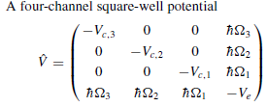



extension of
two-channel model of Lange et. al. to 1D geometry
Sh.Saeidian, V.S. Melezhik ,and P.Schmelcher, Phys.Rev. A86, 062713 (2012)
4-coupled radial equations
4-coupled 2D equations in the plane

Slide 31
extension of
two-channel model of Lange et. al. to 1D geometry
Sh.Saeidian, V.S. Melezhik ,and P.Schmelcher, Phys.Rev. A86, 062713 (2012)
4-coupled radial equations
4-coupled 2D equations in the plane

Slide 32
extension of
two-channel model of Lange et. al. to 1D geometry
Sh.Saeidian, V.S. Melezhik ,and P.Schmelcher, Phys.Rev. A86, 062713 (2012)
4-coupled radial equations
4-coupled 2D equations in the plane
scattering problem → boundary-value problem
V.Melezhik,C.Y.Hu,Phys.Rev.Lett.90(2003)083202
S.Saeidian,V.Melezhik,P.Schmelcher,Phys.Rev.A77(2008)042701

Slide 33
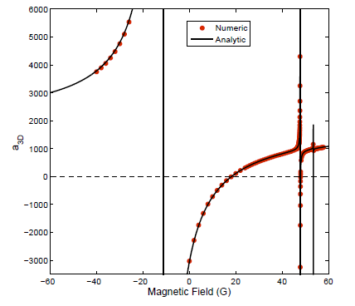

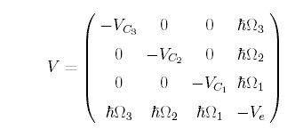
tensorial structure of the interatomic interaction V(r)
Shifts and widths of Feshbach resonances in atomic waveguides
Sh.Saeidian, V.S. Melezhik ,and P.Schmelcher, Phys.Rev. A86, 062713 (2012)
s
d
g
region of Innsbruck experiment
(d-wave Feshbach resonance)

Slide 34
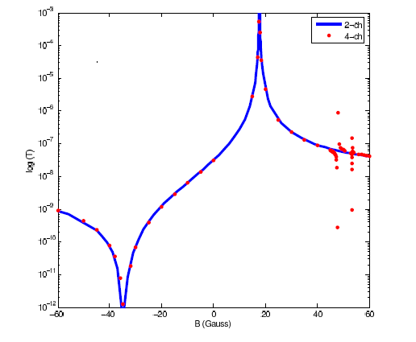


tensorial structure of the interatomic interaction V(r)
Shifts and widths of Feshbach resonances in atomic waveguides
Sh.Saeidian, V.S. Melezhik ,and P.Schmelcher, Phys.Rev. A86, 062713 (2012)
s
d
g
region of Innsbruck experiment
(d-wave Feshbach resonance)

Slide 35
tensorial structure of the interatomic interaction V(r)
Shifts and widths of Feshbach resonances in atomic waveguides
Sh.Saeidian, V.S. Melezhik ,and P.Schmelcher, Phys.Rev. A86, 062713 (2012)
region of Innsbruck experiment
(d-wave Feshbach resonance)

Slide 36
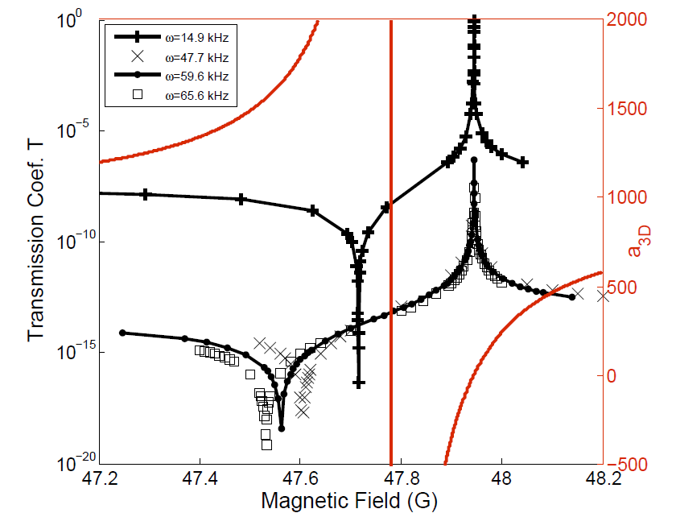
tensorial structure of the interatomic interaction V(r)
Shifts and widths of Feshbach resonances in atomic waveguides
Sh.Saeidian, V.S. Melezhik ,and P.Schmelcher, Phys.Rev. A86, 062713 (2012)
region of Innsbruck experiment
(d-wave Feshbach resonance)

Slide 37
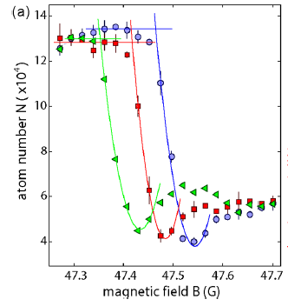
tensorial structure of the interatomic interaction V(r)
Shifts and widths of Feshbach resonances in atomic waveguides
Sh.Saeidian, V.S. Melezhik ,and P.Schmelcher, Phys.Rev. A86, 062713 (2012)
region of Innsbruck experiment
(d-wave Feshbach resonance)
experiment:
E.Haller et.al. Phys.Rev.Lett.104,
153203 (2010)

Slide 38
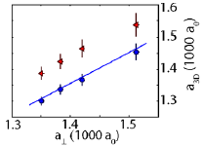

tensorial structure of the interatomic interaction V(r)
Shifts and widths of Feshbach resonances in atomic waveguides
Sh.Saeidian, V.S. Melezhik ,and P.Schmelcher, Phys.Rev. A86, 062713 (2012)
region of Innsbruck experiment
(d-wave Feshbach resonance)
our multi-channel theory coincides with single-channel theory of
experiment:
E.Haller et.al. Phys.Rev.Lett.104,
153203 (2010)
M.Olshanii, Phys.Rev.Lett.81,938 (1998) :

Slide 39
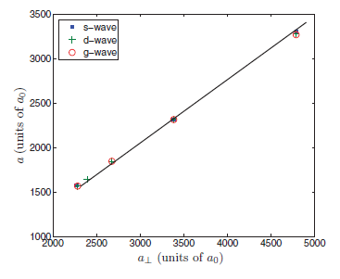
tensorial structure of the interatomic interaction V(r)
Shifts and widths of Feshbach resonances in atomic waveguides
Sh.Saeidian, V.S. Melezhik ,and P.Schmelcher, Phys.Rev. A86, 062713 (2012)
region of Innsbruck experiment
(d-wave Feshbach resonance)
our multi-channel theory coincides with single-channel theory of
experiment:
E.Haller et.al. Phys.Rev.Lett.104,
153203 (2010)
M.Olshanii, Phys.Rev.Lett.81,938 (1998) :

Slide 40
tensorial structure of the interatomic interaction V(r)
Shifts and widths of Feshbach resonances in atomic waveguides
Sh.Saeidian, V.S. Melezhik ,and P.Schmelcher, Phys.Rev. A86, 062713 (2012)
region of Innsbruck experiment
(d-wave Feshbach resonance)
position of T_{max} is stable with respect to
variation of and coincides with

Slide 41
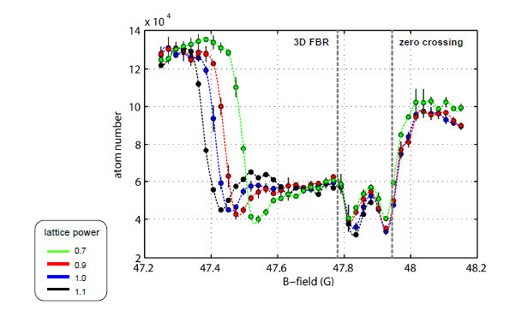
tensorial structure of the interatomic interaction V(r)
Shifts and widths of Feshbach resonances in atomic waveguides
Sh.Saeidian, V.S. Melezhik ,and P.Schmelcher, Phys.Rev. A86, 062713 (2012)
region of Innsbruck experiment
(d-wave Feshbach resonance)
Innsbruck data, E.Haller (unpublished)
?

Slide 42
tensorial structure of the interatomic interaction V(r)
Shifts and widths of Feshbach resonances in atomic waveguides
Sh.Saeidian, V.S. Melezhik ,and P.Schmelcher, Phys.Rev. A86, 062713 (2012)
region of Innsbruck experiment
(d-wave Feshbach resonance)
d-wave shape resonance
2) Efimov like resonance (3 body) :
?
?

Slide 43
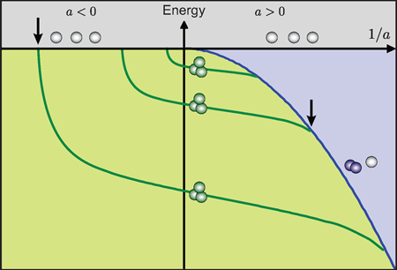
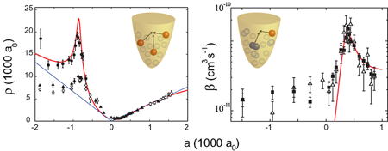
tensorial structure of the interatomic interaction V(r)
Shifts and widths of Feshbach resonances in atomic waveguides
Sh.Saeidian, V.S. Melezhik ,and P.Schmelcher, Phys.Rev. A86, 062713 (2012)
region of Innsbruck experiment
(d-wave Feshbach resonance)
d-wave shape resonance
2) Efimov like resonance (3 body) :
?
?

Slide 44
tensorial structure of the interatomic interaction V(r)
Shifts and widths of Feshbach resonances in atomic waveguides
Sh.Saeidian, V.S. Melezhik ,and P.Schmelcher, Phys.Rev. A86, 062713 (2012)
region of Innsbruck experiment
(d-wave Feshbach resonance)

Slide 45
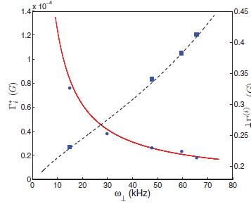
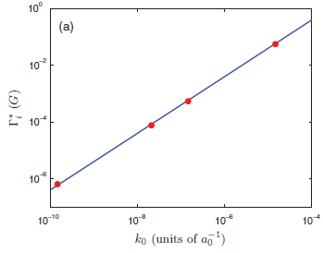

tensorial structure of the interatomic interaction V(r)
Shifts and widths of Feshbach resonances in atomic waveguides
Sh.Saeidian, V.S. Melezhik ,and P.Schmelcher, Phys.Rev. A86, 062713 (2012)
region of Innsbruck experiment
(d-wave Feshbach resonance)

Slide 46
tensorial structure of the interatomic interaction V(r)
Shifts and widths of Feshbach resonances in atomic waveguides
Sh.Saeidian, V.S. Melezhik ,and P.Schmelcher, Phys.Rev. A86, 062713 (2012)
region of Innsbruck experiment
(d-wave Feshbach resonance)

Slide 47
Shifts and widths of Feshbach resonances in atomic waveguides
S.Saeidian(IASBS,Iran) V.S.Melezhik(BLTP, JINR) P.Schmelcher(Hamburg,Germany): Phys.Rev. A86(2012)62713
shifts and widths of s-,d- and g-wave magnetic FRs of Sc atoms
in optical waveguides
with
were calculated
d-wave FR at 47.8G develops in waveguide as
depending on minimums and stable maximum
of transmission coefficient T
experiment
theory
narrowing width
with increasing of waveguide
can potentially be used experimentally

Slide 48





Shifts and widths of Feshbach resonances in atomic waveguides
S.Saeidian(IASBS,Iran) V.S.Melezhik(BLTP, JINR) P.Schmelcher(Hamburg,Germany): Phys.Rev. A86(2012)62713

Slide 49
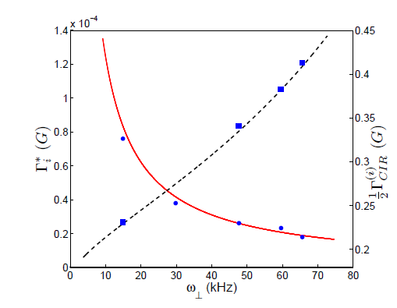
Shifts and widths of Feshbach resonances in atomic waveguides
S.Saeidian(IASBS,Iran) V.S.Melezhik(BLTP, JINR) P.Schmelcher(Hamburg,Germany): Phys.Rev. A86(2012)62713

Slide 50

?

Slide 51

?
!

Slide 52
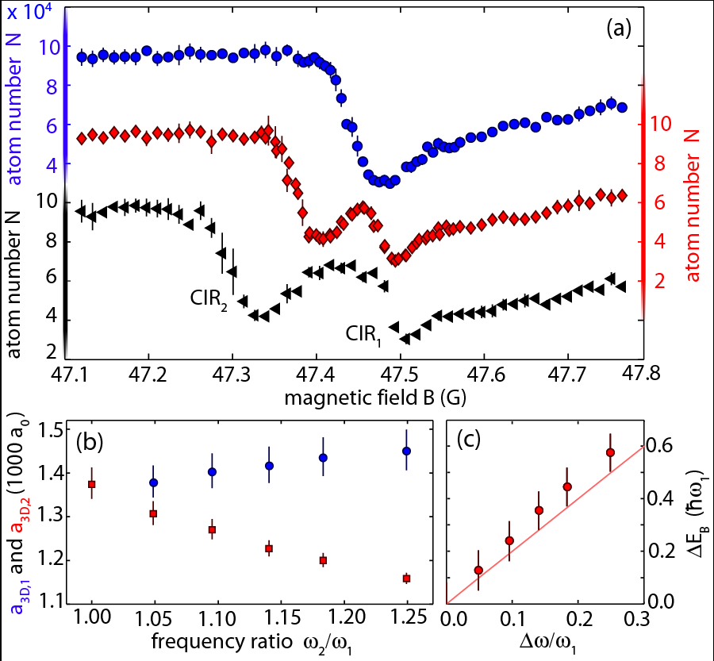

Slide 54
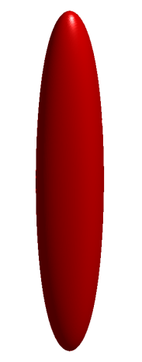

anisotropic
transversal
confinement
a splitting of the confinement-induced resonance
was found upon introducing an anisotropy
for the transversal confinement
ω₁
ω₂

Slide 57
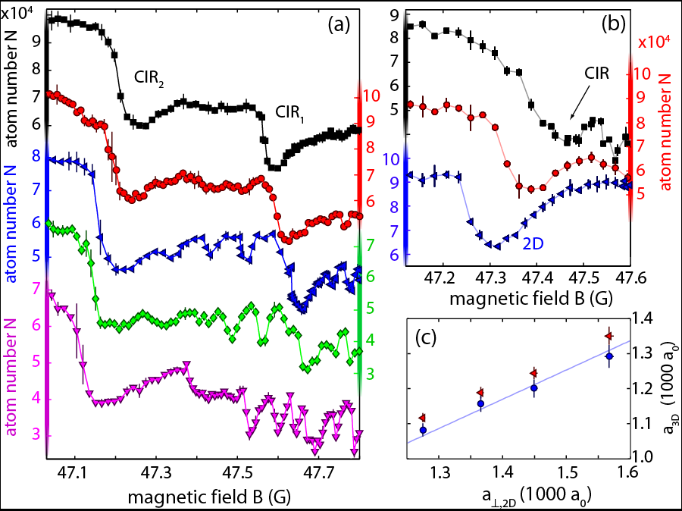
?
?
!

Slide 58
Experimental setups in:
MIT (Boston), Boulder, NIST (Washington), Munich, Heidelberg,
Shtutgart, Hamburg, Innsbruck, Vienna, Paris, Firenze, Barselona,
FIAN, N.Novgorod, Troitsk …
Rb,Cs,K,Sr,Li …
Rb₂ , Cs₂ , RbK … 1D, 2D, 3D
~ 80 experimental groups worldwide
theory including confined geometry of traps

Slide 59


Outlook
model → widths and shifts of FRs in atomic waveguides
confirmed for s-,d- and g-wave resonances
molecule formation rates in waveguides show enhancement in point

Slide 60
Outlook
model → widths and shifts of FRs in atomic waveguides
confirmed for s-,d- and g-wave resonances
molecule formation rates in waveguides show enhancement in point

Slide 61
Outlook
model → widths and shifts of FRs in atomic waveguides
confirmed for s-,d- and g-wave resonances
molecule formation rates in waveguides show enhancement in point

Slide 62
Outlook
model → widths and shifts of FRs in atomic waveguides
confirmed for s-,d- and g-wave resonances
Feshbach resonances in fermionic systems, including anharmonicity of traps, …

Slide 63
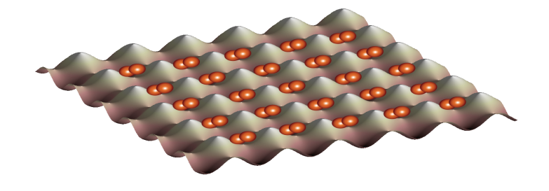
Quantum simulation with fully controlled few-body systems
control over: quantum states, particle number, interaction
attractive interactions BCS-like pairing in finite systems
repulsive int.+splitting of trap entangled pairs of atoms
(quantum information processing)
+ periodic potential quantum many-body physics
(systems with low entropy to explore
such as quantum magnetism)
...
Bose-Hubbard Physics

Slide 64
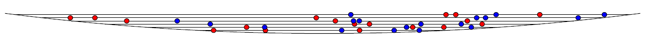
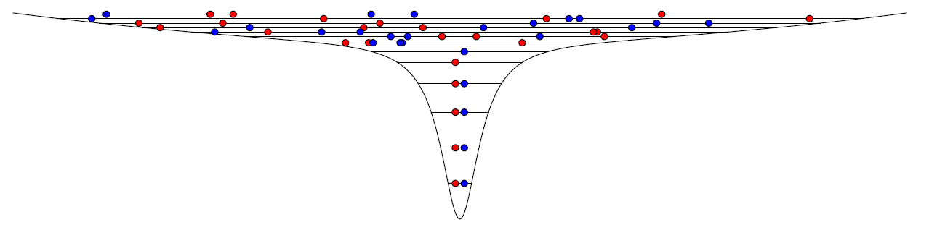
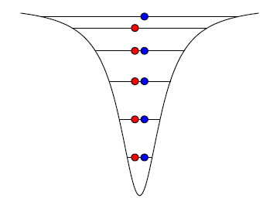
Preparation
2-component mixture in reservoir T=250nK
superimpose microtrap
scattering → thermalisation
expected degeneracy: T/T_{F}= 0.1
switch off reservoir
p₀= 0.9999
count the atoms
+ magnetic field gradient in axial direction
S.Serwane et.al. Science 332 (2011)

Slide 65
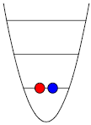
High fidelity preparation
2 fermions
fluorescence normalized to atom number
F. Serwane et al., Science 332, 336-338 (2011)
Notes:
65

Slide 66
Detection:
Modern CCD Cameras allow detection of single photons:
Capture ~10%
of all scattered photons
Scatter ~100 photons
fluorescence
imaging beam
CCD Camera
S.Serwane et.al. Science 332 (2011)
Notes:
66

