Slide 1
On manifestation of in-medium effects in HIC
D.N. Voskresensky NRNU MEPhI, Moscow
Key message -- simultaneous analysis of the relevant phenomena in different domains of nuclear physics -- hadron scattering, atomic nuclei, neutron stars, supernovas, heavy-ion collisions

Slide 2
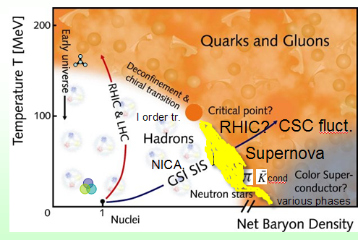
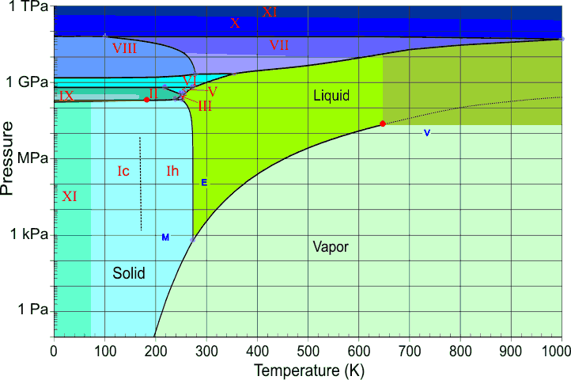
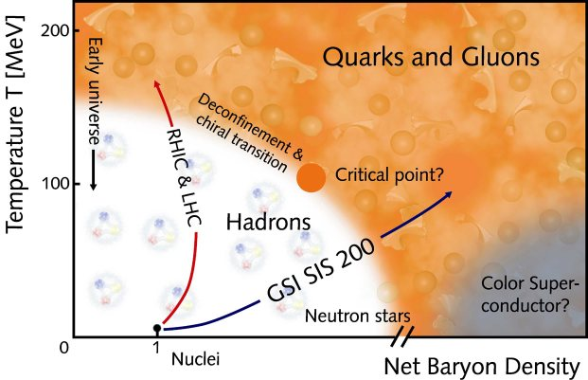
Phase Diagrams
Water and Nuclear Matter
Variety of phases: 12 crystalline,
3 glass, liquid, vapor, CEP
Crossover;
-CEP
NICA,
FAIR
I order tr.
Mixed
phase
CSC fluct.
RHIC?
Quarkyonic?
Supernova
NICA,
cond
Chapline et al. (2007)
various phases
Low density,low T: HIC (liquid-gas);
excited nuclei (high spin, pairing); high density, low T: SN,NS: (NN-pairing, π,K,ρ- condensates; CSC, quarkyonic); high T HIC: (chiral restoration, deconfinement)

Slide 3
Plan/conclusion
Hadron description
EoS of baryon-reach hadron matter (dense, not too hot)
quasiparticle description, a cut-mechanism for EoS
CEP and effects of first-order quark-hadron phase transition
viscosity and thermal conductivity are necessary to describe
dynamics of first order phase transition
Pions and kaons in baryon-reach hadron matter
p-wave polarization effects
EoS of baryon-poor hadron matter (hot, not too dense)
baryon blurs (unparticles)
Possible pion and zero-sound condensation in peripheral HIC
instabilities in interpenetrating beams

Slide 4
Existing constraints on EoS
EoS of the cold hadronic matter should:
satisfy experimental information on properties of dilute nuclear matter
empirical constraints on global characteristics of atomic nuclei
constraints on the pressure of the nuclear mater from the description of particle transverse and elliptic flows and the K⁺ production in HIC;
allow for the heaviest known compact stars with the mass
allow for an adequate description of the compact star cooling, most probably without DU neutrino processes in the majority of the known pulsars
explain the gravitational mass and total baryon number of pulsar PSR J0737-3039(B)
yield a mass-radius relation comparable with the empirical constraints
being extended to T≠0, appropriately describe supernova explosions and proto-neutron stars, and heavy-ion collision data till T~T _{CEP}.

Slide 5
EoS of baryon-reach hadron matter (dense, not too hot)
baryons are good quasiparticles

Slide 6
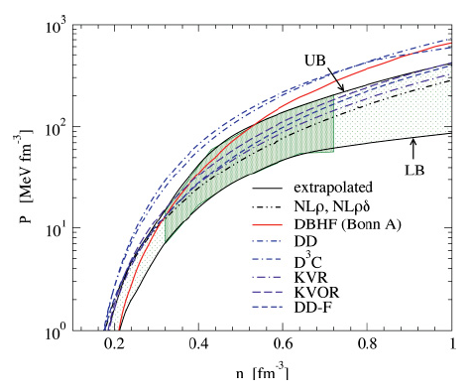
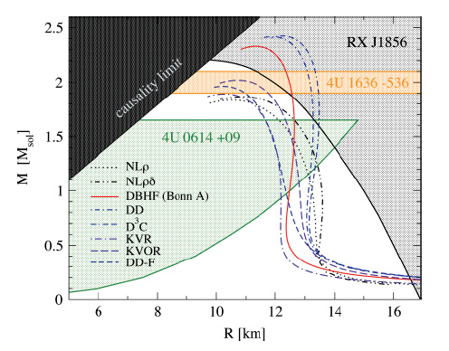
EoSs without inclusion of hyperons and Deltas
Most difficult is to satisfy simultaneously the flow and the maximum NS mass constraints constraints
Ordinary non-linear Walecka RMF models can only marginally satisfy simultaneously both constraints
idea of a “cut”-mechanism (excluded volume-like effect)

Slide 7
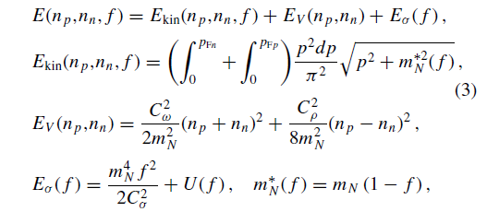

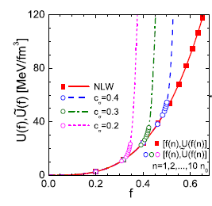
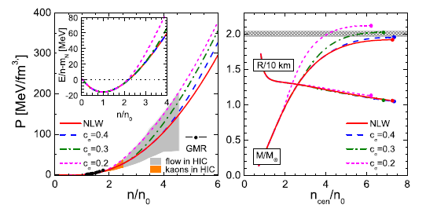
Cut in scalar sector of RMF model
chiral symmetry is only partially restored

Slide 8
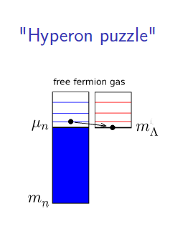
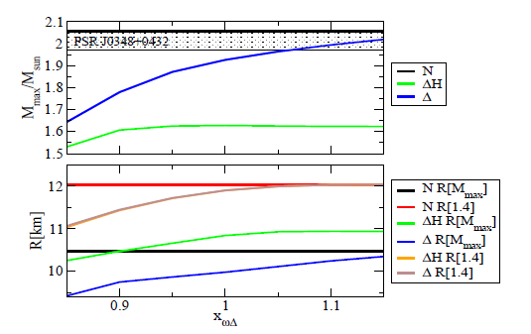
Hyperon and Delta puzzles
a non-linear Walecka RMF model

Slide 9
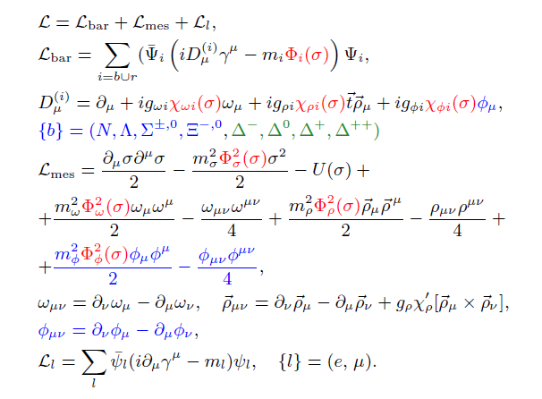


RMF model with Ϭ-field-scaled hadron masses and couplings
E. Kolomeitsev, D.V. NPA 2005, T. Klahn et al. PRC 2007 (N ≠ Z, T=0),
Khvorostukhin, V. Toneev, D.V. NPA 2007,2008 (N=Z, T≠0, include hyperons, Delta’s)
Now A. Maslov, E. Kolomeitsev, D.V. NPA 2016 (N ≠ Z, T=0, include hyperons, Delta’s)

Slide 10
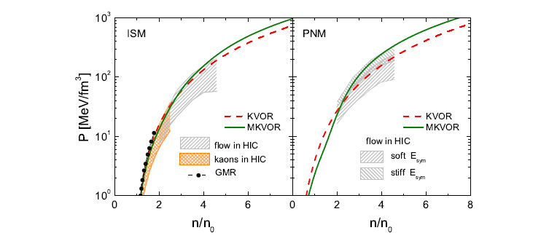
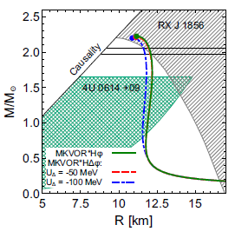
with scaling functions with the cut-mechansm in ω and/or ρ sectors

Slide 11
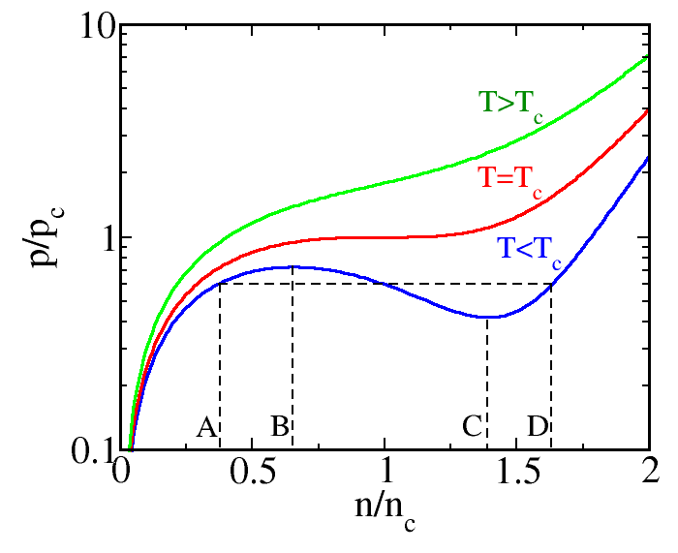

CEP and effects of I-order phase transition
Pressure isotherms
OA – gas phase, dP/dn >0;
>D – liquid phase, dP/dn >0;
BC – mechanically unstable,
dP/dn <0;
AB (supercooled wapor),
CD (overheated liquid) –
mechanically stable dP/dn >0,
metastable, finite lifetime
Maxwell construction

Slide 12
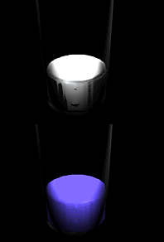
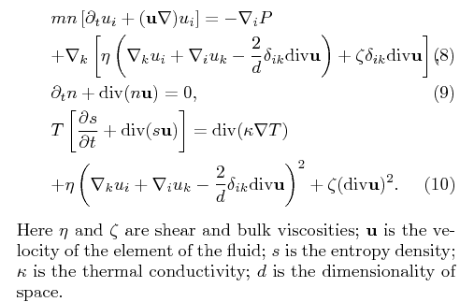
Non-ideal non-relativistic hydrodynamics
the less viscous the fluid is, the
greater its ease of movement
The reciprocal of thermal
conductivity is thermal resistivity
in collective processes u is usually small

Slide 13

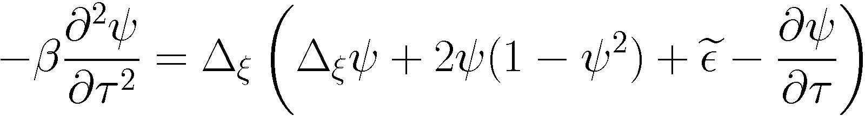
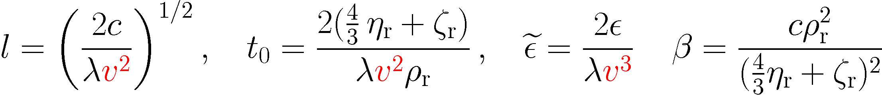
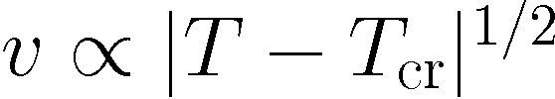
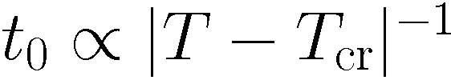
V.Skokov, D.V. JETP Lett. 90 (2009); Nucl. Phys. A828 (2009) 401; A846 (2010);
neglecting u² terms:
: T ∂s/ ∂ t = κ Δ T,
Lett R (t) is the size of evolving seed
viscosities
heat transport time
t _{T} ~ R² c_{v} / κ , c_{v} is specific heat density
typical time for density fluctuation: t _{ρ} ~ R (constant velocity ~1/(η+ζ))
In dimensionless variables
processes in the vicinity of the critical point prove to be very slow
Viscosity and thermal cond. are driving forces of first-order phase transition

Slide 14

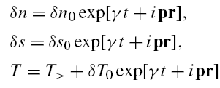


Instabilities in spinodal region
aerosol-like mixture of bubbles and droplets (mixed phase)
From equations of non-ideal hydro:
are speeds of sound
Skokov, D.V. JETP Lett. 90 (2009); Nucl. Phys. A828 (2009); A846 (2010); Randrup, PRC79 (2009)

Slide 15
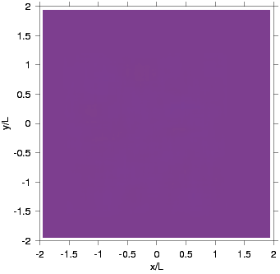
Spinodal instability
Dynamics in spinodal region.
Blue – hadrons,
Red – quarks.

Slide 16
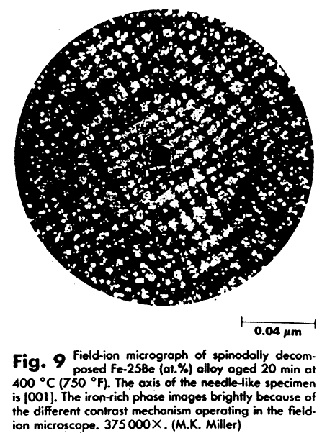
What one may observe if system is in spinodal region
is a structured phase !
a spine

Slide 17
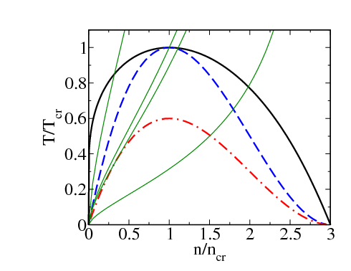
Pressure isotherms and constant entropy trajectories
CEP and effects of first-order phase transition
Gi~1
ITS
SV
AS,
region of instability
in ideal hydro
OL
- - - isothermal spinodal (ITS), - . - . - adiabatic spinodal (AS),
Maxwell construction

Slide 18
Pions and kaons in dense baryon matter
Their description is beyond RMF approximation
p-wave polarization

Slide 19
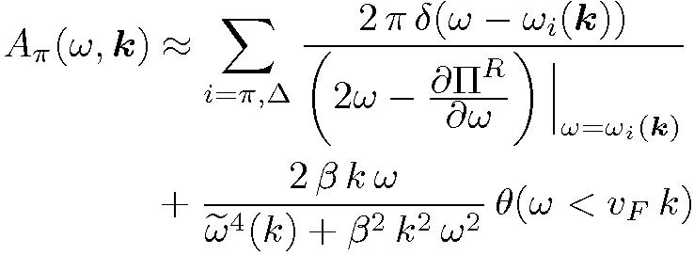
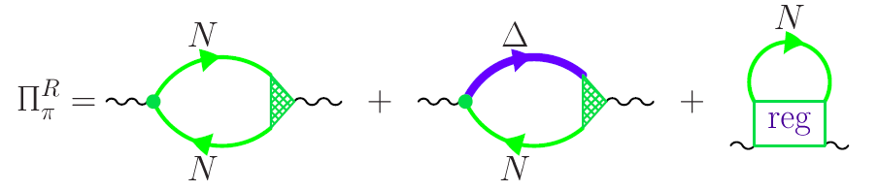
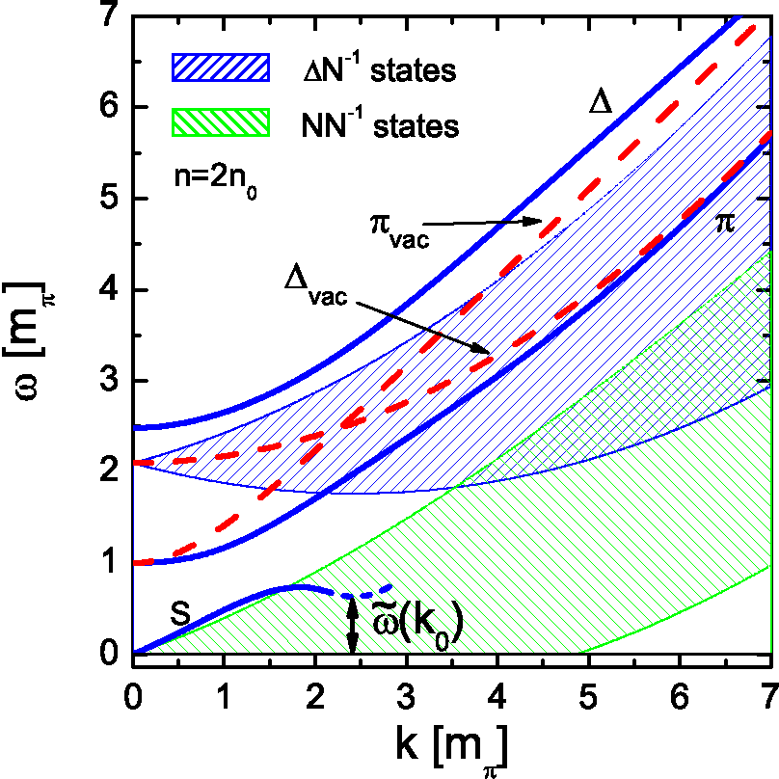

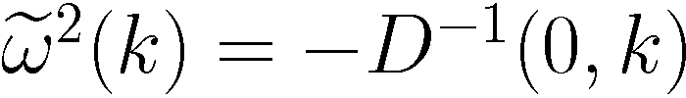

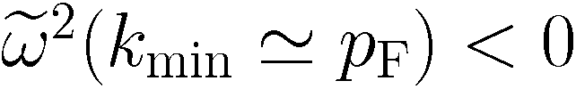
Pion softening in dense baryonic matter
Migdal,Saperstein,Troitsky,D.V., , Phys. Rept. 192 (1990)
ISM
pion propagator has a complex pole
when
for n>n _{c}~1.5-3 n₀
“pion gap”
instability
pion condensation

Slide 20
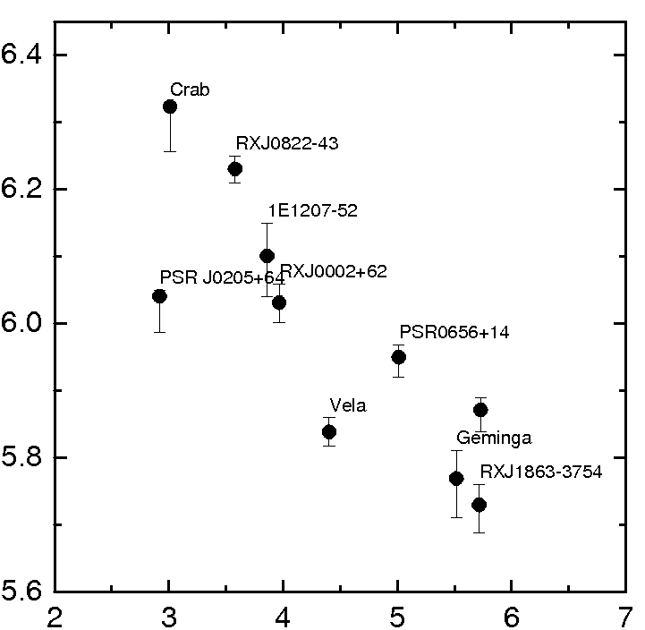



Neutron star cooling
3 groups+Cas A:
∞
>10³ in emissivity
slow cooling
XMMU-J17328
CaS A
intermediate cooling
rapid cooling
With pion softening effect included data are described within one cooling scenario.

Slide 21
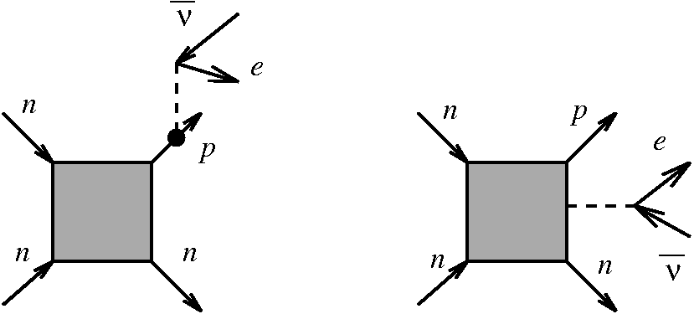

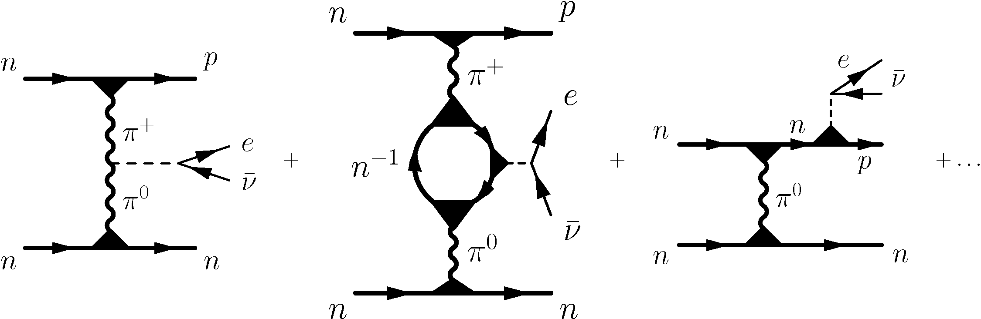
Straight generalization of MU
emissivity:
larger
smaller
Very important !
Very strong density
dependence
included in series of works by Blaschke, Grigorian, D.V.; last work EPJ A52 (2016)

Slide 22
Pulsar period-age diagram

Slide 23
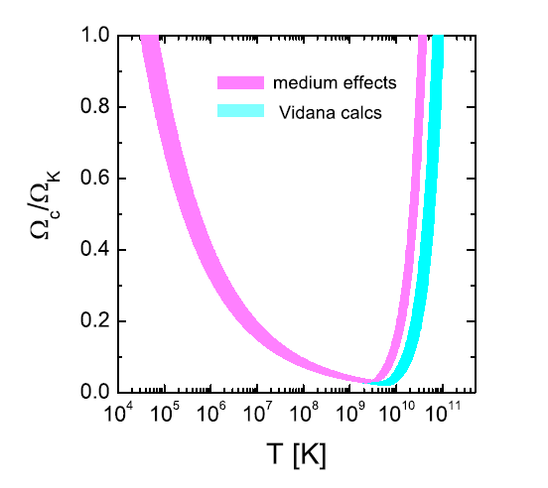
Region of r-mode instability
Coriolis driving force, Rossby waves
in Earth’s atmosphere and oceans
Kolomeitsev,D.V. PRC91(2015)
Stable owing to
shear viscosity
Unstable region
bulk visc.
Max.
rotating
young
pulsar
Within nucl.medium cooling we are able to
explain low frequencies of young pulsars

Slide 24
Cooling of NS and absence of too rapidly rotating young pulsars can be explained taking into account pion softening effect on neutrino emissivity and bulk viscosity.

Slide 25
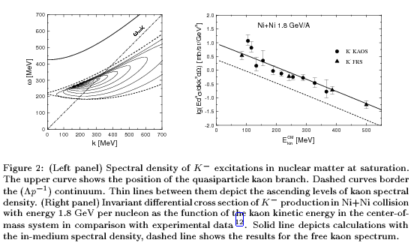
Antikaon spectra in nuclear matter
K- have short mean free path and radiate from freeze out
Possibility of S and/or P wave antikaon condensation in dense NS interiors
Kolomeitsev, Kampfer, D.V., Int.J.Mod.Phys. E5 (1996), Kolomeitsev, D.V. PRC68 (2003)

Slide 26
Hadron unparticle description

Slide 27
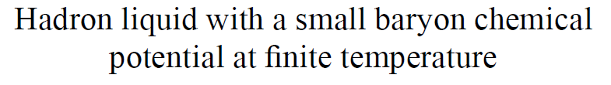
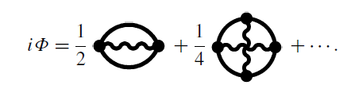





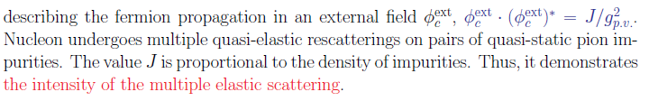
retain

Slide 28
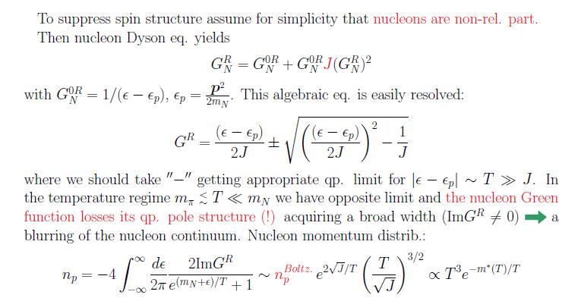

Full blurring of baryon vacuum (baryon blurs-unparticles)

Slide 29
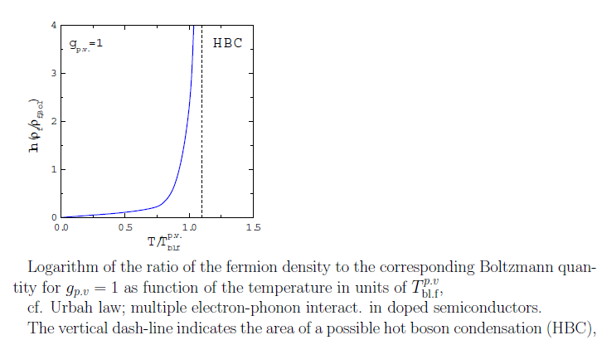


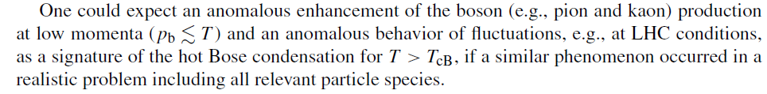

Slide 30
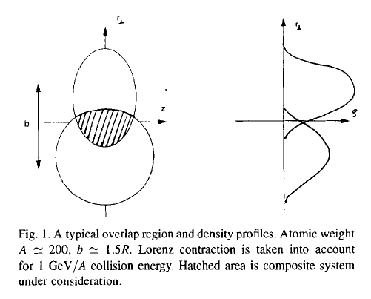


Peripheral collisions
condition
is safely satisfied
Pion self-energy
~ - 2p _{F} (n)
2p _{F} ~ (8n) ^{1/3}
effective attraction as at 8 n
n (A₁+A₂) =2n (A₁)
pion condensation might be

Slide 31
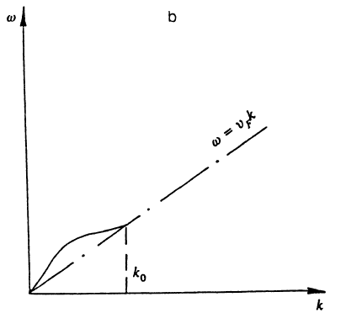
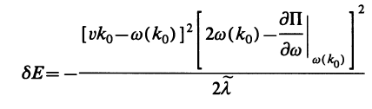
Peripheral collisions
of zero sound modes with subsequent condensation
provided
v>

Slide 32
Conclusion/Plan
Hadron description
EoS of baryon-reach hadron matter (dense, not too hot)
quasiparticle description, a cut-mechanism for EoS
CEP and effects of first-order quark-hadron phase transition
viscosity and thermal conductivity are necessary to describe
dynamics of first order phase transition
Pions and kaons in baryon-reach hadron matter
p-wave polarization effects
EoS of baryon-poor hadron matter (hot, not too dense)
baryon blurs (unparticles)
Possible pion and zero-sound condensation in peripheral HIC
instabilities in interpenetrating beams

