Slide 1

A novel probe of Chiral restoration in nuclear medium
Su Houng Lee
Order Parameters of chiral symmetry breaking
- Correlation function of chiral partners
f₁(1285) and ω meson
Measuring the mass shift of f₁(1285)
Conclusion
Ref: SHL, T. Hatsuda, PRD 54, R1871 (1996)
Y. Kwon, SHL, K. Morita, G. Wolf, PRD86,034014 (2012)
SHL, S. Cho, IJMP E 22 (2013) 1330008
P. Gubler, T. Kunihiro, SHL, arXiv:1608.05141

Slide 2

UA(1) breaking and Chiral symmetry breaking in QCD
QCD Lagrangian
- Understanding the generation of hadron masses -
mass
a₁
?
η‘
ρ
?
?
π

Slide 3
UA(1) breaking and Chiral symmetry breaking in QCD
QCD Lagrangian
U_{A}(1) breaking
Chiral sym breaking
- Understanding the generation of hadron masses -
mass
a₁
?
η‘
ρ
?
?
π
Confinement

Slide 4
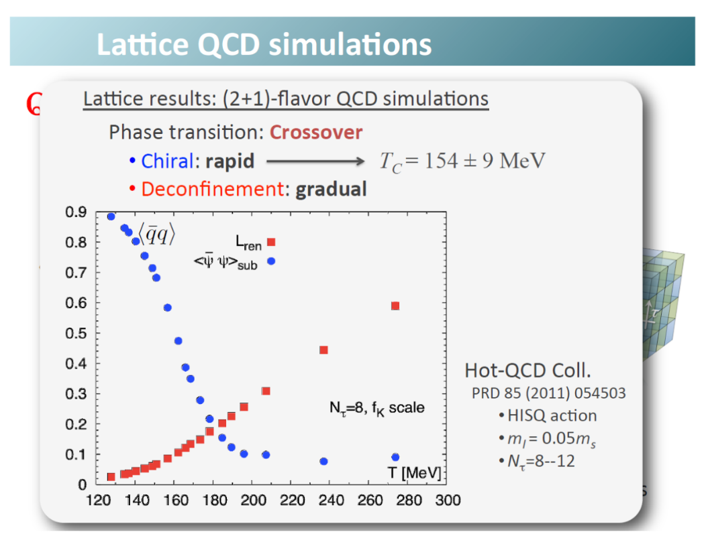
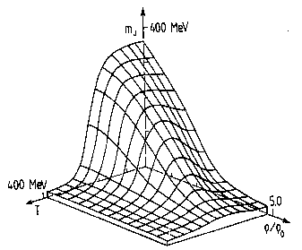
Chiral symmetry restoration at finite T and ρ
W. Weise
30% reduction at nuclear matter
→ What will happen to hadron masses : A bridge between QCD and experiment ?
Soft modes, scalar meson: Hatsuda, Kunihiro (85,87)
Pseudoscalar mesons: Bernard, Jaffe, Meissner (88), Klimt, Lutz, Vogel, Weise (90)
Brown-Rho: 91
4. Vector mesons: Hatsuda, Lee (92)
+ many more

Slide 5
Chiral order parameter
Correlation function of chiral partners
U_{A}(1) breaking effects in Correlators
Cohen 96
Hatsuda, Lee 96

Slide 6
Chiral symmetry breaking (m→0) : order parameter
Quark condensate
ν=0
→ Chiral symmetry breaking order parameter : any operator that checks the existence of this link
ν=0
→ Casher Banks formula: nontrivial zero mode ( λ =0) contribution

Slide 7
Other order parameters: σ − π correlator
ν=0
ν=0
Meson with one heavy quark : S-P
ν=0

Slide 8
Other order parameters: ρ– a₁ correlator (mass difference)
ν=0
Singlet channel: ω − f₁(ideally mixed) correlator
ν=0
ν=0

Slide 9
U_{A}(1) effect
Correlation function of Chiral partners
U_{A}(1) breaking effects in Correlators
Cohen 96
Hatsuda, Lee 96

Slide 10
U_{A}(1) effect : effective order parameter (Lee, Hatsuda 96)
Topologically nontrivial contributions
→ Chiral symmetry breaking effect
ν=0
→ UA(1) breaking effects
ν=1

Slide 11
η ‘− π correlator : ν nonzero part
Lee, Hatsuda (96)
For SU(3) :
ν=1
For SU(2) : Always non zero
ν=1
For 2-point function: U(1)_{A} will be restored when Chiral symmetry is restored for N_{F} =3
but always broken for N_{F} =2
But Non trivial to check because
Also is not good to check UA(1) effect when flavor is larger than 2 that is why it is called the Chiral order parameter in SU(N)xSU(N) case.

Slide 12
How can we observe restoration of Chiral symmetry
can not be directly related to physical observable in a model independent way
could be considered
Whole spectrum not necessary
(Glozeman: Chiral symmetry is restored for excited states+ QCD duality)
Ground states that couple to each current can be compared
Unfortunately, both states have large intrinsic width that becomes very large in medium and hence experimentally difficult to observe any changes
But

Slide 13
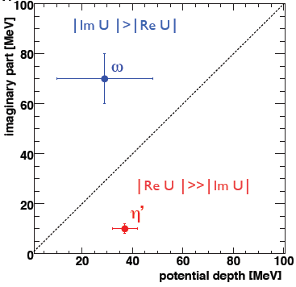
How can we observe mass shift
CBELSA/TAPS coll (V. Metag, M. Nanova et al)
Vacuum values | Mass | Width
ω | 782.65 MeV | 8.49 MeV
η‘ | 957.78 MeV | 0.198 MeV

Slide 14
f₁(1285) and ω meson
Chiral partners
CLAS measurement

Slide 15
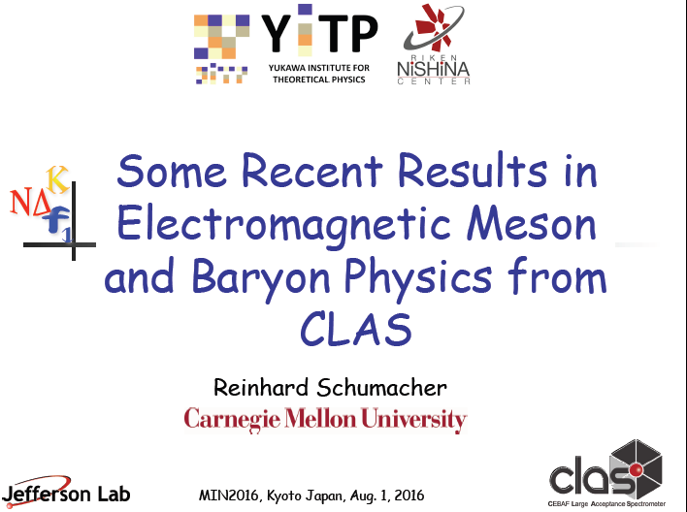
f₁(1285) observation by CLAS

Slide 16
Light vector mesons
J^{PC}=1⁻⁻ | Mass | Width | J^{PC}=1⁺⁺ | Mass | Width
ρ | 770 | 150. | a₁ | 1260 | 250-600
ω | 782 | 8.49 | f₁ | 1285 | 24.2
φ | 1020 | 4.266 | f₁ | 1420 | 54.9
ρ and a₁ are chiral partners
The I=0 singlet and octet states are mixed ideally
→ Ideal mixing comes when disconnected diagrams are neglected
→ Rho omega correlation function becomes degenerate when disconnected diagrams are neglected
→ are ω and f₁(1285) chiral partners when disconnected diagrams are neglected?

Slide 17
Ideal mixing
2x2 matrix of correlation functions
→ Neglecting disconnected diagrams
→ Diagonalizing, we obtain ideal mixing

Slide 18
Light axial mesons
J^{PC}=1⁻⁻ | Mass | Width | J^{PC}=1⁺⁺ | Mass | Width
ρ | 770 | 150. | a₁ | 1260 | 250-600
ω | 782 | 8.49 | f₁ | 1285 | 24.2
φ | 1020 | 4.266 | f₁ | 1420 | 54.9
QCD sum rule reproduces mass well when ideal mixing is assumed P. Gubler, SHLee (16)

Slide 19
f1(1285) mass shift in QCD sum rules -1
OPE -q².=Q² → large
Borel transformed Dispersion relation

Slide 20
f1(1285) mass shift in QCD sum rules -2
Ideal mixing persists in medium
→ Valid in the large Nc
Borel curve
→ Most important input
Mass shift

Slide 21
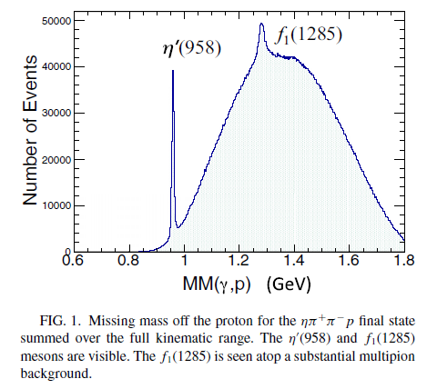

f1(1285) measurement by CLAS at J-Lab [PRC93,065202 (2016)]
observation
→ Missing mass analysis for η
Could be done on nuclear target

Slide 22
Singlet channel: ω − f₁(ideally mixed) correlator
ν=0
ν=0
ρ– a₁ correlator
Combine with existing data on ω, η’
Can learn about chiral and UA(1) symmetry
and masses of hadron

Slide 23
Summary
Chiral order parameter:
f₁(1285) and ω are chiral partners in large Nc when disconnected diagrams are neglected: Masses are expected to change in nuclear medium by partial chiral symmetry restoration
Photoproduction of f₁(1285) on proton can be generalized to nuclear target → will mass of chiral partners change?
ω, f₁ , η ‘ all have small width and Direct observation of chiral symmetry restoration and UA(1) breaking effects→ understand mass generation in hadrons

Slide 24
η’ mass? Witten-Veneziano formula - I
Gluons only from low energy theorem
With quarks using
Large Nc argument
Need η‘ meson

Slide 25
W-V formula at finite density: Y. Kwon, SHL, K. Morita, G. Wolf, PRD86,034014 (2012)
→ Most model calculations
Very small change
Therefore ,

