Slide 1

On hyperon production at NICA energies
Hadronic Matter 2016

Slide 2
Content
Motivation
Strangeness Enhancement: From subthreshold yield of K⁺-s to ‘Horn’-effect
New interpretation of Strangeness Enhancement
Conclusion
Notes:
In heavy ion collisions, and in particular when a QGP is formed, it has long been predicted
that there should be no polarization [9–11]. The essence of the models is that when a QGP has
been formed, a hyperon (for example, a ) would be formed by coalescence of three random
u, d and s quarks. The spins therefore have no preferred axis, and there is no net polarization.

Slide 3
Motivation
How nuclear matter behave under high compression?
Which observables are sensitive to dynamics of HIC?

Slide 4
Excitation function of particle yields and ratios (π, K, Λ, Σ, Ξ, Ω)
Energy range: √s = 3 – 11 GeV most interesting!
Enhanced yield of K⁺
experiments: KaoS at SIS, AGS, NA49 at low energies of SPS
Horn-effect (irregular behaviour of K⁺/π⁺ )
Step-effect in Inverse Slope of Kaon p_{t} Distributions
experiments: NA49, STAR (BES RHIC program)
Projects: FAIR/CBM, NICA/MPD, BM&N

Slide 5
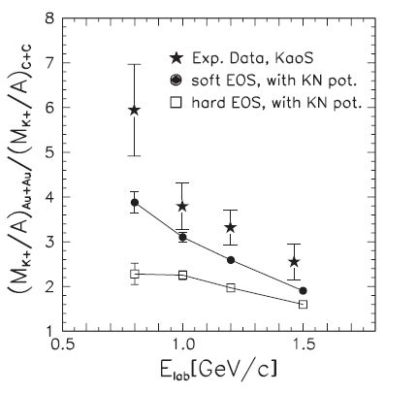
Enhanced yield of K⁺ in subthreshold kaon production
Transport models with NN-interactions
underestimate yield of K⁺ by a factor of 6
overestimate yield of K⁻
KaoS at SIS
J. Phys. G: Nucl. Part. Phys. 27 (2001) 275
RQMD:
K⁺ N repulsive potential
K⁻ N attractive potential
Momentum dependent Skyrme forces
Compression parameter
soft ~ 200 MeV
hard ~ 380 MeV
Notes:
Calculations were performed with two values for the compression modulus: =
200 MeV (solid line) and = 380 MeV (dashed line) corresponding to a “soft” or to
a “hard” nuclear equation-of-state, respectively. The RQMD transport model takes
into account a repulsive K+N-potential and uses momentum-dependent Skyrme forces
to determine the compressional energy per nucleon (i.e. the energy stored in the
compression).
K+ yield is sensitive to the EOS with increasing system mass and with decreasing beam energies.

Slide 6
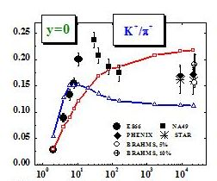
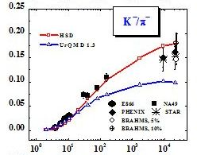
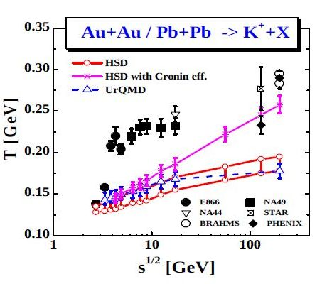
Excitation functions of K⁺/π⁺ and K⁻/π⁻ ratios
Phys.Rev. C69 (2004) 015202 PRL 92 (2004) 013302
Clear evidence for “horn” structure in K⁺/π⁺ at ~30 A GeV !
Non-horn structure in K⁻/π⁻
“horn” was not reproduced by transport models (without PT)
“step” in inverse slop parameter
New degrees of freedom?

Slide 7
Is ‘horn’-effect a signal of PT?
J. Rafelski, Phys. Rep. 88 (1982) 331
Strangeness as a good signal of deconfinement
Strangeness production
In a hadronic matter:
N+N -> N+Λ+K requires ΔE = 670 MeV
π+N -> Λ+K requires ΔE = 535 MeV
In QGP
- quarks requires ΔE = 300 MeV - cheaper !
M. Gazditzki, M. Gorenstein, 1999.
SMES: with PT
Notes:
The data can be interpreted in the framework of the Statistical Model of the Early Stage (SMES) [8]. In
this model it is assumed that the primordial particle production follows the prescription of statistical equilibrium.
The increase of the hK+i/h+i ratio at low collision energies is a consequence of an enhanced strangeness
content due to a larger energy deposit. The sharp decrease of the ratio above the beam energy of 30 AGeV
is connected with a first order phase transition between hadronic and deconfined phases. The decreasing part
of the excitation function corresponds to the mixture of the two phases, while the flat dependence at high energies
is realized in the deconfined phase.

Slide 8
Models
Thermal-Statistical HRG Model
P. Brawn-Munzinger, et al. (one-component hadronic core with artificial heavy resonances)
K. Bugaev, et al. (multi-component hadronic cores)
Others
Kinetic Model with parton phase J.K. Nayak et al.
Hadronic Kinetic Model E. Kolomeitsev, B. Tomasic
pHSD with PT

Slide 9
FAIR–NICA Energy Range
“Horn” and “Step” effects are of most interest!
Are them a manifestation of phase transition from HP to QGP?
Not likely!
Then of what?

Slide 10
FAIR–NICA Energy Range
“Horn” and “Step” effects are of most interest!
Are them a manifestation of phase transition from HP to QGP?
Not likely!
Then of what?
How do finite size nucleons (r ≈ 0.8 fm) composed of light quarks (u, d) behave under high compression and do they change their properties?
R_{A} = 1.2 A^{1/3}
Conjecture:
At early stage of central HIC nucleons transit into hypronic states!

Slide 11
Nucleon Transition into Hyperonic Phase
How can nucleons be converted into hyperons?
Inside highly compressed nuclear matter a strange quark-antiquark condensate < > is created.
And:
u and d quarks in nucleons are replaced by s-quarks,
s-antiquarks together with those u and d form kaons:
p, n → hyperons + kaons
the heavier quark content of a baryon, the less spatial dimensions it occupies

Slide 12
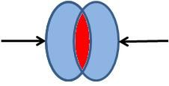
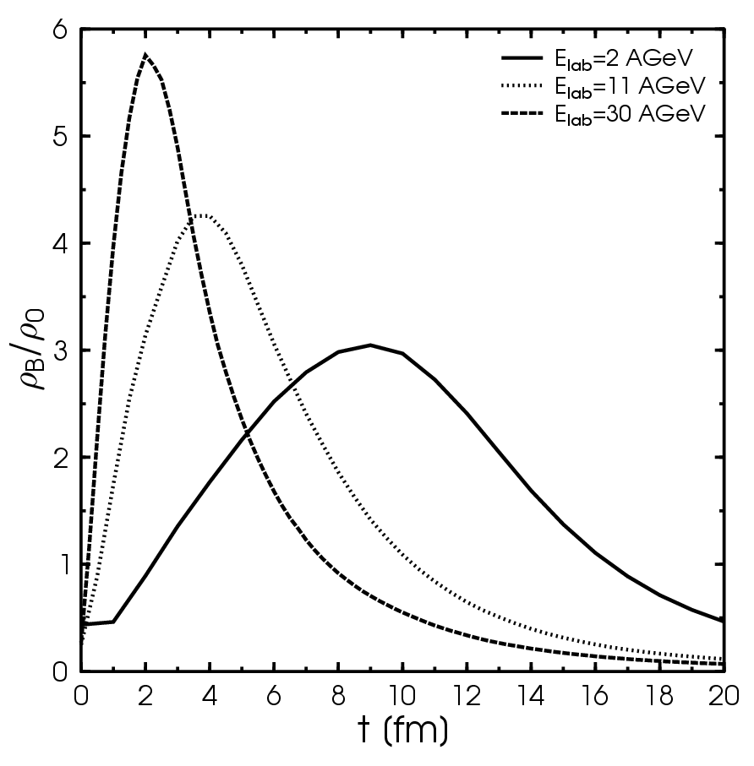
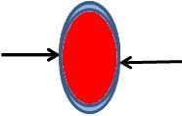
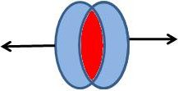
Requirements for nucleon → hyperon transition
Baryon density evolution
in central Au+Au/Pb+Pb
In overlap region nucleons are under compression and forced to occupy much less space volume.
Overlap time in c.m.s
τ_{o} = [2R_{A}/(γβ)]·b_{SP}
In Bjorken scenario b_{SP} = 1
For central AuAu-collisions ‘horn’ location:
τ_{o} ≈ 3 - 4 fm⁻¹
Above ‘horn’
τ_{o} → 0

Slide 13
Strangeness Enhancement Mechanism in HIC
Baryon/Energy Density
Overlap Time
Strangeness/entropy
τ ~ τ₀ ≈ 3 – 4 fm⁻¹
Collision Energy
√s ≈ 7-9 GeV

Slide 14
Initial stage of a central fireball formation
Nucleons transformation to hyperons
P_{n→hyp} ~ (τ_{o} / τ_{re})^{c} f(ε)
τ_{ovelap} - overlap time
τ_{re} ~ 1fm⁻¹ - rearrangement time
c – adjustable parameter
f(ε) – nucleon → hyperon probability,
ε – energy density in the overlap region
Expansion of the central fireball
Non-equilibrium kinetic mechanism
~ 1/λ_{int} ~ ρσ_{hN}
λ - mean free path
σ_{hB} - hadron-baryon cross section

Slide 15
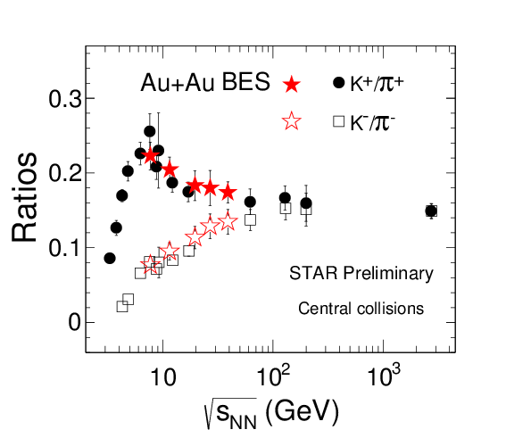
But why ‘horn’ structure takes place for K⁺/π⁺ but not for K⁻/π⁻ ?

Slide 16
Proton-to-hyperon transition channels
Only K⁺ and K⁰ are produced
No one K⁻ is created!

Slide 17
Neutron-to-hyperon transition channels
Only K⁺ and K⁰ are produced
No one K⁻ is created!

Slide 18
Stangeness Production in central HIC
AGS, NICA, CBM, low SPS: N2H-Transition mechanism at early stage of HIC + Kinetic mechanism
1 ≤ (τ_{o}/τ_{re}), τ_{re} ≤ 3 – 4 fm⁻¹
top SPS, RHIC: Only kinetic mechanism
(τ_{o}/τ_{re}) « 1
BB→ BYK⁺, BB→ BBK⁺K⁻ ,
MB→ YK⁺, MB→ BK⁺K⁻

Slide 19
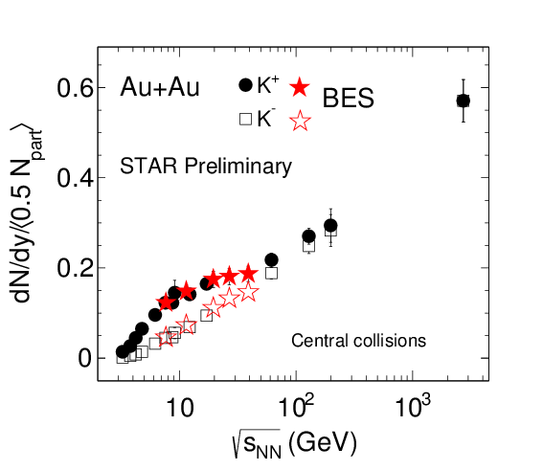
Stangeness Production in central HIC
kinetic mechanism
N2Hyp + kinetic mechanism

Slide 20
What could be studied in BM&N-NICA-FAIR energy region
Enhanced yield of positive and neutral kaons near threshold.
Enhanced yield of neutral kaons (“horn-effect”)
Enhanced yield of one, double and triple strange baryons near threshold.
EoS near threshold
Correlation of kaons with hyperons
Elliptic and direct flows of hyperons
Global polarization of hyperons

Slide 21
Conclusion
Enhanced yield of strangeness at √s ~ 2 ÷ 10 GeV may be a manifestation of the nucleon to hyperon phase transition in a dense baryonic matter.

Slide 22
Thank you for your attention!

Slide 23
Inverse T slopes of K⁺ and K⁻ spectra
Phys.Rev. C69 (2004) 015202, PRL 92 (2004) 013302
Inverse slope is not reproduced by hadronic transport models
New degrees of freedom?

Slide 24
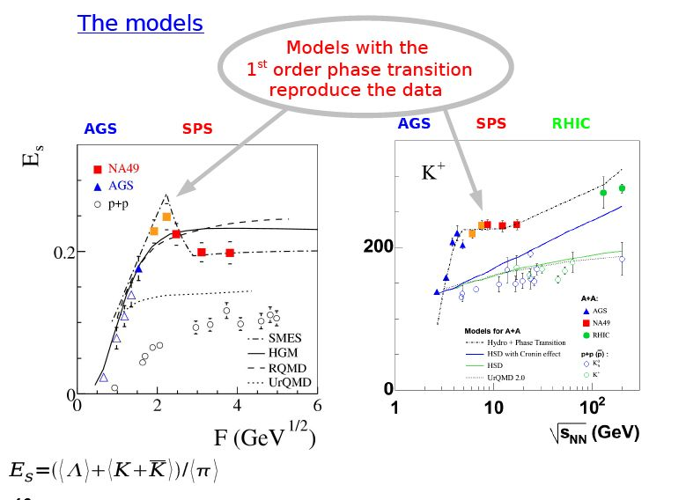
Models
SMES M. Ga´zdzicki, M.I. Gorenstein, Acta Phys. Polon. B 30 (1999) 2705
Notes:
The data can be interpreted in the framework of the Statistical Model of the Early Stage (SMES) [8]. In this model it is assumed that the primordial particle production follows the prescription of statistical equilibrium. The increase of the K+/pi+ ratio at low collision energies is a consequence of an enhanced strangeness content due to a larger energy deposit. The sharp decrease of the ratio above the beam energy of 30 AGeV is connected with a first order phase transition between hadronic and deconfined phases. The decreasing part
of the excitation function corresponds to the mixture of the two phases, while the flat dependence at high energies is realized in the deconfined phase.

Slide 25
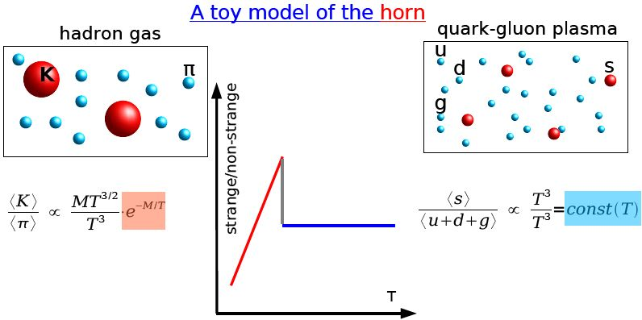
Models
SMES M. Gazditzki, M. Gorenstein
Notes:
The data can be interpreted in the framework of the Statistical Model of the Early Stage (SMES) [8]. In
this model it is assumed that the primordial particle production follows the prescription of statistical equilibrium.
The increase of the hK+i/h+i ratio at low collision energies is a consequence of an enhanced strangeness
content due to a larger energy deposit. The sharp decrease of the ratio above the beam energy of 30 AGeV
is connected with a first order phase transition between hadronic and deconfined phases. The decreasing part
of the excitation function corresponds to the mixture of the two phases, while the flat dependence at high energies
is realized in the deconfined phase.

Slide 26

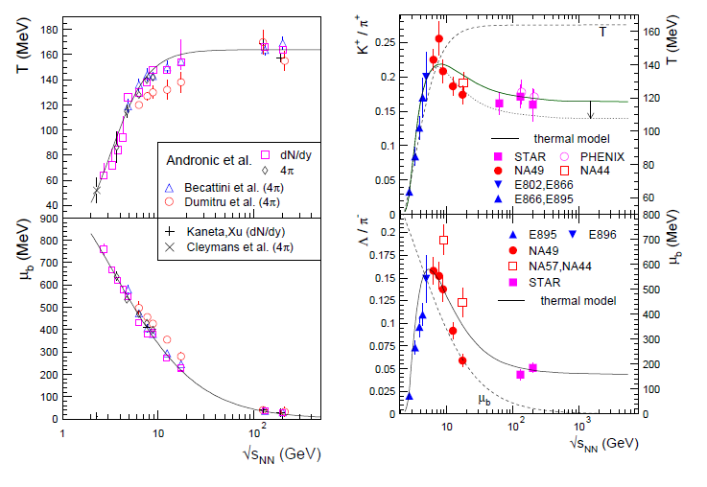
Models
HRG P. Brawn-Munzinger, et al.
One-component, with artificial heavy resonances
parameters are the chemical freeze-out temperature
T, the baryo-chemical potential μ_{b}, and the fireball volume V.

Slide 27
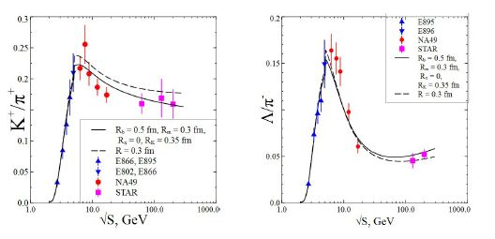
Models
K. Bugaev, et al.
HRG model with multi-component hard-core radii R_{π}, R_{K}, R_{B}, R_{m}

Slide 28
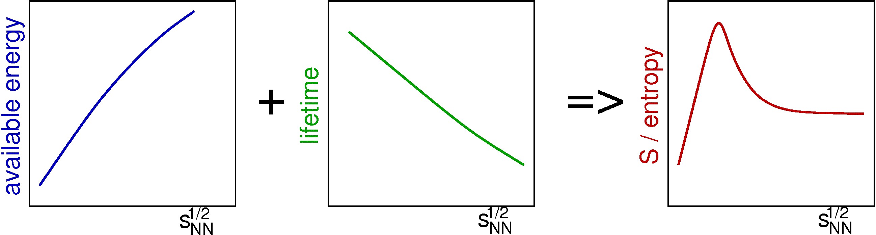
Models
Non-equilibrium Kinetic Model E. Kolomeitsev, B. Tomasik
The strangeness production in a HIC is controlled by
fireball expansion
available energy (energy density) for strangeness production ~ collision energy
temporal evolution of a HIC (fireball lifetime)
Notes:
Our findings are based on the assumption that the lifetime of a fireball becomes shorter as one moves to higher beam energies.

Slide 29
Inputs
Initial K+ content estimated from pp (pn, nn) collisions
Rescattering, production and annihilation in binary collisions
Fireball freezout : fix the final state ε_{FO}, ρ_{B,FO}
Parameters: the initial ε₀ and the lifetime τ_{T}
The time needed for a strangeness production, τ_{T} , is about 15-20 fm/c.
In hydro the typical expansion time is <10 fm/c.

Slide 30
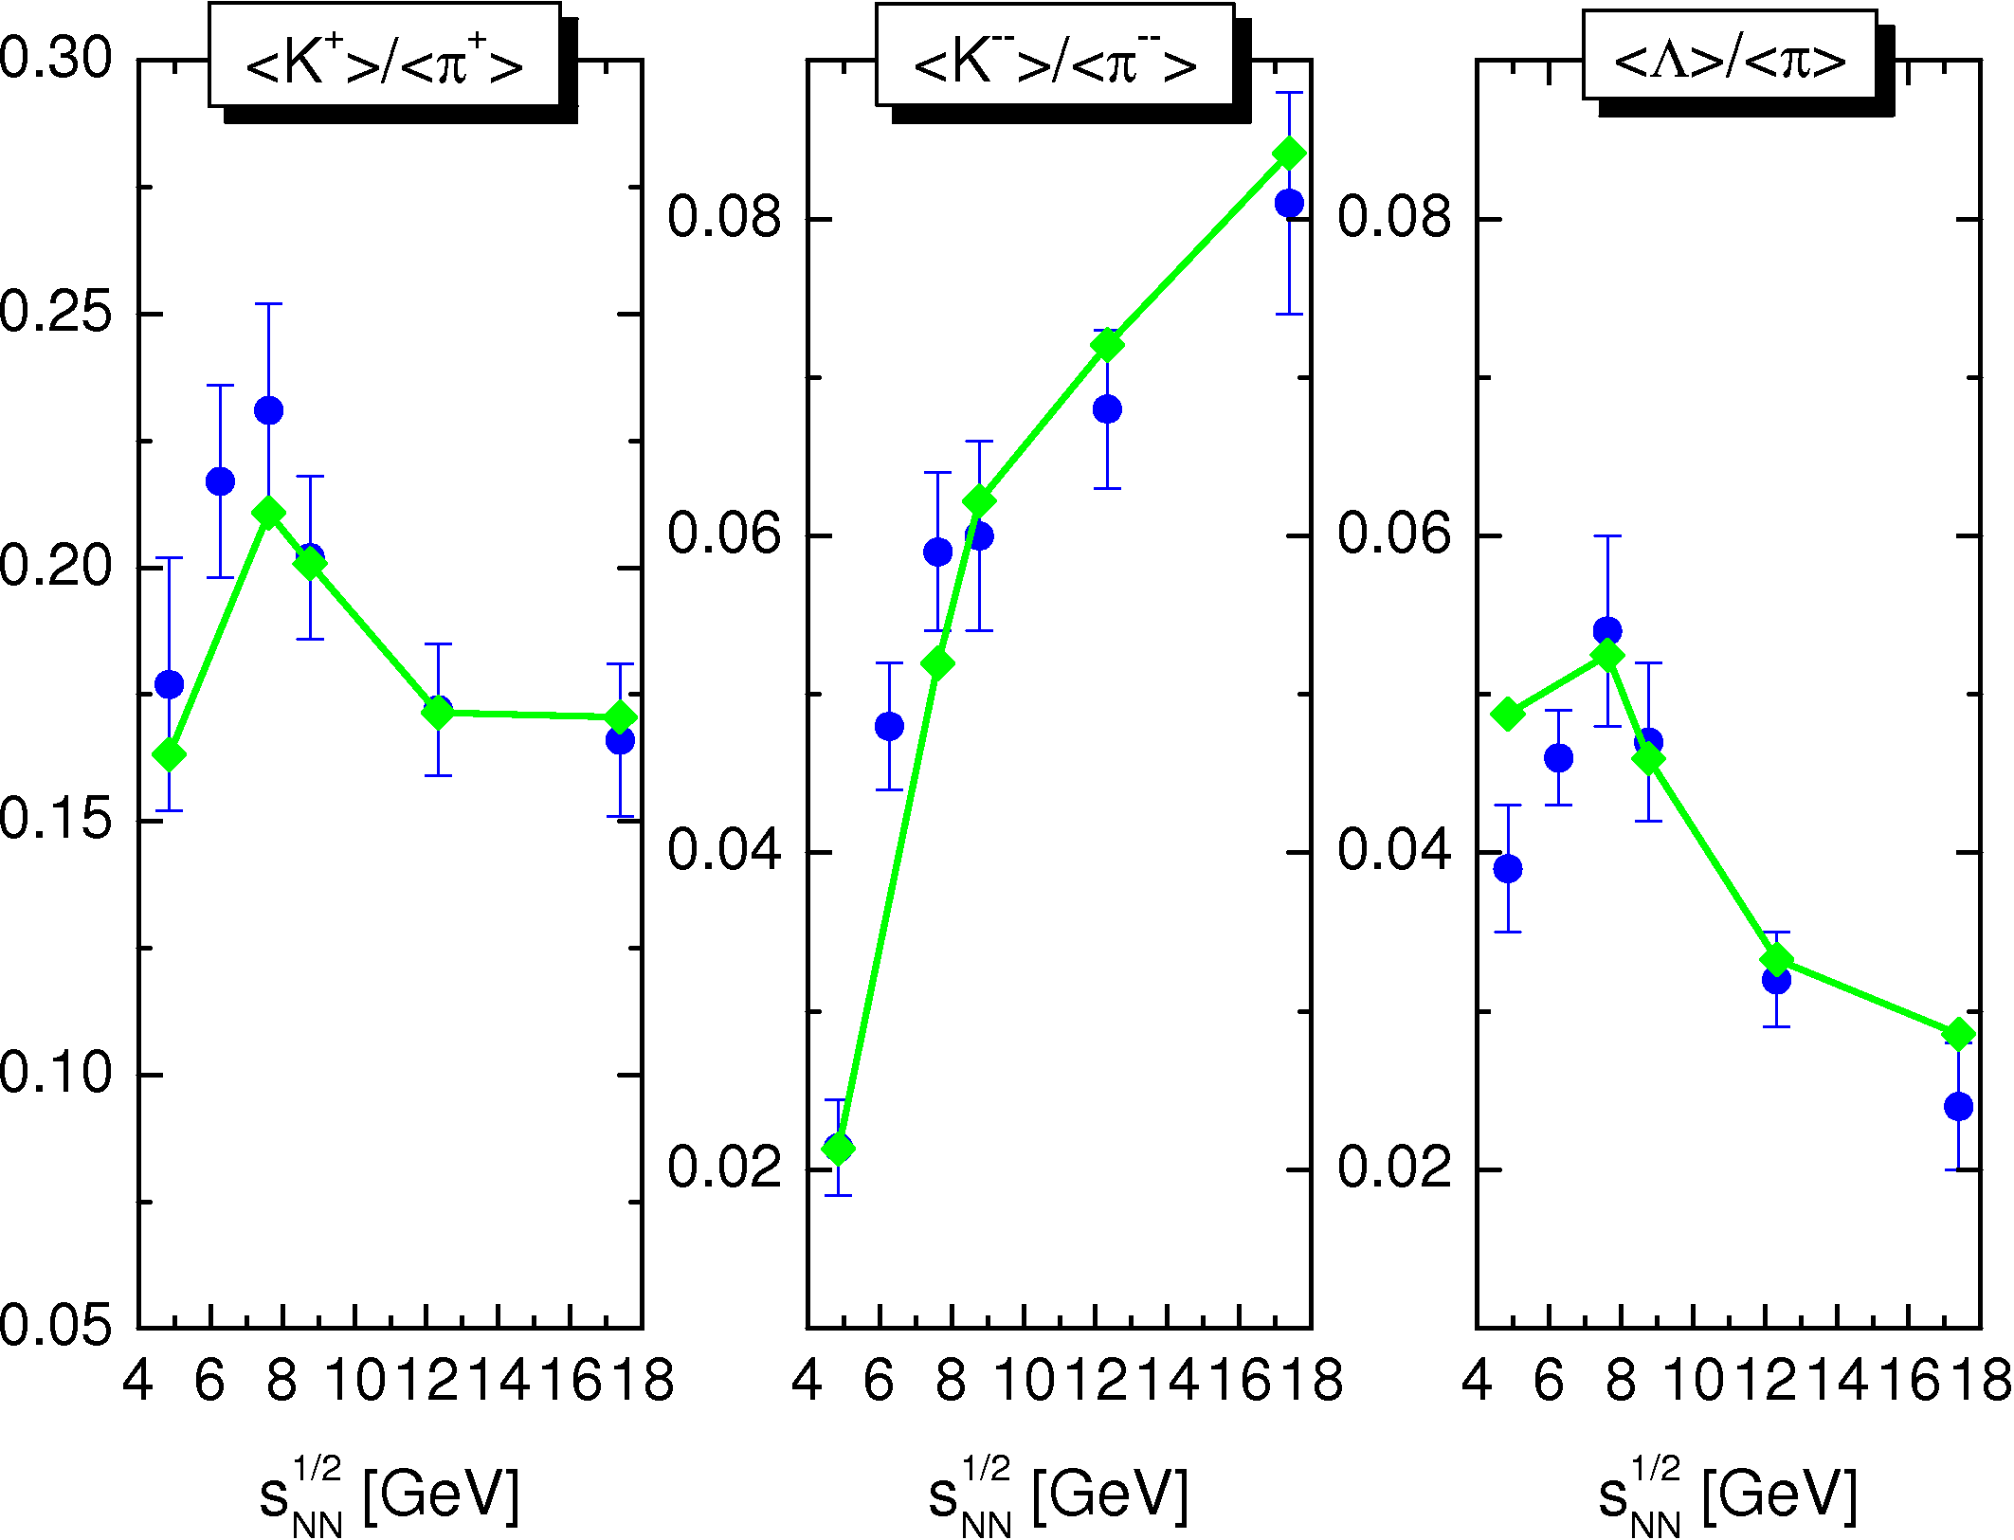
Models
Non-equilibrium Kinetic Model E. Kolomeitsev, B. Tomasik
Notes:
Our findings are based on the assumption that the lifetime of a fireball becomes shorter as one moves to higher
beam energies.

Slide 31
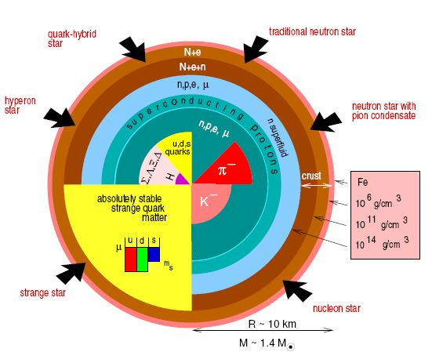
Neutron star
Gravitational compression
NS core
Nuclear matter
Δ- isobar matter
Hyperonic matter
…
compression
Notes:
The behaviour of strange particles in dense nuclear matter plays a crucial role in the dynamics of supernovae and in the stability of neutron stars

Slide 32
Dileptons Yield
Dileptons are an ideal probe for vector meson spectroscopy in the nuclear medium and for the nuclear dynamics !
Λ
π
n
p
p
π
Δ⁺⁺
ρ
e⁺, μ⁺
e⁻, μ⁻
no measurements between
2-40 AGeV beam energy yet!

Slide 33
Physics Motivation
Are we able to observe unambiguous signals from the most compressed region of the system?
in-medium modifications of hadrons [ρ,ω,φ →e⁺e⁻(μ⁺μ⁻)]
Central Au+Au/Pb+Pb collisions

Slide 34
Modelling of in-medium spectral functions for vector mesons
In-medium scenarios:
dropping mass collisional broadening dropping mass + coll. broad.
m*=m₀(1-α ρ/ρ0) Γ(M,ρ)=Γ_{vac}(M)+Γ_{CB}(M,ρ) m* & Γ_{CB}(M,ρ)
Collisional width Γ_{CB}(M,ρ) ~ γ ρ σ_{VN}^{tot}
ρ−meson spectral function:
Note: for a consistent off-shell transport one needs not only in-medium spectral functions but also in-medium transition rates for all channels with vector mesons, i.e. the full knowledge of the in-medium off-shell cross sections σ(s,ρ)
E.L.B., NPA 686 (2001), E.L.B. &W. Cassing, NPA 807 (2008) 214

Slide 35
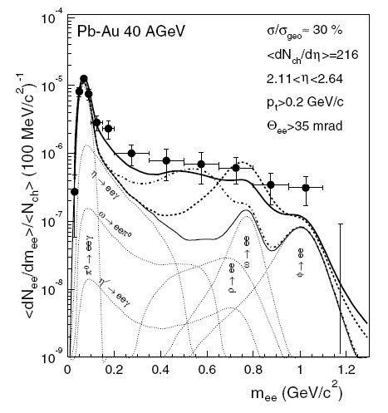
Hadronic Cocktail
+
π+π → ρ → e⁺ + e⁻
√S = 9 GeV
+
in-medium ρ – mass drop (B-R scaling)
+
in-medium ρ – width spread

