Slide 1






















Joint Institute for Nuclear Research
International Intergovernmental Organization
NICA Project at JINR
D. Blaschssskse, A.S. Sorin
V. Kekelidze, A. Kovalenko, R. Lednicky, V. Matveev,
I. Meshkov, A. Sorin, G. Trubnikov
(for the NICA collaboration)
Meeting of the working group on
Theory of Hadronic Matter under Extreme Conditions
BLTP JINR Dubna, October 31, 2016

Slide 2

http://nica.jinr.ru/

Slide 3
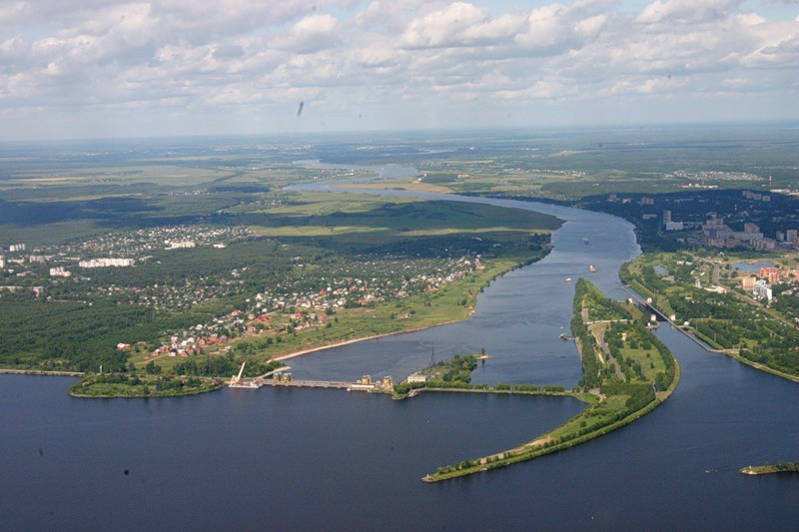


Slide 4
NICA (Nuclotron based Ion Colider fAcility)
– the flagship project in HEP
of Joint Institute for Nuclear Research (JINR)
Main targets of “NICA Complex”:
- study of hot and dense baryonic matter
- investigation of nucleon spin structure,
polarization phenomena
- development of accelerator facility for HEP @ JINR providing
intensive beams of relativistic ions from p to Au
polarized protons and deuterons
with energy up to
√S_{NN} = 11 GeV (Au⁷⁹⁺ , L ~ 10²⁷ cm⁻² c⁻¹)
√S =27 GeV (p, L ~ 10³² cm⁻² c⁻¹)

Slide 5
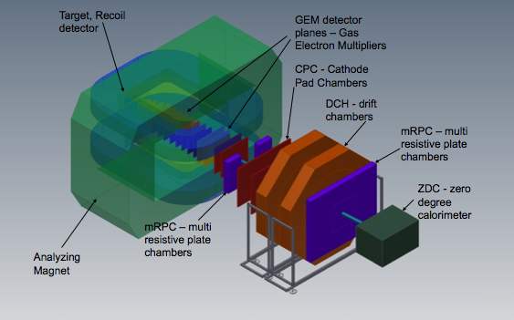
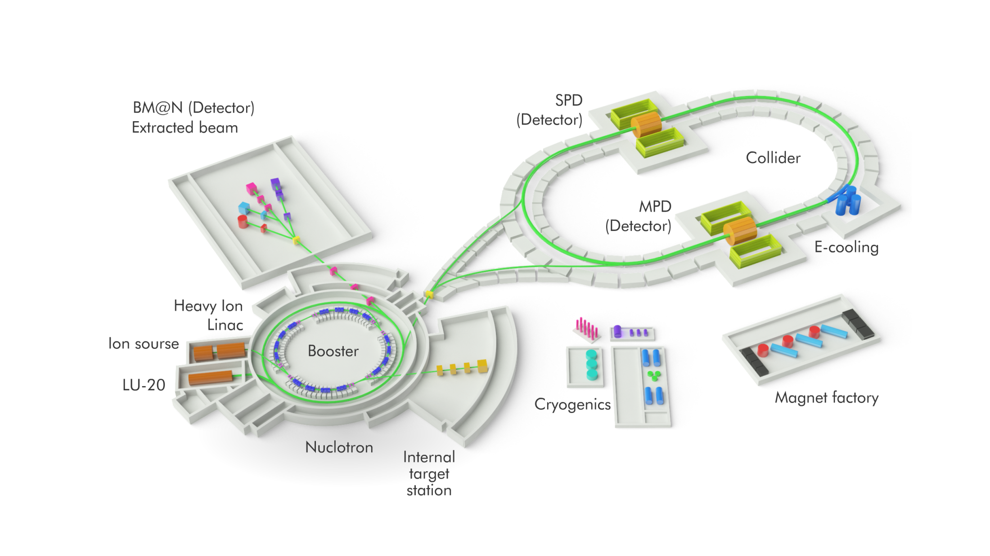
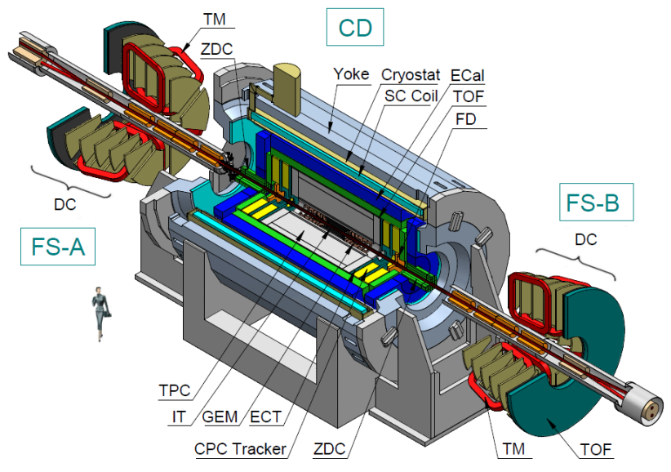
NICA Complex
Baryonic Matter at Nuclotron (BM@N)
SPD (Spin Physics Detector)
Ring circumference
503.04 m.
Ion source
MultiPurpose Detector (MPD)

Slide 6

3 detectors
Baryonic Matter at Nuclotron (BM@N)
The fixed target experiment at the Nuclotron
Stage I: end 2017
MultiPurpose Detector (MPD)
Collider experiment at NICA
Stage I: 2020
SPD (Spin Physics Detector) at the NICA Collider
project is under preparation

Slide 7
All basic parts of the NICA complex
are at the stages of fabrication or TDR approval.
The major milestones for the commissioning:
  accelerator complex
    start-up configuration – 2020
    the design configuration – 2023
  BM@N
    the I stage – 2017
    the II stage – 2019
  MPD
    the I stage – 2020
    upgraded (IT + end-cups) – 2023
  SPD project is under preparation

Slide 8
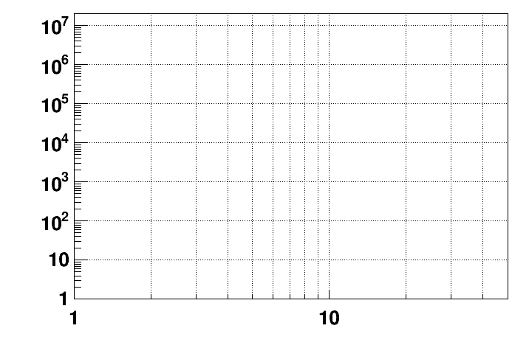
Present and future HIC experiments
energy region of max.
baryonic density
CBM
2022 – 2025: SIS-100 FAIR
NICA/BM@N II
NICA/BM@N I
HADES
NICA/MPD
Interaction rate [Hz]
STAR F.T.
STAR BES II
NA-61/SHINE
Collision energy √S [GeV]
NN

Slide 9
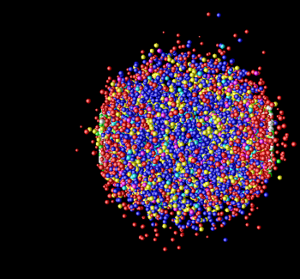
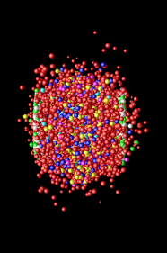
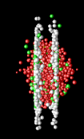
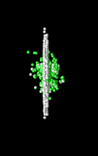

Space-time Evolution of the Collisions
time
e
φ
jet
p
K
π
Λ
γ
μ
γ
e
Freeze-out
(~ 10 fm/c)
(no more elastic collisions)
Hadronization particle composition is fixed (no more inel. Collisions)
→ Expansion →
QGP (~ few fm/c)
Hard Scattering + Thermalization (< 1 fm/c)
space
Au
Au

Slide 10
“Hilbert Problems”
of Dense Matter Physics:
- Which phases?
- Which degrees of freedom?
- Nature of the (spin) nucleon?
How hadronization proceeds?
...
Challenging questions:
Character of phase transitions (if any)?
Signals for 1st order phase transition?
Critical Point?
When does the perfect fluid turn on?
Duality of dynamical and thermal descriptions?
Global polarization in HIC?
…

Slide 11
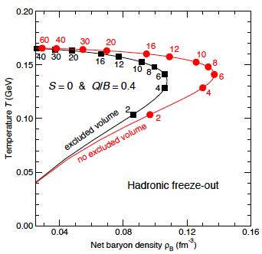
Maximal freeze-out baryon density
NICA
J.Randrup, J.Cleymans (NICA White Paper)

Slide 12
Experimental modes
Collider mode
Fixed target mode
Advantages:
coverage of max. phase space
minimum biased acceptance
free of target parasitic effects
NICA energy range: energy independent homogenous acceptance
….
rate is limited just
by detector capability
easy upgradable
….
Disadvantages:
rate is limited by luminosity
limited combinations
“beam”/”target”
…..
a limited phase space
momentum dependent
corrections
target influenced
corrections

Slide 13
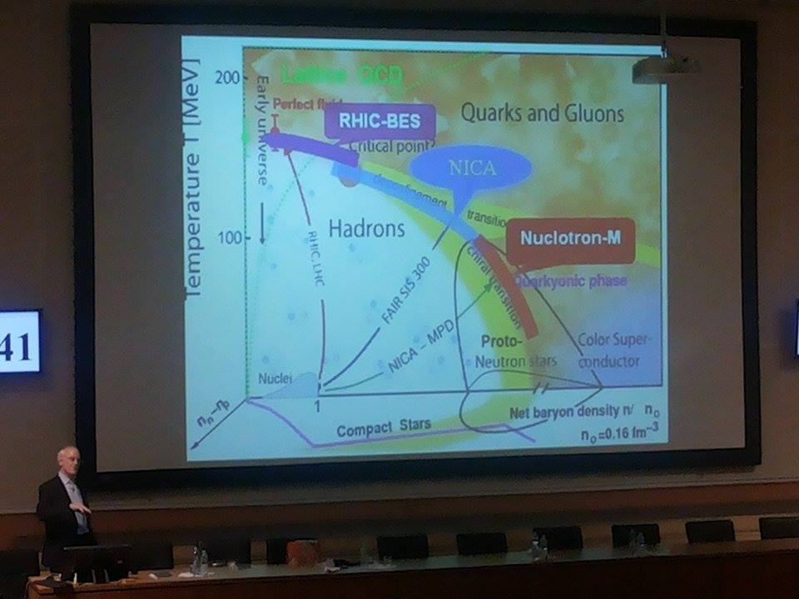
Study of the phase transition from hadronic to quark-gluon matter
Search for the
critical point
Study of in-medium properties of hadrons
at high baryon density and temperature

Slide 14
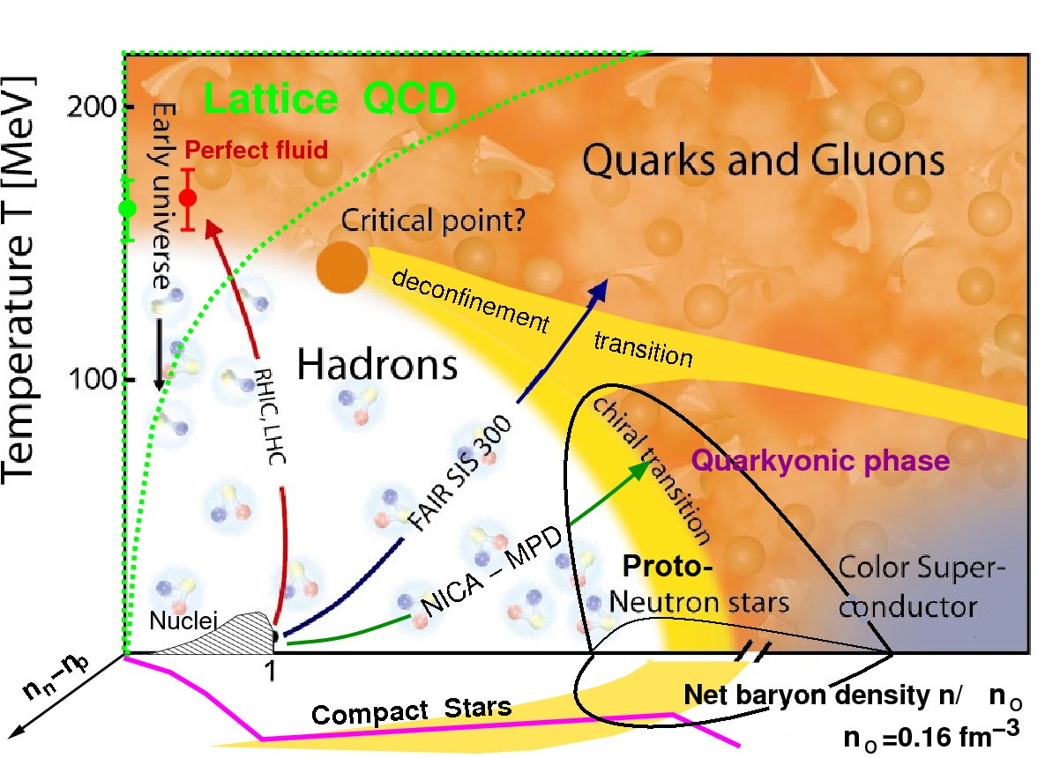
QCD phase diagram: prospects for NICA
Energy Range of NICA
unexplored region of the QCD phase diagram:
Highest net baryon density
Onset of deconfinement phase
transition
Discovery potential:
a) Critical End Point
b) Chiral Symmetry Restoration
с) Hypothetic (e.g. quarkyonic)
phases
Complementary to
RHIC/BES, NA61/CERN, CBM/FAIR
RHIC-BES
NICA
Nuclotron-M
Comprehensive experimental program requires scan over the QCD phase diagram by varying collision parameters: system size, beam energy and collision centrality
NICA provides capabilities for studying a variety of phenomena in a large region of the phase diagram
Notes:
14

Slide 15
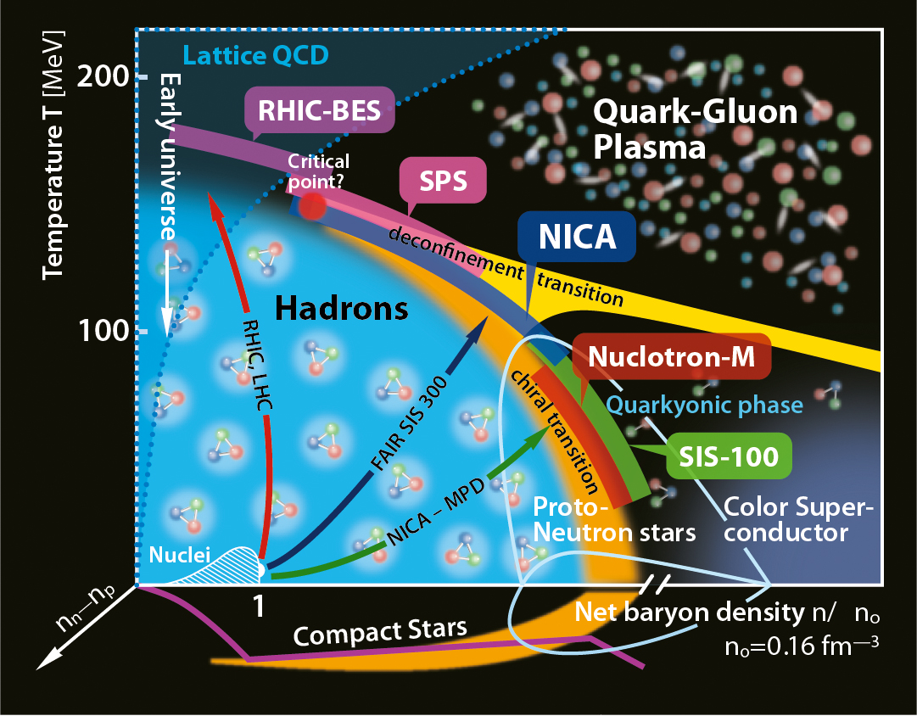
MPD@NICA Physics
QCD matter at MPD@NICA :
Highest net baryon density
Energy range covers onset of deconfinement
Complementary to the RHIC/BES, FAIR ,
J-PARC-HI and CERN experimental programs
Bulk properties, EOS - particle yields
& spectra, ratios, femtoscopy, flow
In-Medium modification of hadron properties
Deconfinement (chiral), phase transition at high r_{B} - enhanced strangeness production
QCD Critical Point - event-by-event fluctuations & correlations
Strangeness in nuclear matter - hypernuclei
The observables in AA, pA and pp collisions: multiplicity of produced hadrons (π, K, p, Λ, Ξ, Ω), electromagnetic probes: electrons, gammas, vector meson decays , event-by-event fluctuations, femtoscopy of π, K, p, Λ
J.Randrup, J.Cleymans

Slide 16
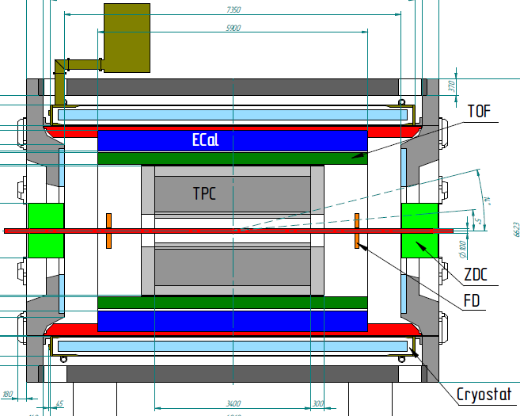
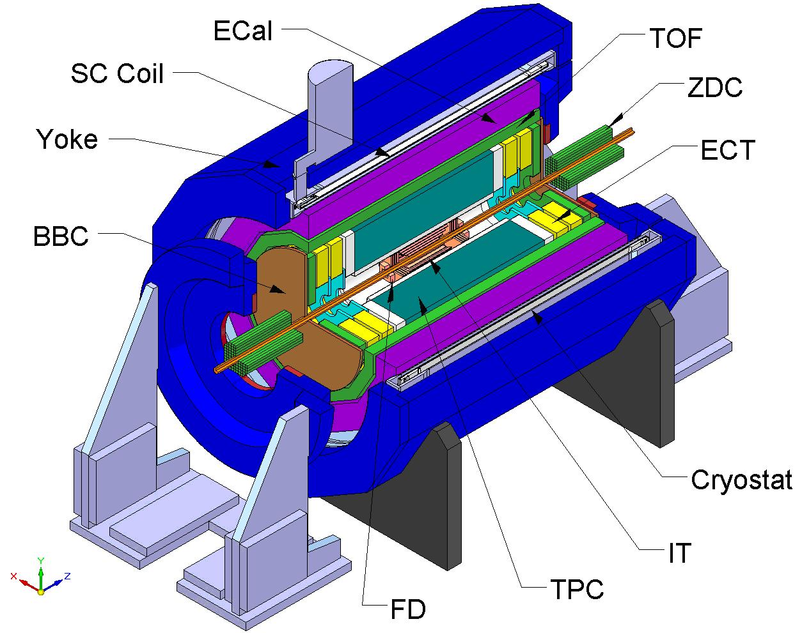

MPD detector for Heavy-Ion Collisions @ NICA
FFD
Tracking: up to |η|<2 (TPC)
PID: hadrons, e, γ (TOF, TPC, ECAL)
Event characterization:
centrality & event plane (ZDC)
Stage 1: TPC, TOF, ECAL, ZDC, FD
Stage 2: IT + Endcaps (tracker, TOF, ECAL)
MPD required features:
hermetic and homogenous acceptance (2π in azimuth), low material budget
good tracking performance and powerful PID (hadrons, e, γ)
high event rate capability and detailed event characterization
Notes:
The MPD will be put in operation at two stages. At the first one the barrel part will be equipped with major tracking detector TPC, TOF end ECAL. ZDC and FD will be in operation as well.
At the second stage the detector will be supplemented with IT and end cap subdetectors.

Slide 17
MultiPurpose Detector (MPD): Observables Staging
I stage: Barrel (TPC, TOF, ECAL), ZDC, FD
mid rapidity region (good performance)
Particle yields and spectra
Event-by-event fluctuations
Femtoscopy involving π, K, p, Λ
Collective flow for identified hadron species
Electromagnetic probes (electrons, gammas), vector mesons
II stage: extended rapidity + Vertex Tracker
Total particle multiplicities
Asymmetries study (better reaction plane determination)
Di-Lepton precise study (ECal extension?)
Exotics (soft photons, hypernuclei)

Slide 18


Strange matter production in heavy ion collisions at the Nuclotron extracted beam:
Baryonic Matter at Nuclotron(BM@N)
experiment has started)
The goal of the experiment is the systematic measurements of the observables for multistrange objects (Ξ⁻, Ω⁻, exotics) in Au-Au collisions in energy range of Nuclotron extracted beams (up to 5.5 A GeV)

Slide 19
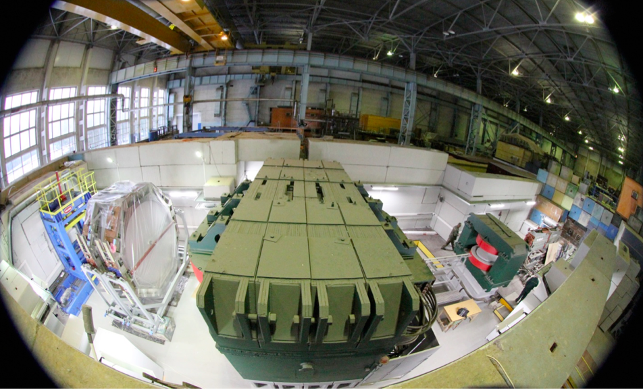
Baryonic Matter at Nuclotron (BM@N)
at Nuclotron extracted beams

Slide 20

BM@N: the 1st stage
Participants from:
Russia: INR, MEPhi, SINP, MSU,
IHEP, S-Ptr Radium Inst.
Bulgaria: Plovdiv University;
China: Tsinghua University, Beijin;
Poland: Warsaw Tech.Uni.
Israel: Tel Aviv Uni.
Germany: Frankfurt Uni.
+ expression of interest from CBM
Physics:
strange / multi-strange hyperon and hypernuclei production
at the threshold
hadron femtoscopy
in-medium modifications of strange & vector mesons
in dense nuclear matter
electromagnetic probes, states decaying into γ, e (with ECAL)
area prepared
for detector installation
Notes:
The participants from several institutions are contributing to the experiment preparation. At the fist stage it will be studied: strange and …..

Slide 21
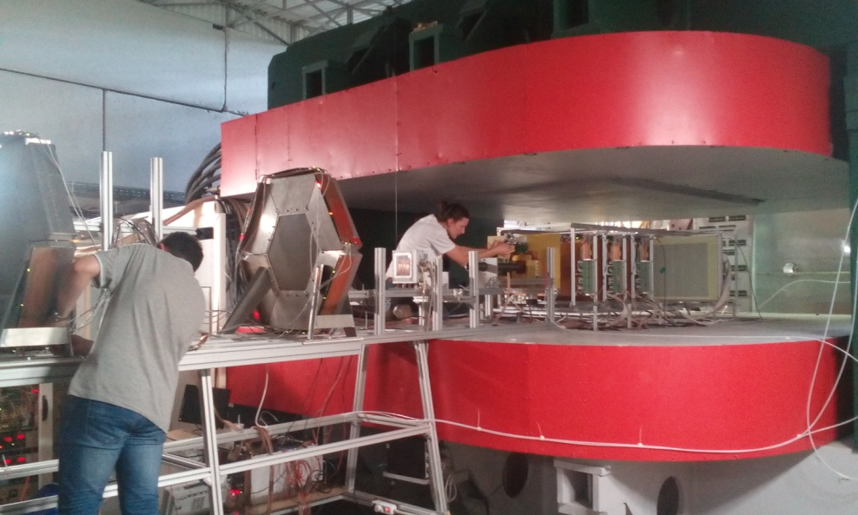
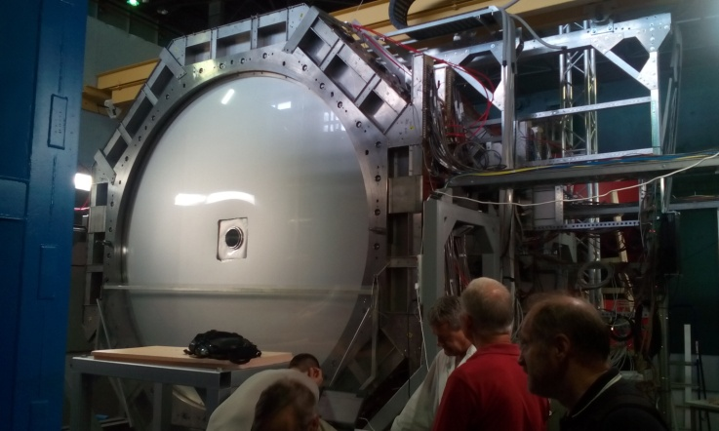
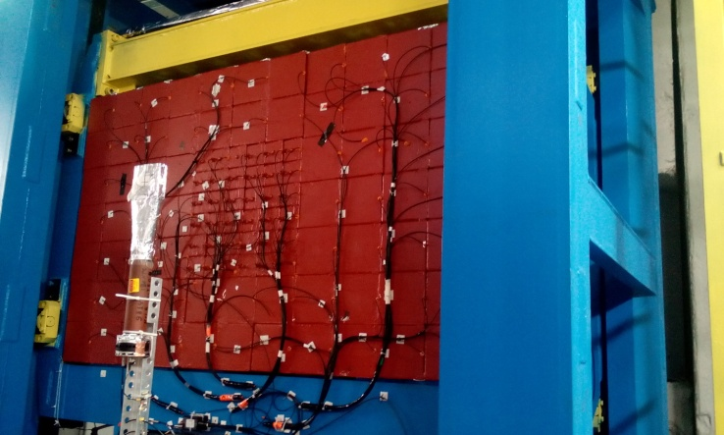
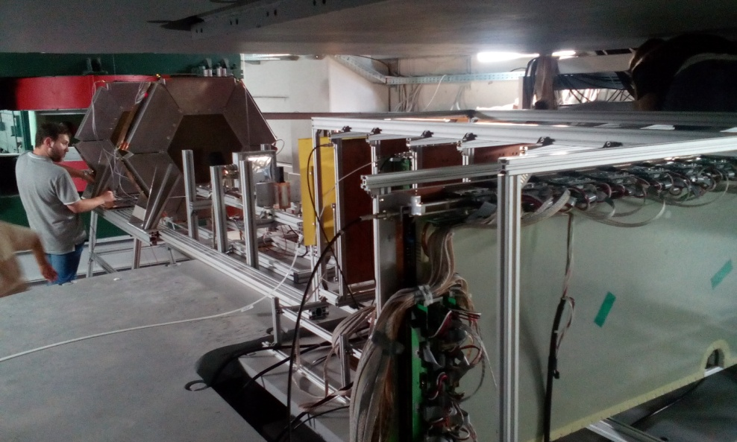
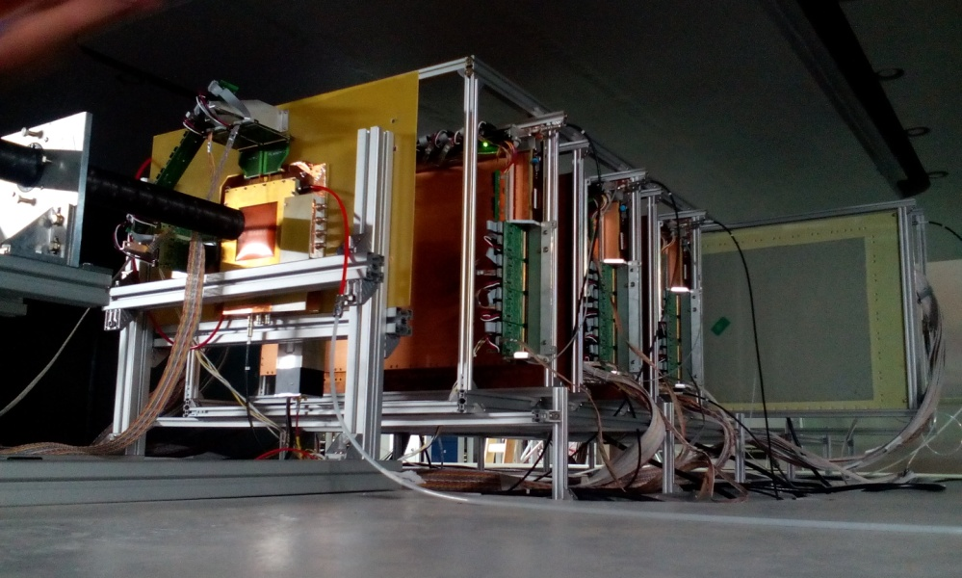
BM@N Run 52 (June 2016): tests & commissioning
of GEM CT located inside analyzing magnet
d beam (~5·10⁵ /cycle) with 2.94 GeV/n
5 GEM detectors 66 x 41cm² + 1 detector 163 x 45 cm²

Slide 22
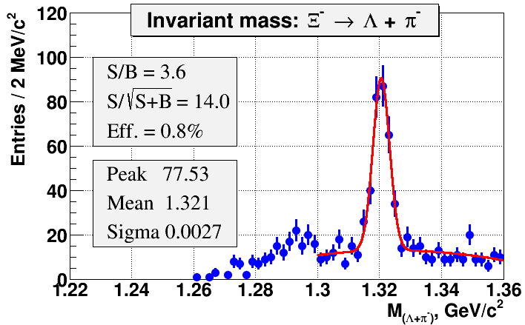
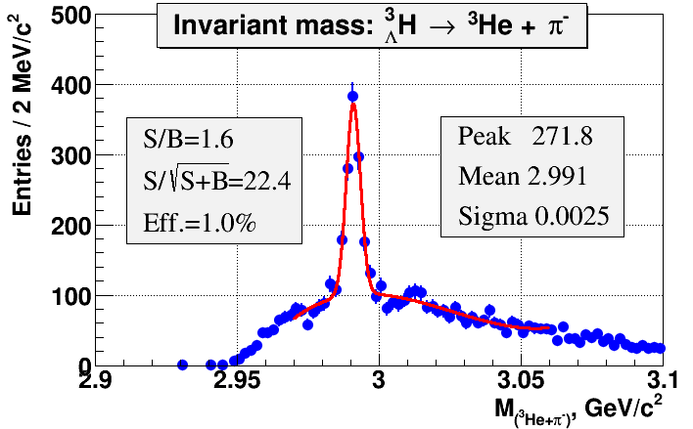
BM@N status and milestones
BM@N plan
technical runs with d, Li, C beams: 2016 – 2017;
physics run BM@N (I stage) with Kr int rate 20 kHz: IV q., 2017;
physics run BM@N (II stage) with Au int rate 50 kHz: 2019.
next technical run in 2016: commissioning of GEM & Si inside magnet
Simulation
A.Zinchenko, V.Vasendina
UrQMD & DCM-QGSM, Au+Au, E_{kin}. = 4.5A GeV, 2×10⁶ events;
Ξ⁻
³H_{Λ} → ³He π⁻
area prepared
for detector installation
DCH-1,2
ToF-700
Scint-700
ZDC
Notes:
The second technical run is foreseen in May-june. The first physics run is planned at the end of 2017 when the Booster will be put in operation. The run with high intensity gold beam is planned in 2019. The simulation indicates a reliable detection of cascades and hyper-nuclei.

Slide 23
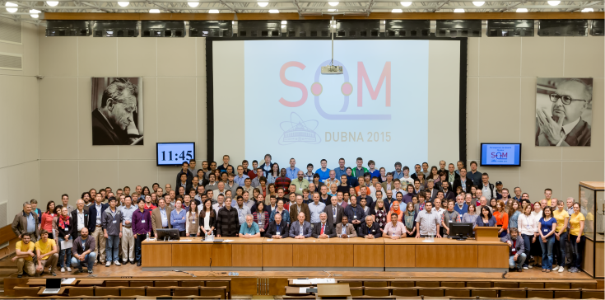
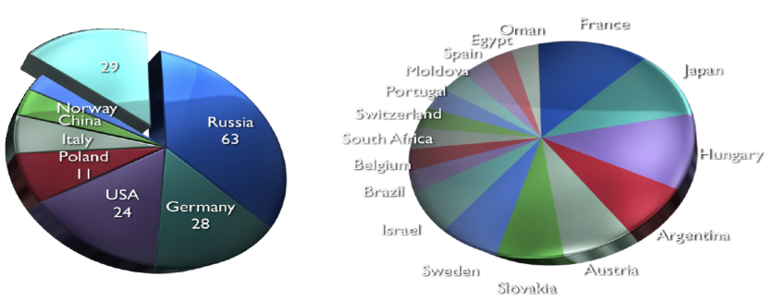
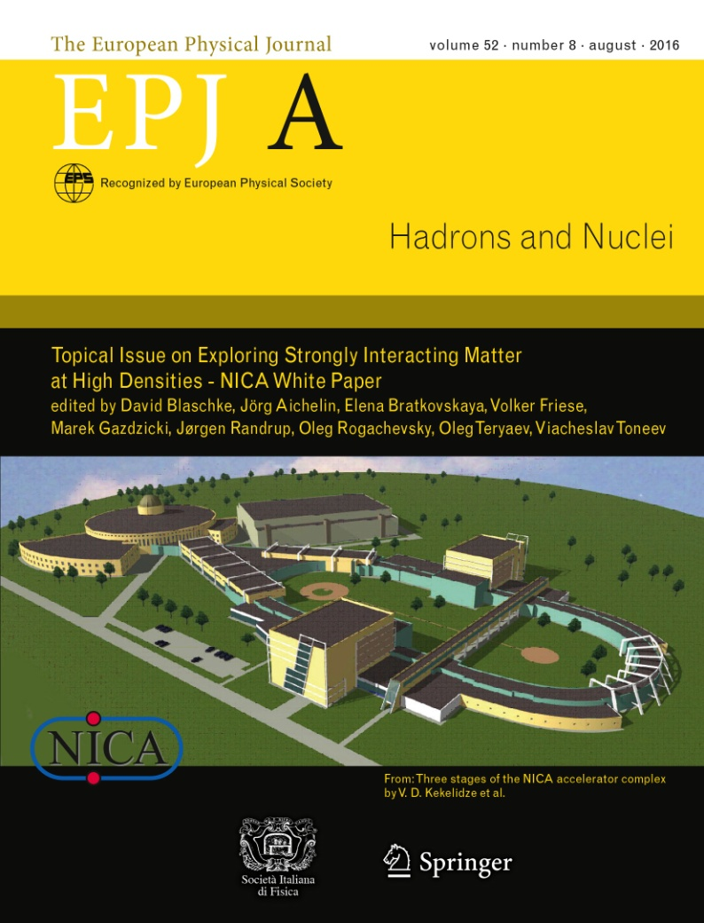


SQM2015 in Dubna
NICA White Paper
111 contributions,
188 authors
from 24 countries
T. D. Lee:
“The NICA heavy
ion collider will be
a very major step
towards the formation
of a new phase of
quark-gluon matter.”
http://theor0.jinr.ru/twiki-cgi/view/NICA/WebHome

Slide 24
Fixed Target Experiments at the Nuclotron
→ Ideally suited for exploration of reaction mechanisms & in-medium properties
→ Energy range formerly not accessible or of limited experimental information
→ Expectation of a rich structure of the QCD phase diagram @ high densities
TOOL:
→ Subthreshold production of (multi-)strange hadrons: Φ, K*, K*, Λ, Σ, Ξ, Ω⁻
→ Extend studies at SIS18, observe Ω⁻ as result of multi-step production here
→ Extract information about densities reached in the collision → EoS
Important:
→ Systematic study of production mechanisms by measurement of excitation functions for hadron production in p+p, d+p
→ High enough statistics for multi-dimensional analysis (centrality, y, p_{T})
Production of hypernuclei: → study recommended!
→ Two mechanisms: (1) Absorption of produce Λ by spectator nuclei
(2) Coalescence of Λ nucleons at midrapidity
→ Important for hypernuclei spectroscopy: extract Y-N, Y-Y interactions

Slide 25
Collider Experiments at MPD
First round of MPD/NICA experiments:
→ diagnostic observables of beam energy scan programs at SPS, RHIC
→ MPD detector to be optimized to study fluctuations an correlations
→ excitation functions of fluct./corr., dependence on centrality & system size
Observables:
→ EBE fluctuations of multiplicty and p_{T} of charged and identified part. (p,K,π)
→ long-range angular correlations like v₁, v₂ of (p,K,π,Λ) and light clusters
→ three-body correlations (for CME) and short-range two-particle corr. (size)
→ coverage in rapidity and p_{T} shall be large, low p_{T} extremely important!
→ measurements as function of collison energy for following systems:
– p+p collisions
– d+d collisions with possibility of off-line event selection of reactions with
(p,p), (p,n), (n,n) spectators
– d+Pb collisions
– collisions of identical heavy nuclei, such as Pb+Pb (later also smaller A)
→ second stage: open-charm hadrons, di-leptons, di-photons at NICA

Slide 26
Spin Physics in Heavy-Ion Collisions
Spin-dependent observables might also be manifested in HIC
No beam polarization but plenty of effects in final state
Especially interesting is the polarization of hyperons
Self-analyzing: revealed in weak P-violating decay
Related to P-odd effects in QCD medium: Vorticity and Hydrodynamic helicity
Detailed study at MPD planned
Extensive theoretical investigations and simulations performed at JINR:
O.Rogachevsky, A.S., O.Teryaev, Phys. Rev. C (2010);
M.Baznat, K.Gudima, A.S., O.Teryaev, Phys. Rev. C (2013), Phys. Rev C (2015);
A.S., O.Teryaev, arXiv:1606.08398
Spin effects in heavy ion collisions might be used as
a complementary probe.
Spin physics program involving all the NICA detectors
(MPD, SPD, BM@N) is possible.

Slide 27
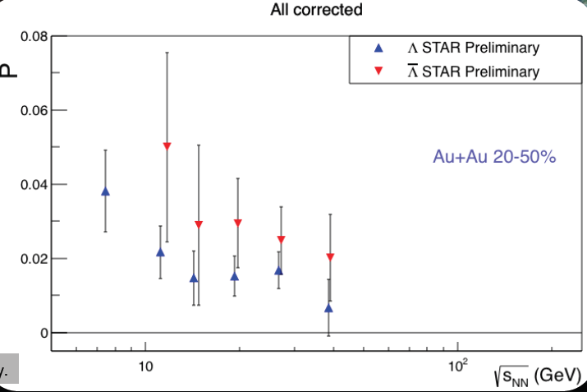
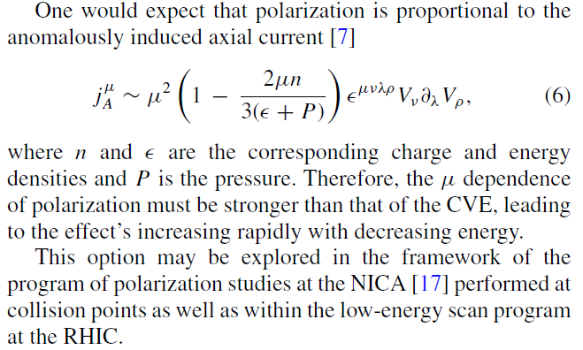
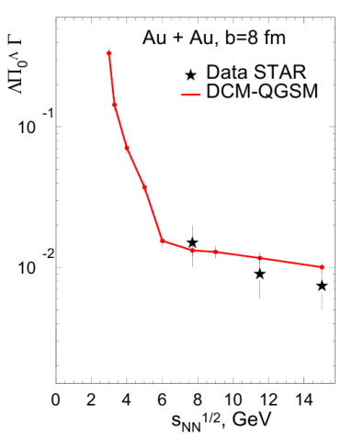
Spin effects in heavy ion collisions
as a complementary probe
M.Lisa, for the STAR collaboration,
SQM2016, Berkeley, June 2016
O.Rogachevsky, A.S., O.Teryaev,
Phys. Rev. C 82, 054910, 2010.
M.Baznat, K.Gudima, A.S., O.Teryaev, XXIII Baldin Conference, Dubna, 2016
M.Baznat, K.Gudima, A.S., O.Teryaev
Phys. Rev. C (2013); Phys. Rev C (2015);
A.S., O.Teryaev arXiv:1606.08398

Slide 28

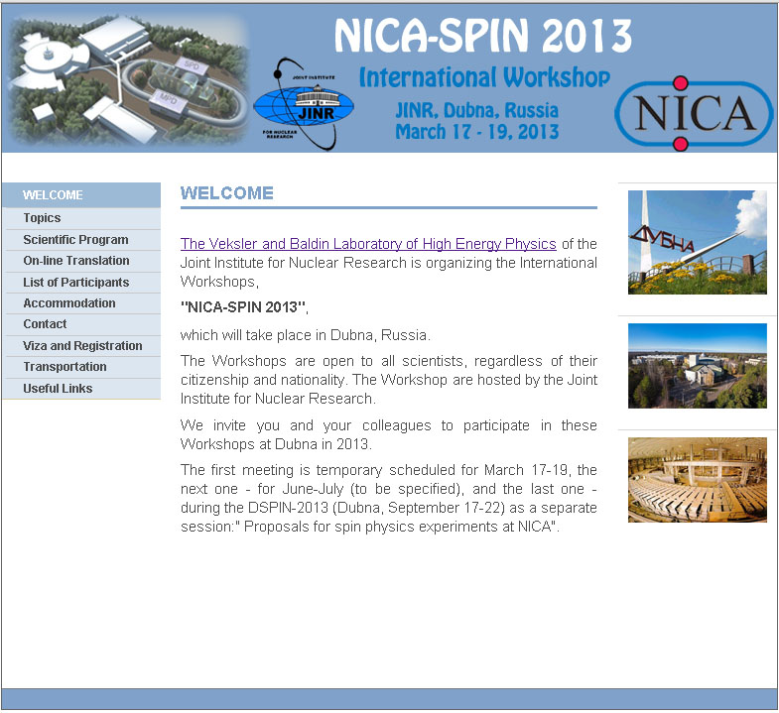
SPD (Spin Physics Detector) at NICA
Collider provides both:
transversally & longitudinally
polarized p & d
with energy up to √S = 27 GeV
The issues to be studied:
► MMT-DY processes
► J/Ψ production processes
► Spin effects in inclusive
high-p_{T} reactions
► Spin effects in one and two
hadron production processes
► Polarization effects in
heavy ion collisions
The Collaboration is forming
Project is under preparation
SPD@NICA will provide unique opportunity to study all PDFs in one experiment and obtain the comprehensive information on nucleon spin structure at high statistical level with min. systematic uncertainties
Notes:
28
28

Slide 29
Current and future experiments towards exploration of nucleon spin structure
experiment | CERN, COMPASS-II | FAIR, PANDA | FNAL, E-906 | RHIC, STAR | RHIC-PHENIX | NICA, SPD
mode | F.T. | F.T. | F.T. | collider | collider | collider
Beam/target | π- , p | anti-p, p | π- , p | pp | pp | pp, pd,dd
Polarization:b/t | 0; 0.8 | 0; 0 | 0; 0 | 0.5 | 0.5 | 0.7
Luminosity | 2·10³³ | 2·10³² | 3.5·10³⁵ | 5·10³² | 5·10³² | 10³²
√s , GeV | 14 | 6 | 16 | 200, 500 | 200, 500 | 10 - 26
x_{1(beam)} range | 0.1-0.9 | 0.1-0.6 | 0.1-0.5 | 0.03-1.0 | 0.03-1.0 | 0.1-0.8
q_{T}, GeV | 0.5 -4.0 | 0.5 -1.5 | 0.5 -3.0 | 1.0 -10.0 | 1.0 -10.0 | 0.5 -6.0
Lepton pairs, | μ-μ+ | μ-μ+ | μ-μ+ | μ-μ+ | μ-μ+ | μ-μ+, e+e-
Data taking | 2015 | >2025 | 2013 | >2016 | >2016 | >2020
Transversity | NO | NO | NO | YES | YES | YES
Boer-Mulders | YES | YES | YES | YES | YES | YES
Sivers | YES | YES | YES | YES | YES | YES
Pretzelosity | NO | NO | NO | NO | YES | YES
Worm Gear | NO | NO | NO | NO | NO | YES
Direct γ | NO | NO | NO | YES | YES | YES

Slide 30
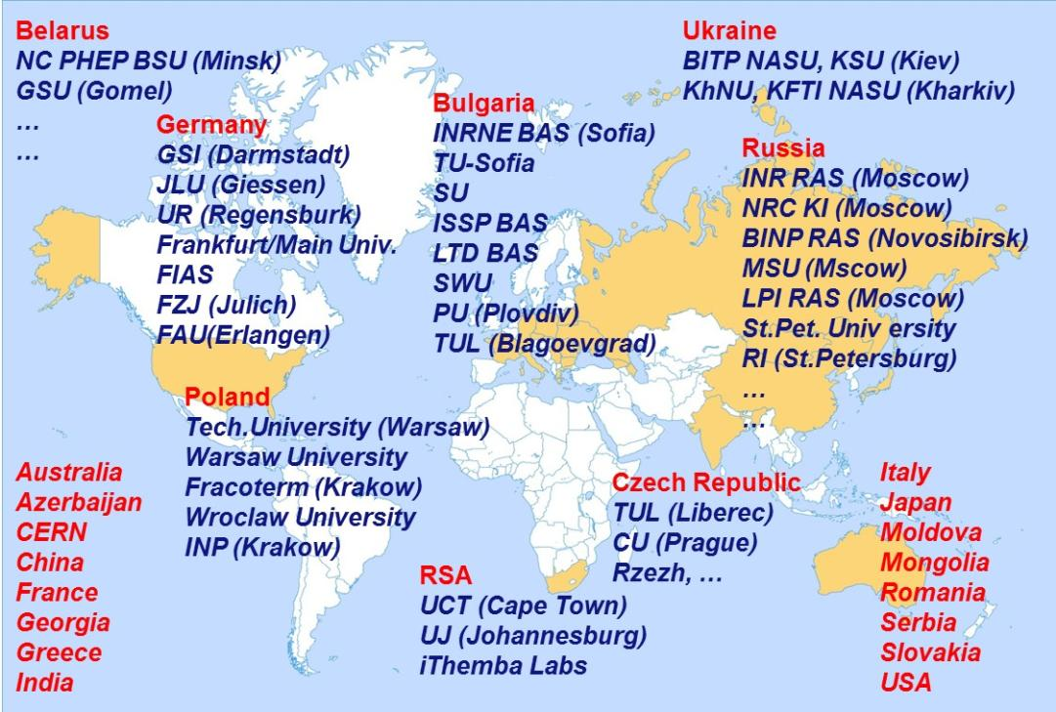
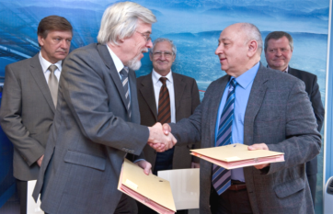
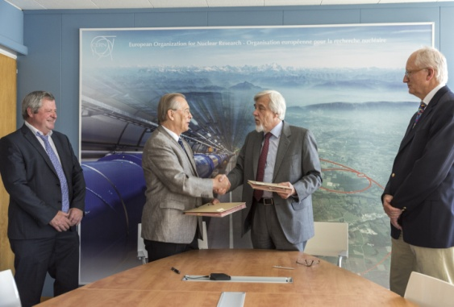
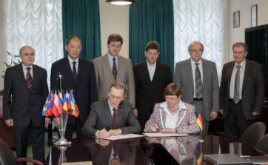
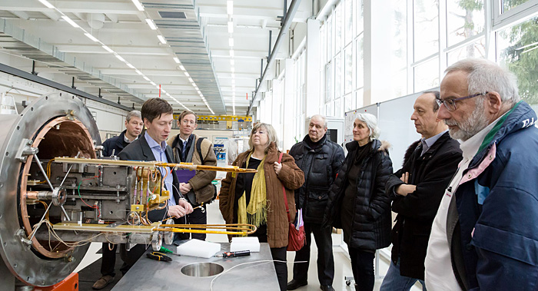
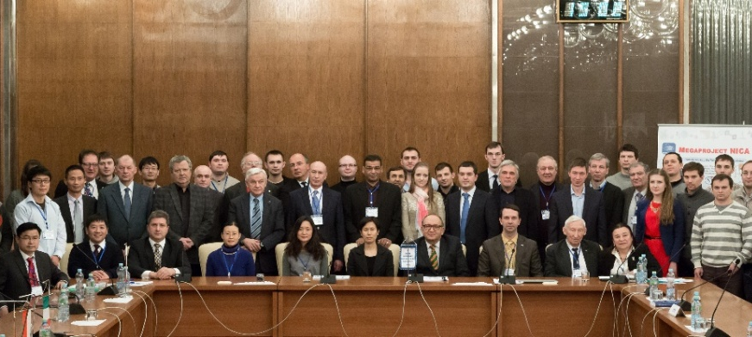
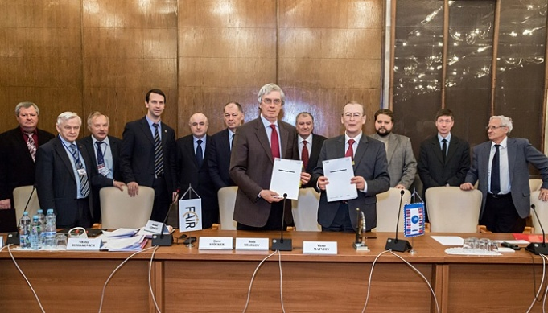
NICA International collaboration
CERN-JINR cooperation
JINR –BMBF Agreement
JINR-France (IN2P3) MoU
Workshop on NICA Megaproject
NICA–FAIR Agreement

Slide 31
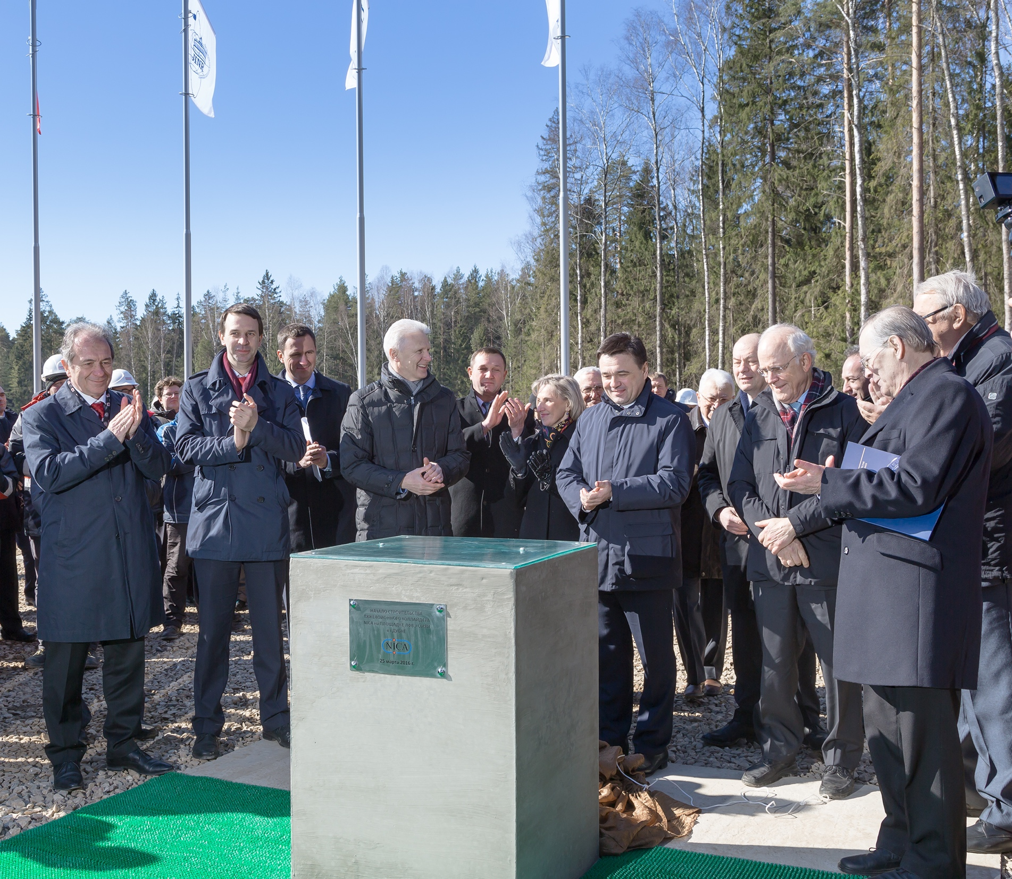
NICA “corner stone” ceremony, JINR, March 25, 2016

Slide 32
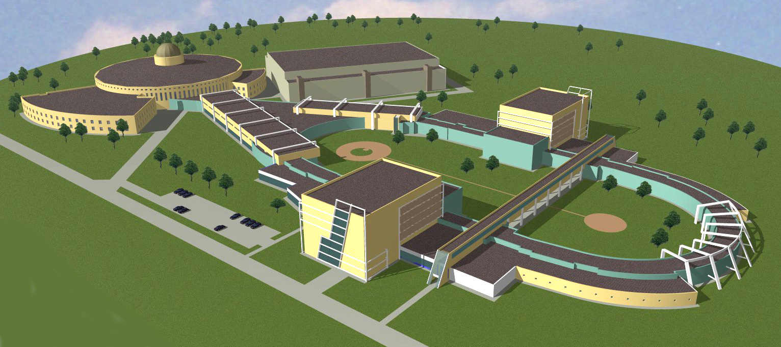
The NICA Civil engineering
General Contract (duration 43 months)
STRABAG – main contractor; Кометa – main designer
The works are in progress: piling, subcontractor for iron/concrete works
The whole Complex comprises several Objects to be commissioned
SPD Hall, II q., 2019
East semi-ring,
IV q., 2018
Beam transport ch.,
I q., 2019
West semi-ring,
III q., 2018
MPD Hall, I q., 2018

Slide 33
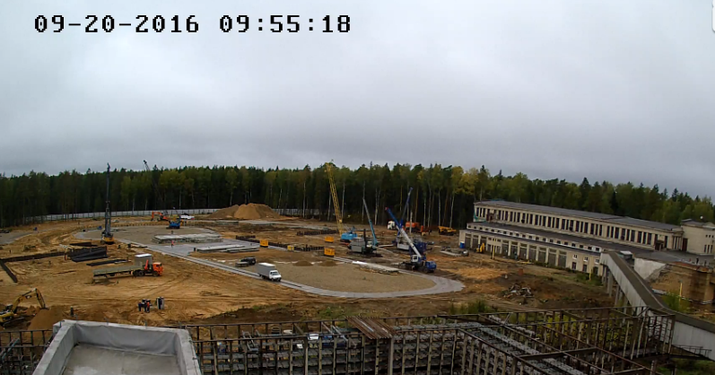
The construction is in progress

Slide 34
NICA Organizational Chart
Russia
CERN ?
China?
…
BMBF?
JINR
Supervisory Board
International Council of NICA collaboration Members
JINR Directorate
Coordinating Committee
(leaded by JINR Director)
Scientific Council
Partner Organizations and Institutes
JINR PAC’s
Research Director
Technical Managing Director
Financial Committee
RRB NICA
NICA Management Board
Int. Advisory Committees (MAC, DAC,…)
NICA subproject’s Leaders
JINR Divisions

Slide 35
Accelerator elements
  Alexander Zlobin, FNAL
  Takeshi Katayama, Tokyo Univ.
  Valeri Lebedev, FNAL
  Rolf Stassen, FZJ
  Yuri Senichev, FZJ
  Evgeny Levichev, BINP
  Victor Yarba, FNAL
  Pavel Zenkevich, ITEP
  Machine Advisory Committee
  Boris Sharkov, ITEP, chairman
  Pavel Beloshitsky, CERN
  Sergei Ivanov, IHEP
  Thomas Roser, BNL
  Alexei Fedotov , BNL
  Markus Steck, GSI
  Nicholas Walker, Desy
  Sergei Nagaitsev, FNAL
Notes:
The accelerator blocks were comprehensively revised by the MAC. The TDR is approved.

Slide 36
MultiPurpose Detector (MPD)
Detector Advisory Committee:
Hans Gutbrod, GSI - chairman
Itzhak Tserruya, Weizmann Institute
Hans Rudolf Scmidt, Tubingen Uni.
Jean Cleymans, Cape Town Uni.
Nu Xu, BNL
Notes:
The MPD will be the fist detector operated at the Collider. The TDRs for…

Slide 37
Baryonic Matter at Nuclotron (BM@N)
Detector Advisory Committee:
Hans Rudolf Schmidt, Tubingen Uni. - chairman
Hans Gutbrod, GSI
Itzhak Tserruya, Weitzmann Istitute
Peter Hristov, CERN
Karlheinz Hiller, DESY
Notes:
This detector will operate at the beam extracted from the Nuclotron.

Slide 38
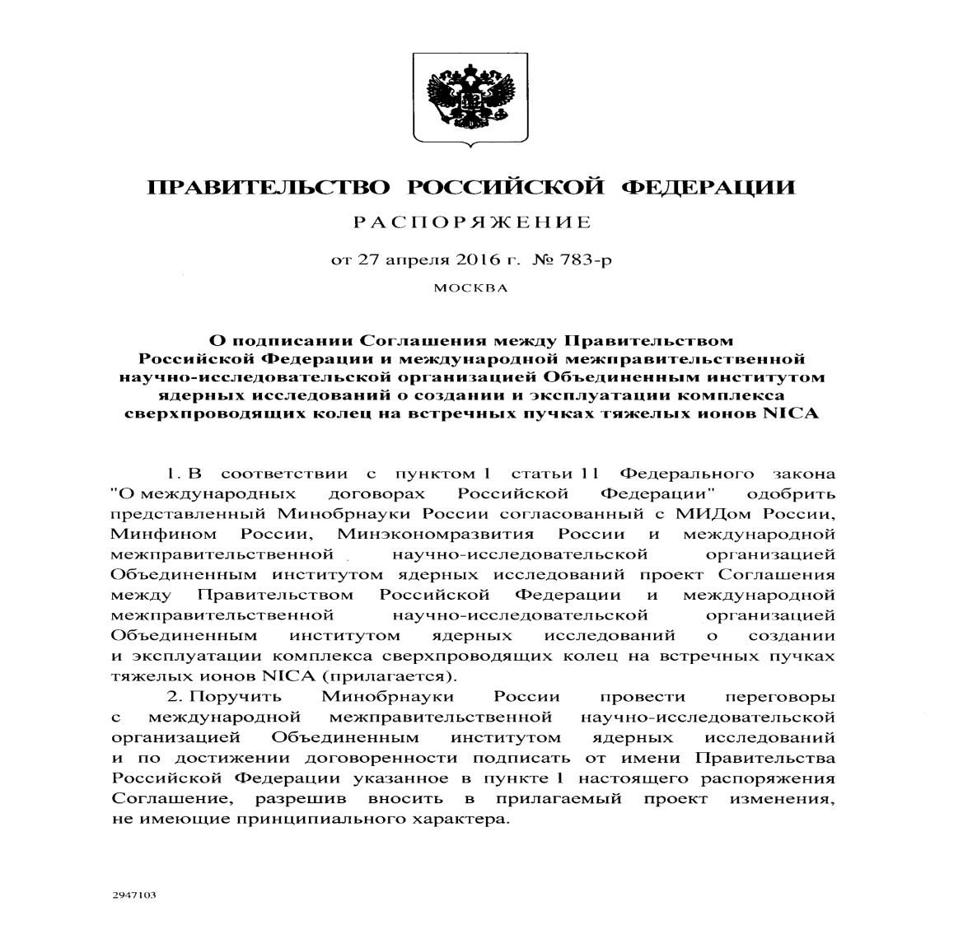
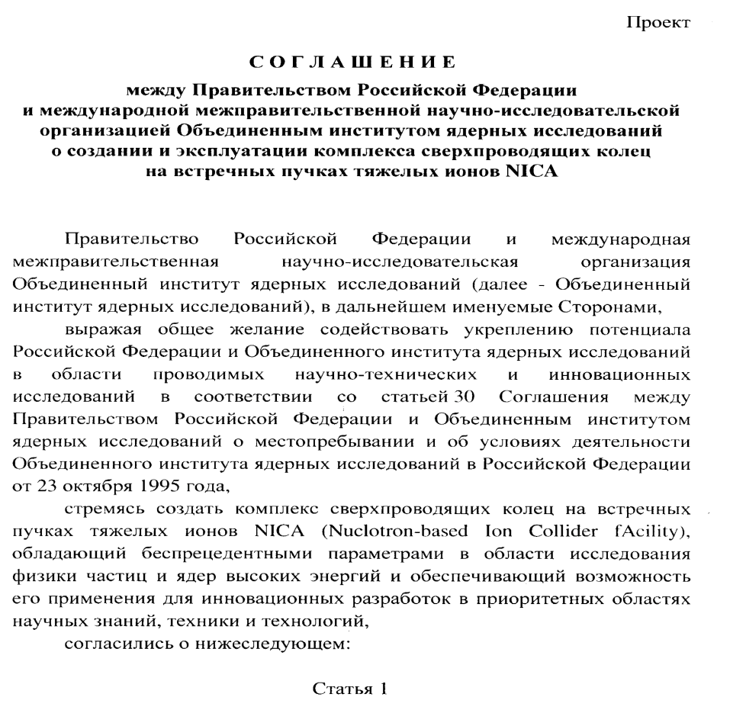
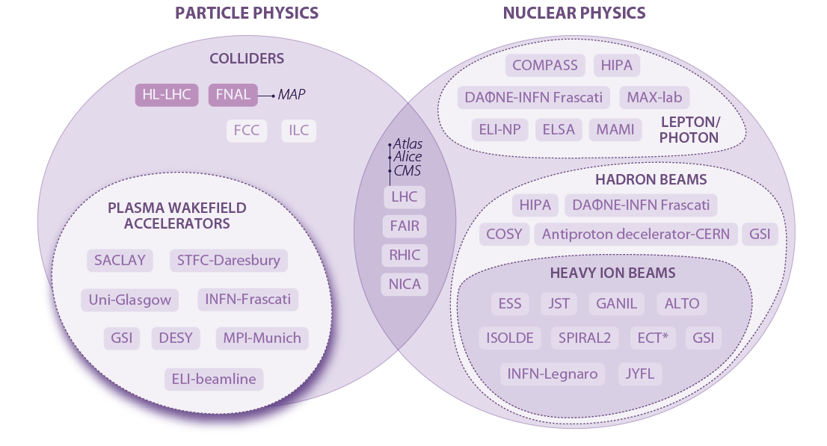
Agreement between Government of Russian Federation and JINR on the NICA realization
NICA in ESFRI road map update 2016

Slide 39
Concluding remarks
NICA can provide a competitive research of dense baryonic matter and spin physics
Construction of the accelerator complex is in progress
Constructions of both BM@N and MPD are well progressing
The SPD project is in preparation
The NICA collaboration is growing
New NICA partners are welcome

Slide 40

NICA
The cooperation makes us stronger!
FAIR
CERN
Thank you!

Slide 41
Round Table Discussions on NICA/MPD@JINR
Round Table Discussion I: Searching for the mixed phase of strongly interacting matter at the JINR Nuclotron, July 7 - 9, 2005 http://theor.jinr.ru/meetings/2005/roundtable/
Round Table Discussion II: Searching for the mixed phase of strongly interacting matter at the JINR Nuclotron: Nuclotron facility development JINR, Dubna, October 6 - 7, 2006
http://theor.jinr.ru/meetings/2006/roundtable/
Round Table Discussion III: Searching for the mixed phase of strongly interacting QCD matter at the NICA: Physics at NICA JINR (Dubna), November 5 - 6, 2008, http://theor.jinr.ru/meetings/2008/roundtable/
Round Table Discussion IV: Searching for the mixed phase
of strongly interacting QCD matter at the NICA: Physics at
NICA (White Paper)‏ JINR (Dubna), September 9 - 12, 2009
http://theor.jinr.ru/meetings/2009/roundtable/
Round Table Discussion V: Searching for the mixed phase of strongly interacting QCD matter at the NICA: Physics at NICA (White Paper)‏ JINR (Dubna), August 28, 2010 http://theor.jinr.ru/~cpod/Dubna_2010_program2.htm

Slide 42





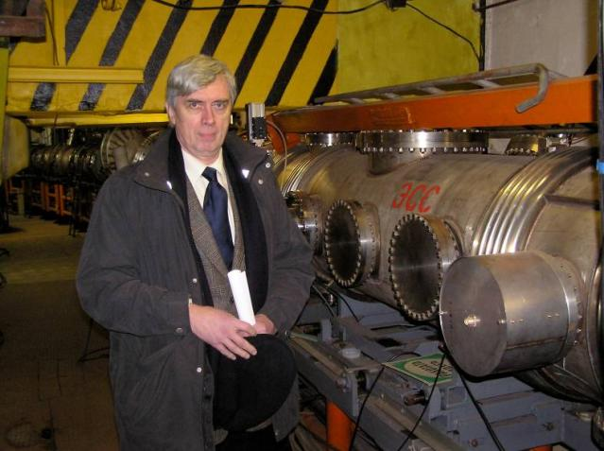
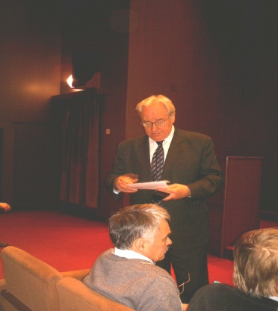
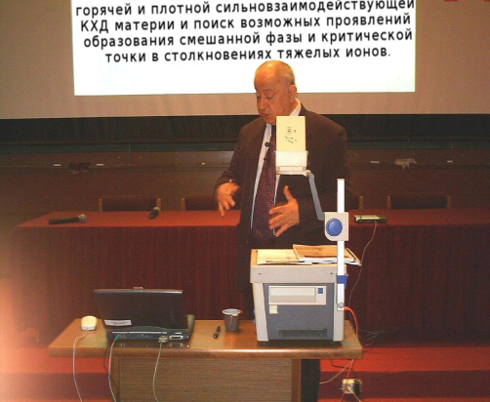
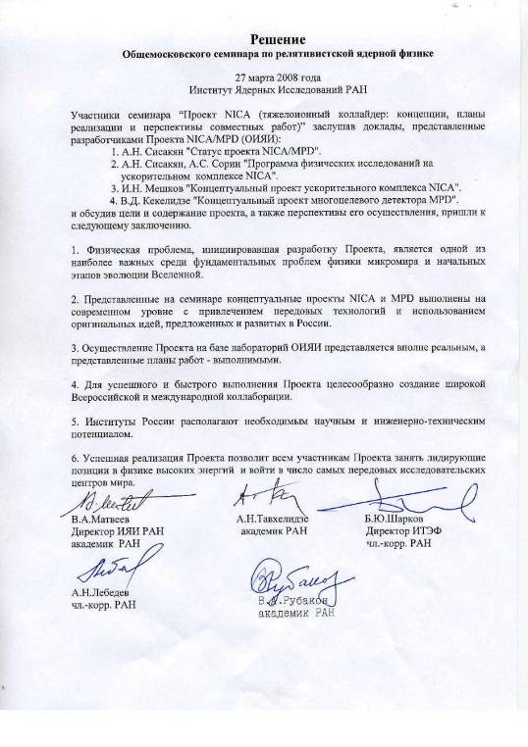

IHEP-JINR seminar at Protvino, 14.02.08
MEMORANDUM
Round Table Discussions I, II, III, IV, V…
JINR, Dubna, 2005, 2006, 2008, 2009,2010…
ITEP-JINR seminar at ITEP, 27.05.09
All Moscow-JINR seminar at INR, 27.03.08

Slide 43
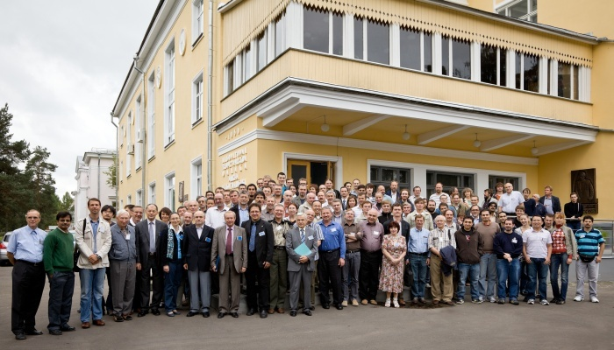
Critical point and onset of deconfinement - CPOD-2010
August 22-29 2010, Dubna

Slide 44


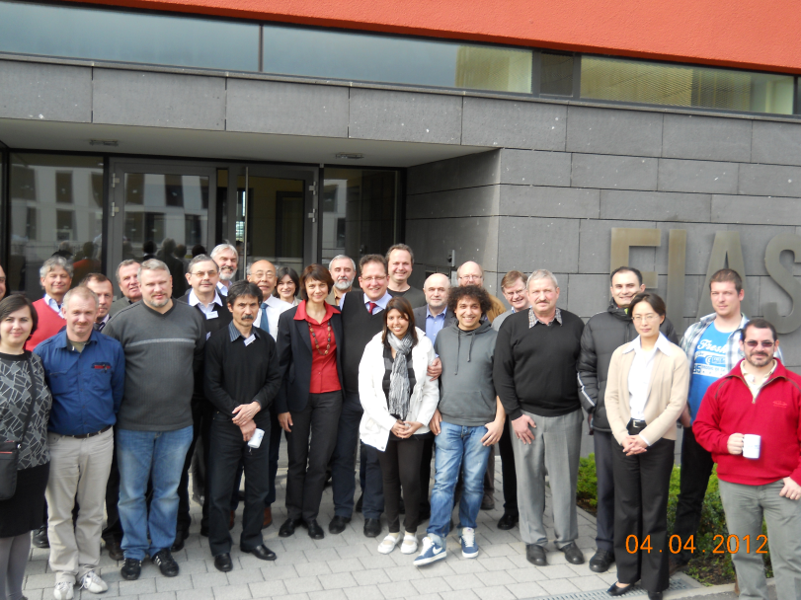
NICA/JINR-FAIR Bilateral Workshop
Matter at Highest Baryon Densities in the Laboratory and in Space
Frankfurt Institute for Advanced Studies, April 2 - 4, 2012
http://theor.jinr.ru/~nica_fair/
Topics:
- Phases of QCD at high baryon densities
- Effects signalling phase transitions
- Observables in heavy-ion collisions and in astrophysics
- Simulations of ion collisions and supernovae
Aims:
- identify discovery potential of Nuclotron-NICA and FAIR
in the canon of current and future HIC experiments
- chiral symmetry restoration
- onset of deconfinement
- in-medium modification of hadron properties
- color superconductivity, multiquark states, etc.
Results:
Most promising and feasible suggestions for
experiments at Nuclotron-NICA and CBM/FAIR
Priorities for detectors and formation of
international collaborations

Slide 45
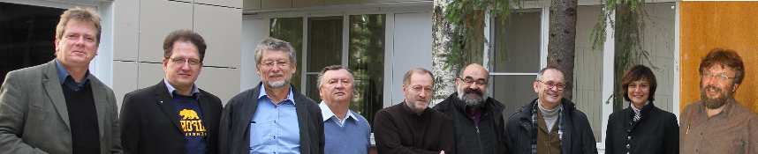
NICA White Paper prioritization meeting
JINR Dubna, November 5, 2013
J. Aichelin (SUBATECH Nantes, France)
D. Blaschke (JINR & Univ. Wroclaw, Poland)
E. Bratkovskaya (Univ. Frankfurt, Germany)
J. Randrup (LBNL Berkeley, USA)
V. Toneev (JINR)
O. Teryaev (JINR)
V. Friese (GSI Darmstadt, Germany)
M. Gazdzicki (Univ. Frankfurt, Germany & Univ. Kielce, Poland)
O. Rogachevsky (JINR)
THEORY
EXPER.

Slide 46


Strangeness in Quark Matter 2015
Dubna, 6.-11. July 2015
Satellite Meetings:
Summer School “Dense Matter”, Dubna, June 29 – July 11, 2015
Round Table “Physics at NICA”, Dubna, July 5, 2015

Slide 47



Slide 48



Slide 50


