Slide 1
Quantum simulations with cold atoms: from solid-state to high-energy physics and cosmology
Vladimir S. Melezhik
Bogoliubov Laboratory of Theoretical Physics JINR, Dubna
THMEC, Dubna, 3 November 2016

Slide 2
Outline
Quantum simulations: why cold atoms ?
Solid state physics: modeling matter phase-transitions
Simulations with degenerate quantum gases
High energy physics: modeling quark-gluon plasma,
string theory, …
Cosmology: unstable quantum vacuum
Outlook, goals and opportunities
Notes:
Preperation of a tunable few-fermion system
Tuning the interaction strength
Analytic theory for two fermions
Experiments with two fermions - Fermionization
Center of mass motion and relative motion coupling
Spectroscopic toolbox and Outlook

Slide 3
Quantum simulations: why cold atoms ?
R.Feynman’s vision: a quantum simulator
to study the quantum dynamics of another system
R. Feynman, Int. J. Theor. Phys. 21, 467 (1982)
Y. Manin, Computable and Uncomputable (Sovetskoye Radio Press, Moscow) (in Russian) 1980.
development of physics of ultracold atoms has opened unique possibility for realisation of R. Feynman’s idea:
to use simple quantum systems with desiered properties
(amenable quantitative description and modeling)
to describe more complex systems and phenomena
Notes:
Preperation of a tunable few-fermion system
Tuning the interaction strength
Analytic theory for two fermions
Experiments with two fermions - Fermionization
Center of mass motion and relative motion coupling
Spectroscopic toolbox and Outlook

Slide 4
Quantum simulation with fully controlled systems
Quantum simulations: why cold atoms ?
control over: particle number
quantum state
interaction
attractive interactions BCS-like pairing in finite systems
repulsive int.+splitting of trap entangled pairs of atoms
(quantum information processing)
+ periodic potential quantum many-body physics
(systems with low entropy to explore
such as quantum magnetism)
...
Bose-Hubbard Physics

Slide 5



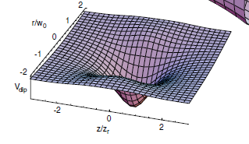


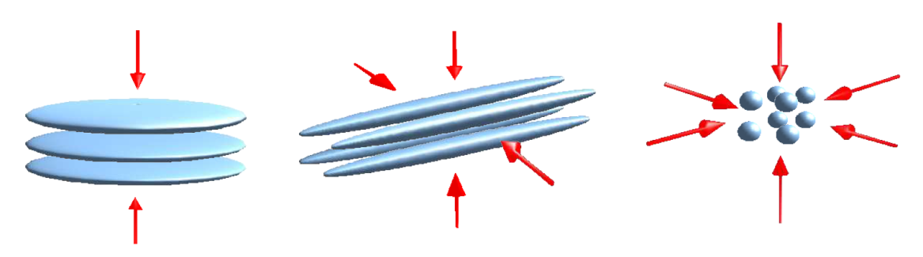
Quantum simulations: why cold atoms ?
control over: particle number

Slide 6
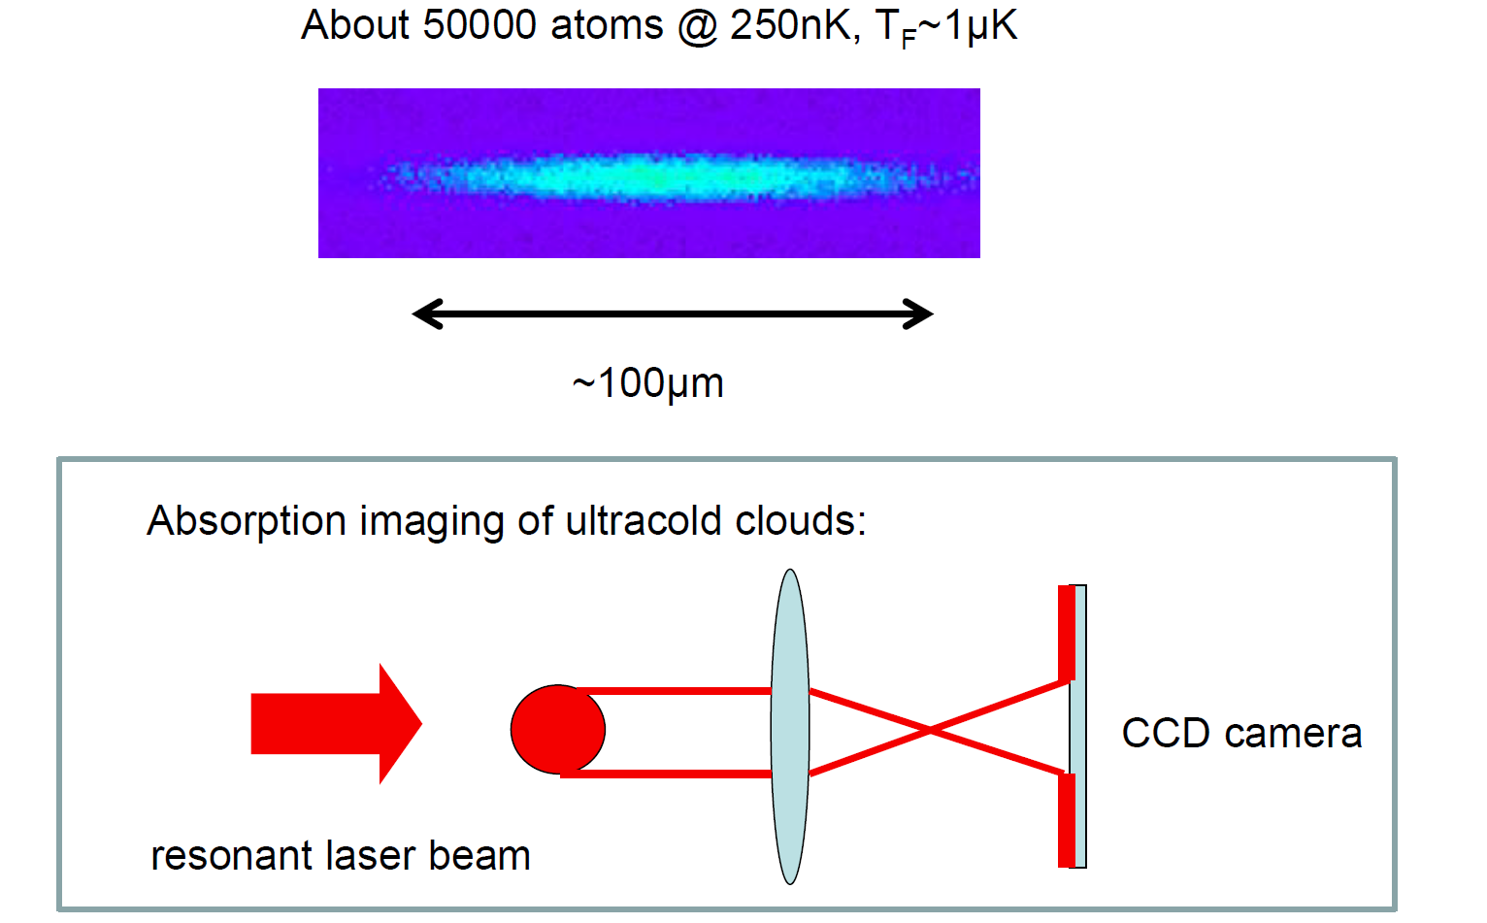
Quantum simulations: why cold atoms ?
control over: particle number

Slide 7
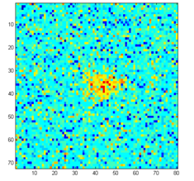
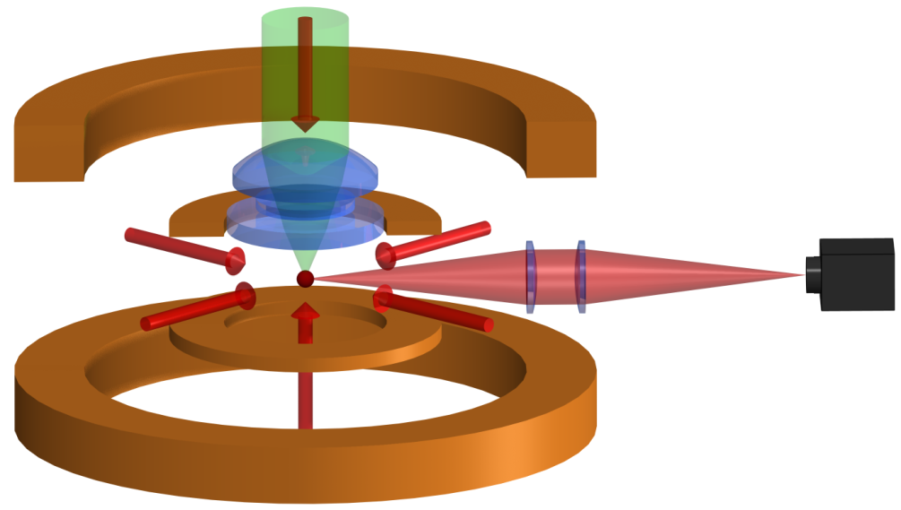
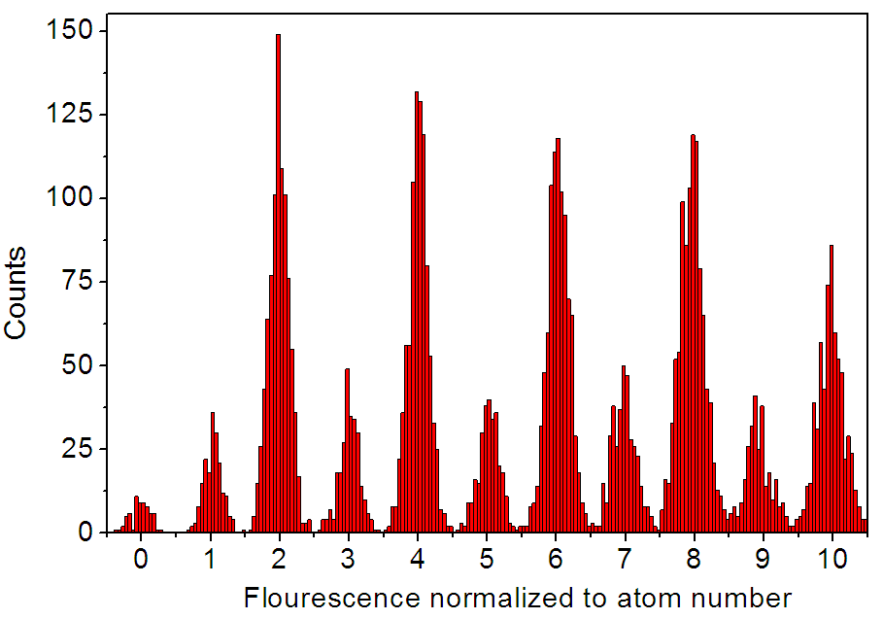
Quantum simulations: why cold atoms ?
control over: particle number
1/e-lifetime: 250s
Exposure time 0.5s
CCD
distance between 2 neighbouring atom peaks: ~ 6σ
1-10 atoms can be distiguished with high fidelity > 99%

Slide 8
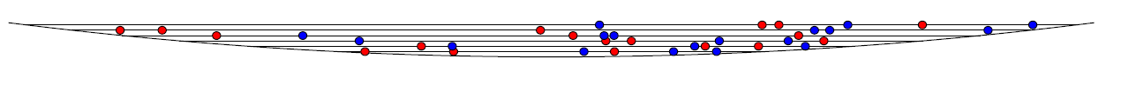
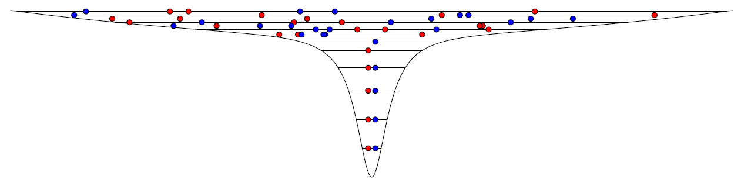
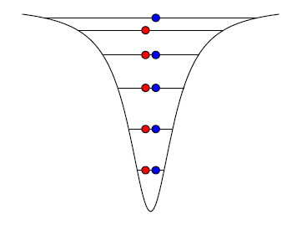
Quantum simulations: why cold atoms ?
control over: particle number
2-component mixture in reservoir T=250nK
superimpose microtrap
switch off reservoir
p₀= 0.9999
+ magnetic field gradient in axial direction

Slide 9
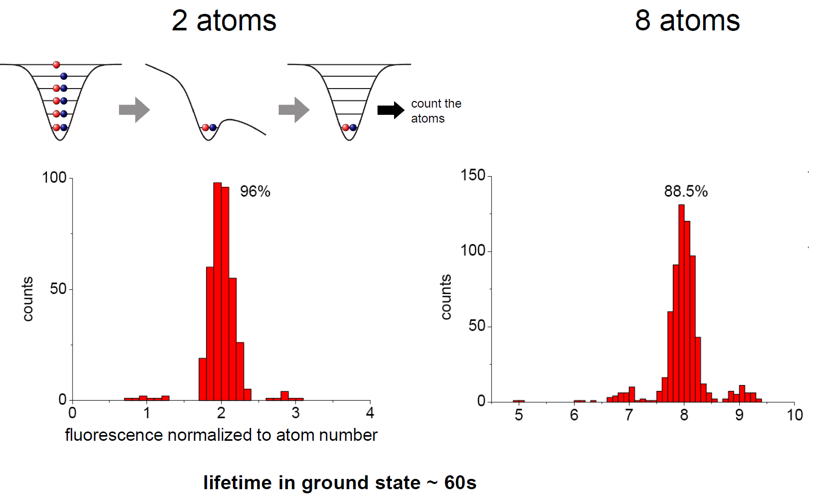
Quantum simulations: why cold atoms ?
control over: particle number with high fidelity
Notes:
Preperation of a tunable few-fermion system
Tuning the interaction strength
Analytic theory for two fermions
Experiments with two fermions - Fermionization
Center of mass motion and relative motion coupling
Spectroscopic toolbox and Outlook

Slide 10
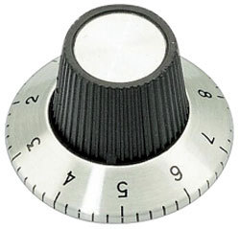
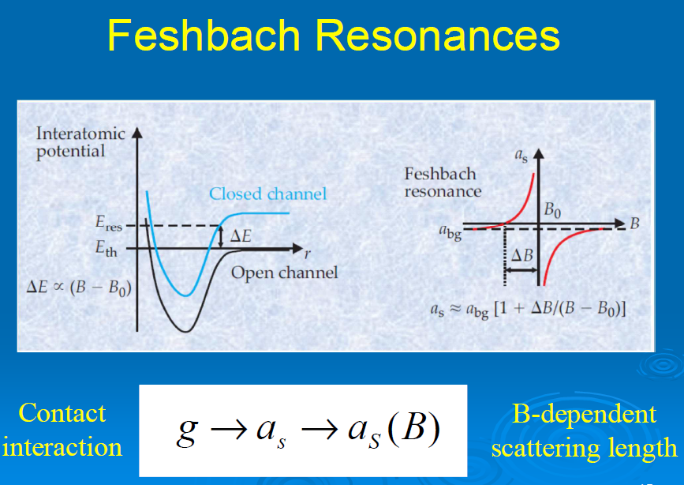



Quantum simulations: why cold atoms ?
control over: interaction
Notes:
Preperation of a tunable few-fermion system
Tuning the interaction strength
Analytic theory for two fermions
Experiments with two fermions - Fermionization
Center of mass motion and relative motion coupling
Spectroscopic toolbox and Outlook

Slide 11
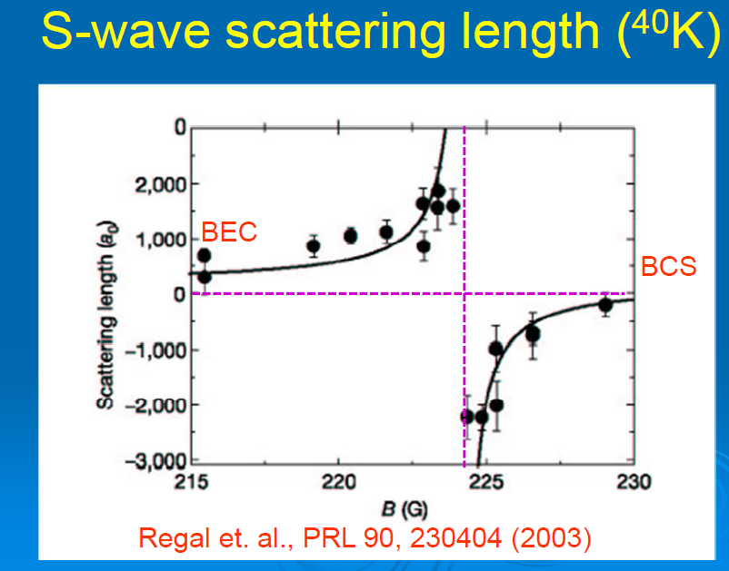
Quantum simulations: why cold atoms ?
control over: interaction
Notes:
Preperation of a tunable few-fermion system
Tuning the interaction strength
Analytic theory for two fermions
Experiments with two fermions - Fermionization
Center of mass motion and relative motion coupling
Spectroscopic toolbox and Outlook

Slide 12

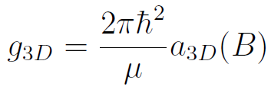
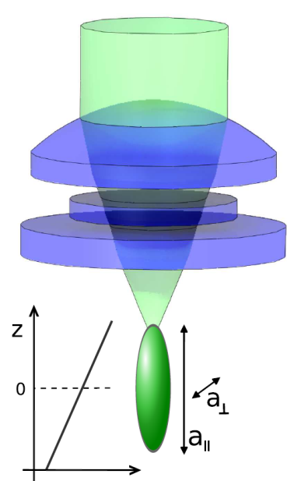

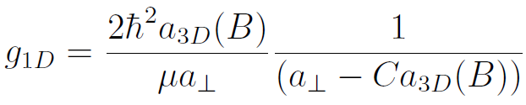

Quantum simulations: why cold atoms ?
control over: interaction
3D
Feshbach resonance
single-channel pseudopotential
strong confinement
1D
Confinement induced resonance
(CIR)
single-channel pseudopotential with
renormalized interaction constant
M. Olshanii, PRL 81, 938 (1998).
Notes:
12

Slide 13
Quantum simulations: why cold atoms ?
control over: interaction
3D
Feshbach resonance
single-channel pseudopotential
strong confinement
1D
Confinement induced resonance
(CIR)
single-channel pseudopotential with
renormalized interaction constant
M. Olshanii, PRL 81, 938 (1998).
Notes:
13

Slide 14

Quantum simulations: why cold atoms ?
control over: interaction
3D
Feshbach resonance
single-channel pseudopotential
strong confinement
1D
Confinement induced resonance
(CIR)
single-channel pseudopotential with
renormalized interaction constant
M. Olshanii, PRL 81, 938 (1998).
Notes:
14

Slide 15
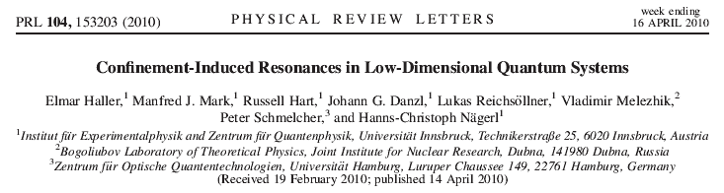
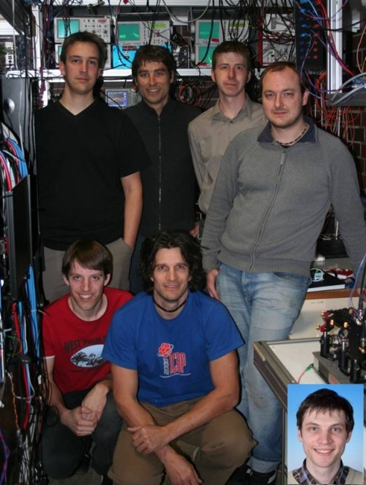

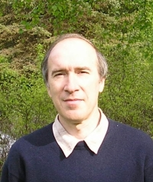
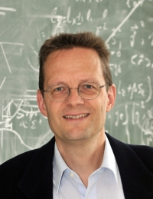
Elmar Haller –>
Outstanding Doctoral
Thesis in AMO Physics Recipients for 2011

Slide 16
Shifts and widths of Feshbach resonances in atomic waveguides
Sh.Saeidian, V.S. Melezhik ,and P.Schmelcher, Phys.Rev. A86, 062713 (2012)
d-wave FR at 47.8G develops in waveguide as
depending on minimums and stable maximum
of transmission coefficient T

Slide 17
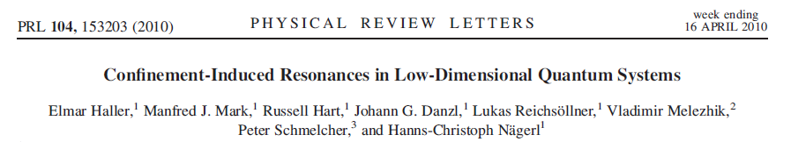
Shifts and widths of Feshbach resonances in atomic waveguides
Sh.Saeidian, V.S. Melezhik ,and P.Schmelcher, Phys.Rev. A86, 062713 (2012)
d-wave FR at 47.8G develops in waveguide as
depending on minimums and stable maximum
of transmission coefficient T
experiment

Slide 18
Shifts and widths of Feshbach resonances in atomic waveguides
Sh.Saeidian, V.S. Melezhik ,and P.Schmelcher, Phys.Rev. A86, 062713 (2012)
d-wave FR at 47.8G develops in waveguide as
depending on minimums and stable maximum
of transmission coefficient T
experiment
theory
Olshanii formula works for s,d,and g FRs

Slide 19


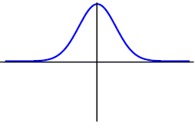
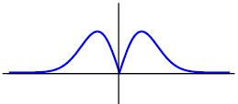
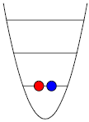
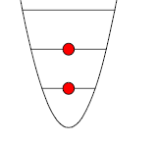
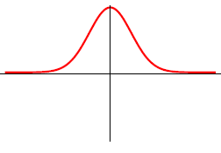
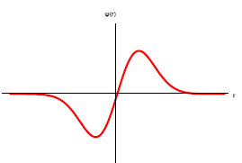
Quantum simulations: why cold atoms ?
control over: quantum state
2
R
r
=
2
R
r
M.D. Girardeau, PRA 82, 011607(R) (2010)
in 1D: same same energy
analytic solution for energy:
T. Busch et al., Found Phys Vol.28, No.4 549-559 (1998)

Slide 20
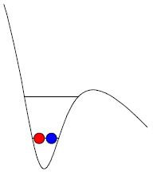
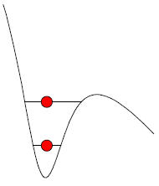
Quantum simulations: why cold atoms ?
control over: quantum state
2 distinguishable fermions
2 identical fermions
F.Serwane et al. Science 332(2011)336

Slide 21
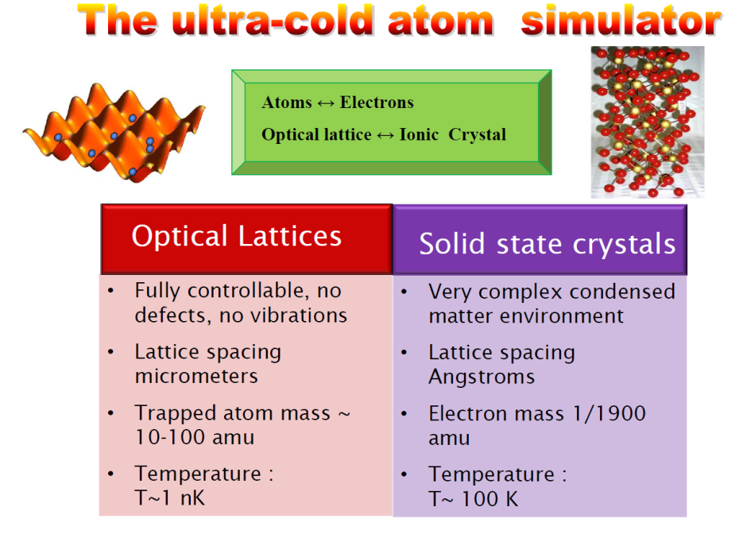
Solid state physics: modeling phase-transitions
Notes:
Preperation of a tunable few-fermion system
Tuning the interaction strength
Analytic theory for two fermions
Experiments with two fermions - Fermionization
Center of mass motion and relative motion coupling
Spectroscopic toolbox and Outlook

Slide 22
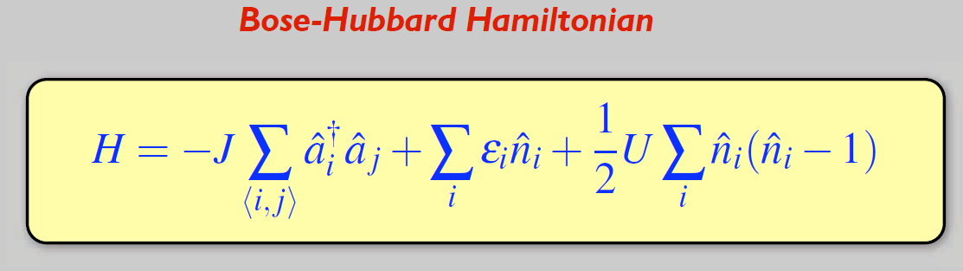
Solid state physics: modeling phase-transitions
Notes:
Preperation of a tunable few-fermion system
Tuning the interaction strength
Analytic theory for two fermions
Experiments with two fermions - Fermionization
Center of mass motion and relative motion coupling
Spectroscopic toolbox and Outlook

Slide 23
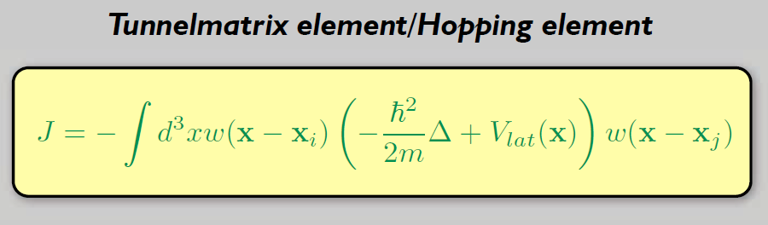
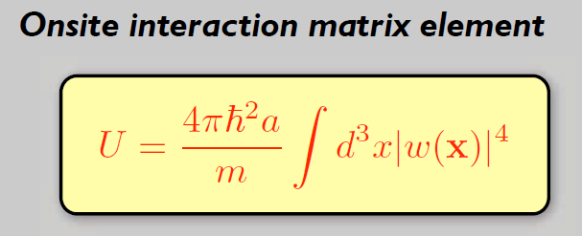
Solid state physics: modeling phase-transitions
Notes:
Preperation of a tunable few-fermion system
Tuning the interaction strength
Analytic theory for two fermions
Experiments with two fermions - Fermionization
Center of mass motion and relative motion coupling
Spectroscopic toolbox and Outlook

Slide 24
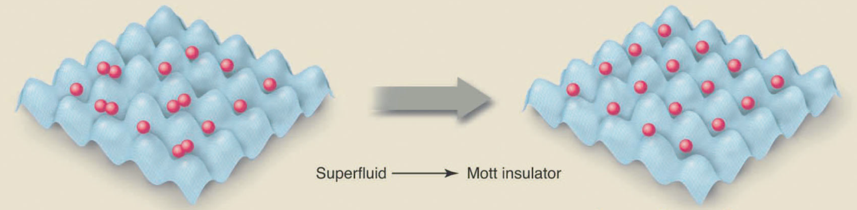
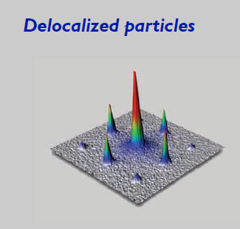
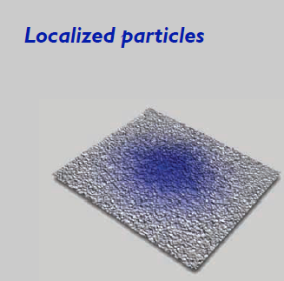

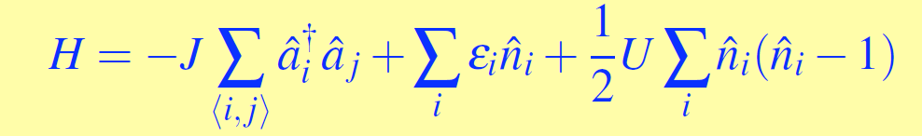
Solid state physics: modeling phase-transitions
Notes:
Preperation of a tunable few-fermion system
Tuning the interaction strength
Analytic theory for two fermions
Experiments with two fermions - Fermionization
Center of mass motion and relative motion coupling
Spectroscopic toolbox and Outlook

Slide 25
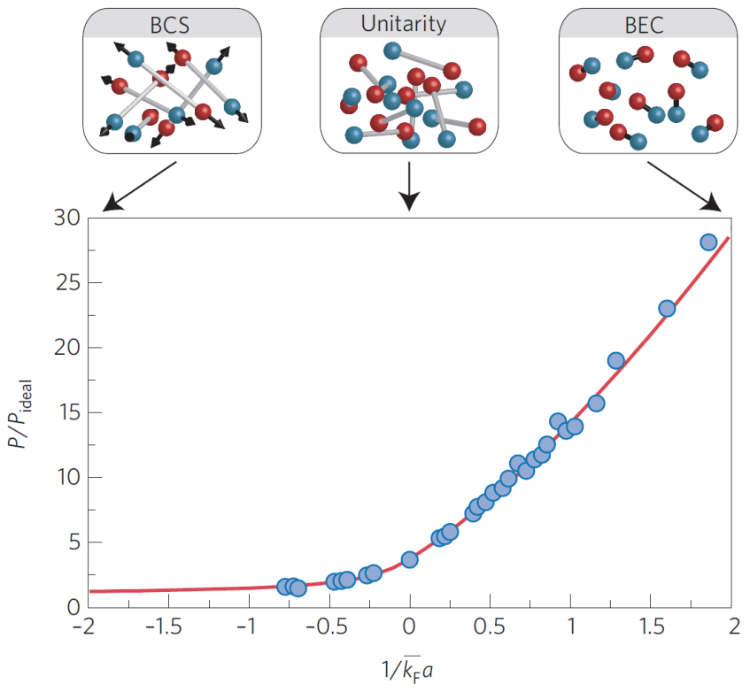
BCS-BEC crossover in ultracold Fermi gas
Notes:
Preperation of a tunable few-fermion system
Tuning the interaction strength
Analytic theory for two fermions
Experiments with two fermions - Fermionization
Center of mass motion and relative motion coupling
Spectroscopic toolbox and Outlook

Slide 26

BCS-BEC crossover in ultracold Fermi gas
diffusion Monte-Carlo simulation
S.Pilati & S.Giorgini PRL 100 (2008) 030401
experiment
N.Navon et al Science 328 (2010) 729
Notes:
Preperation of a tunable few-fermion system
Tuning the interaction strength
Analytic theory for two fermions
Experiments with two fermions - Fermionization
Center of mass motion and relative motion coupling
Spectroscopic toolbox and Outlook

Slide 27
BCS-BEC crossover in ultracold Fermi gas
diffusion Monte-Carlo simulation
S.Pilati & S.Giorgini PRL 100 (2008) 030401
experiment
N.Navon et al Science 328 (2010) 729
Notes:
Preperation of a tunable few-fermion system
Tuning the interaction strength
Analytic theory for two fermions
Experiments with two fermions - Fermionization
Center of mass motion and relative motion coupling
Spectroscopic toolbox and Outlook

Slide 28

BCS-BEC crossover in ultracold Fermi gas
diffusion Monte-Carlo simulation
S.Pilati & S.Giorgini PRL 100 (2008) 030401
experiment
N.Navon et al Science 328 (2010) 729
Notes:
Preperation of a tunable few-fermion system
Tuning the interaction strength
Analytic theory for two fermions
Experiments with two fermions - Fermionization
Center of mass motion and relative motion coupling
Spectroscopic toolbox and Outlook

Slide 29
BCS-BEC crossover in ultracold Fermi gas
diffusion Monte-Carlo simulation
S.Pilati & S.Giorgini PRL 100 (2008) 030401
experiment
N.Navon et al Science 328 (2010) 729
Notes:
Preperation of a tunable few-fermion system
Tuning the interaction strength
Analytic theory for two fermions
Experiments with two fermions - Fermionization
Center of mass motion and relative motion coupling
Spectroscopic toolbox and Outlook

Slide 30





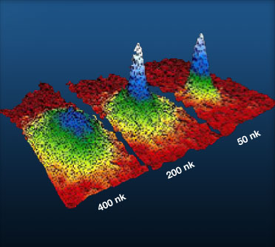
Simulations with degenerate quantum gases
Gross-Pitaevski equation
Bose-Einstein condensation
degenarate quantum gases
Notes:
Preperation of a tunable few-fermion system
Tuning the interaction strength
Analytic theory for two fermions
Experiments with two fermions - Fermionization
Center of mass motion and relative motion coupling
Spectroscopic toolbox and Outlook

Slide 31
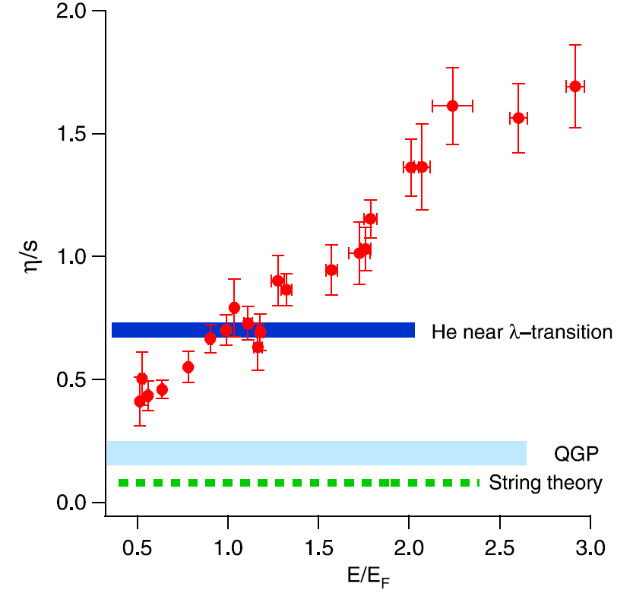


Modeling quark-gluon plasma, string theory
Optically-trapped, strongly-interacting atomic Fermi gases provide a unique
possibility for modeling nonperturbative many-body systems and theories.
Particularly → quark-gluon plasma, string theory
a highly-degenerate Fermi gas of
= shear viscosity/ entropy density
A. Turlapov, J. Kinast, B. Clancy, L. Luo, J. Joseph, J.E. Thomas,
J Low Temp Phys 150 (2008) 567

Slide 32
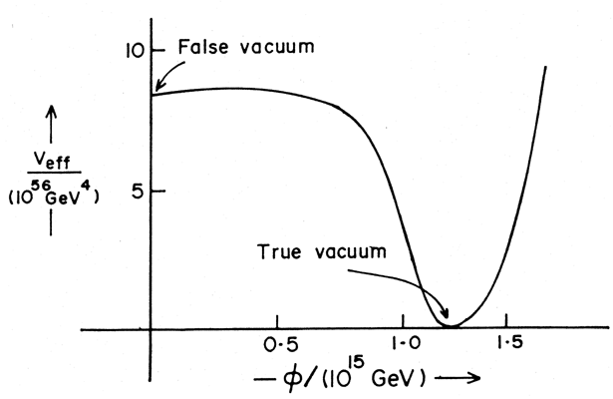

Modeling unstable quantum vacuum
Take 2 BECs and couple them with a laser light.
RF
BEC 1
BEC 2
Stable
(true vacuum)
Unstable
(false vacuum)
Their phase difference behaves like a pendulum, which has stable and unstable points.
-- relativistic field equation of the early Universe.

Slide 33
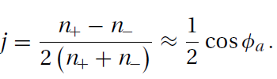
Unstable quantum vacuum: BEC simulations
“Bubbles” appear during the transition to true vacuum

Slide 34
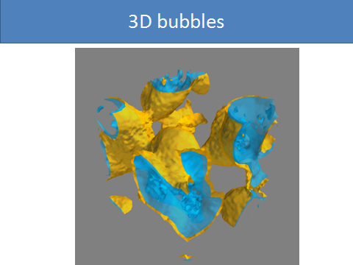
Opanchuk et al. Annalen der Physik 525 (2013) 866

Slide 35
Quantum simulation with fully controlled systems
Outlook, goals and opportunities
control over: particle number, quantum states, interaction
Fast-growing field, promising applications in study of many problems
I.M.Georgescu et al. Quantum simulations, Rev.Mod.Phys. 86 (2014) 153
J.I. Cirac and P.Zoller, Goals and opportunities in quantum simulation,
Nature Phys. 8 (2012) 264
M.Dalmonte and S.Montangero, Lattice gauge theories simulations…,arXiv:1602.03776
~ few tens experimental groups worldwide
Rb,Cs,K,Sr,Li … Rb₂ , Cs₂ , RbK … 1D, 2D, 3D

Slide 36
Quantum simulation with fully controlled systems
Outlook, goals and opportunities
control over: particle number, quantum states, interaction
Fast-growing field, promising applications in study of many problems
I.M.Georgescu et al. Quantum simulations, Rev.Mod.Phys. 86 (2014) 153
J.I. Cirac and P.Zoller, Goals and opportunities in quantum simulation,
Nature Phys. 8 (2012) 264
M.Dalmonte and S.Montangero, Lattice gauge theories simulations…,arXiv:1602.03776
~ few tens experimental groups worldwide
Rb,Cs,K,Sr,Li … Rb₂ , Cs₂ , RbK … 1D, 2D, 3D
recently -> hybrid “atom-ion” systems Li-Yb+, Rb-Ba+ …

Slide 37
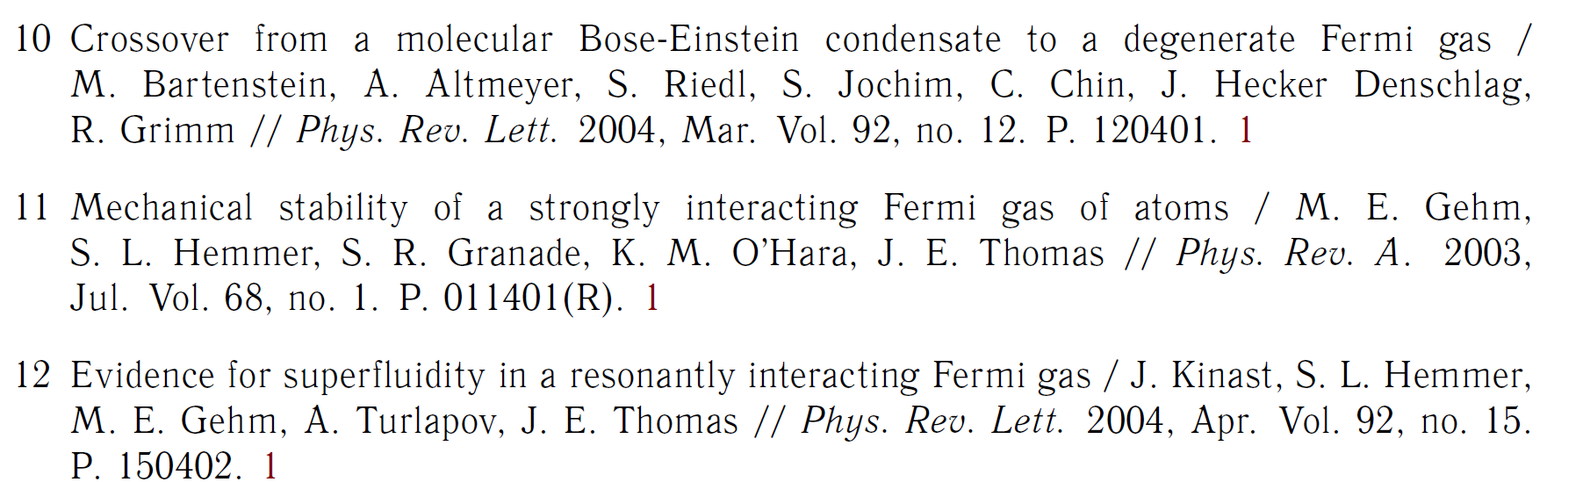
in proposed quantum simulators improved controllability and scalability are required.

