Slide 1

Brane effects in vacuum currents on AdS spacetime with toroidal compactifications
Stefano Bellucci
INFN, Laboratori Nazionali di Frascati
QFEXT09
7th RT Italy-Russia at JINR 2015

Slide 2
Summary
In the present talk we show how to obtain the brane-induced effects on the VEV of the current density for a charged scalar field in the background of locally AdS spacetime with an arbitrary number of toroidally compactified spatial dimensions, in the presence of a brane parallel to the AdS boundary
arXiv:1508.07255 [hep-th]. JHEP (in press)

Slide 3
Outline
Motivation
Quantum vacuum
Experimentally verified effects of vacuum fluctuations
Background geometry: AdS spacetime with compact dimensions
Vacuum currents in AdS spacetime
Vacuum currents in the presence of a brane
Conclusions

Slide 4
Vacuum in classical physics
Classical physics: Particles and Fields
Vacuum in classical physics Empty space
Vacuum no particles and no fields
Vacuum has no properties

Slide 5
Vacuum in quantum physics
Vacuum in QFT A state of quantum field with zero number of quanta
Number of quanta operator and field operator do not commute
Heisenberg’s uncertainty principle Field has no definite value in the vacuum state
In the vacuum state the field is subject to quantum fluctuations (virtual particles)
Vacuum or zero-point fluctuations
In QED vacuum the electric and magnetic fields have zero average values, but their variances are not zero
Vacuum is a state with non-trivial properties

Slide 6
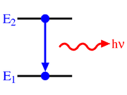
Experimentally verified effects of vacuum fluctuations
Spontaneous emission of atoms
Spontaneous emission in free space depends upon vacuum fluctuations to get started
Lamb shift
According to Dirac theory the orbitals ²S_{1/2} and ²P_{1/2} of the hydrogen atom should have the same energies
Lamb & Retherford (1947) experimentally observed the splitting between these states 1057.864 MHz (Lamb, Nobel Prize in Physics, 1955)
Energy shift is explained by the interaction of electron with vacuum fluctuations of the electromagnetic field

Slide 7
Experimentally verified effects of vacuum fluctuations
Screening of the Coulomb field near an electric charge Vacuum Polarization
Virtual particles of opposing charge are attracted to the charge, and virtual particles of like charge are repelled
Getting closer and closer to the central charge, one sees less and less of the effect of the vacuum, and the effective charge increases
Casimir effect
Imposing boundary conditions on the field operator leads to the change of the spectrum for vacuum (zero-point) fluctuations
As a result the vacuum expectation values of physical observables are changed

Slide 8
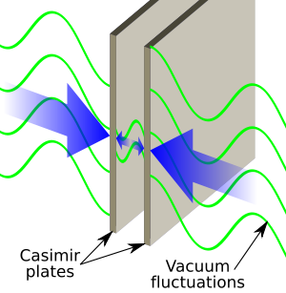
Casimir configuration
Parallel neutral metallic plates in the vacuum
Casimir energy = Change in the vacuum energy induced by the presence of conducting plates
Force acting per unit surface of the plate

Slide 9
Casimir densities
Vacuum expectation value of the energy-momentum tensor
Energy density
Vacuum pressures
Unlike classical sources the vacuum energy-momentum tensor violates the energy conditions of Hawking-Penrose singularity theorems in General Relativity
Non-singular solutions with quantum effects
Casimir effect has been investigated for a number of highly symmetric geometries of boundaries (spherical, cylindrical, ellipsoidal…)

Slide 10
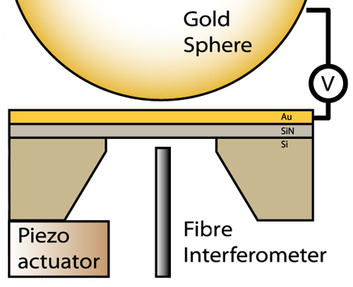
Casimir Experiments
Typical range of distances 0.1 – 10 µm
Radius of the sphere 100 µm – 10 cm

Slide 11
QFT effects in models with non-trivial topology
Quantum field theory plays an important role in models with non-trivial topology
Fields propagating in the bulk are subject to boundary conditions along compact dimensions
Imposing boundary conditions on the field leads to the change of the spectrum for vacuum (zero-point) fluctuations
As a result the vacuum expectation values of physical observables are changed (topological Casimir effect)
Vacuum energy depends on the size of compact space
Stabilization mechanism for compact dimensions

Slide 12
Aim
We aim to consider combined effects of topology and gravity on the properties of quantum vacuum
Gravitational field is considered as a classical curved background
Back-reaction of quantum effects is described by Einstein equations with the expectation value of the energy-momentum tensor for quantum fields in the right-hand side
This hybrid but very useful scheme is an important intermediate step to the development of quantum gravity
Among the most interesting effects in this field are the particle production and the vacuum polarization by strong gravitational fields
As a background geometry we consider AdS spacetime

Slide 13
Importance of AdS in QFT on curved backgorunds
Because of the high symmetry, numerous problems are exactly solvable on AdS bulk and this may shed light on the influence of a classical gravitational field on the quantum matter in more general geometries
Questions of principal nature related to the quantization of fields propagating on curved backgrounds (boundary,irreg. modes)
AdS spacetime generically arises as a ground state in extended supergravity and in string theories
AdS/Conformal Field Theory correspondence: Relates string theories or supergravity in the bulk of AdS with a conformal field theory living on its boundary
Braneworld models: Provide a solution to the hierarchy problem between the gravitational and electroweak scales
Braneworlds naturally appear in string/M-theory context and provide a novel setting for discussing phenomenological and cosmological issues related to extra dimensions
Near-horizon geometry of BHs

Slide 14
Randall-Sundrum-type braneworlds
Original Randall-Sundrum model (RS1) offers a solution to the hierarchy problem by postulating 5D AdS spacetime bounded by two (3+1)-dimensional branes
Gravity is localized near UV or Planck brane
SM particles are localized on IR or TeV brane
AdS bulk
SM
Only graviton and some other non SM fields propagate in the bulk
UV brane
IR brane
y
Hierarchy problem between the gravitational and electroweak scales is solved for
k·distance between branes = 40

Slide 15

Geometry
(D+1)-dimensional AdS spacetime
New coordinate
Topology local properties unchanged
q-dimensional torus
Cartesian coordinates along uncompactified and compactified dimensions
Compactification
length of the l-th compact dimension

Slide 16
Field content
Charged scalar field with general curvature coupling
External classical gauge field
In models with nontrivial topology one need also to specify the periodicity conditions obeyed by the field operator along compact dimensions
Special cases:
Untwisted fields
Twisted fields
We assume that the gauge field is constant:
Though the corresponding field strength vanishes, the nontrivial topology gives rise to Aharonov-Bohm-like effects

Slide 17
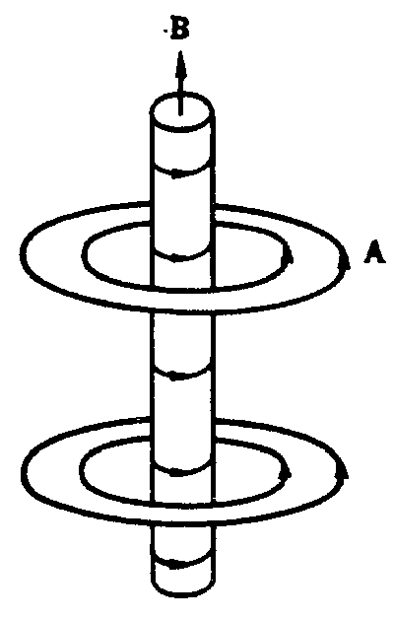
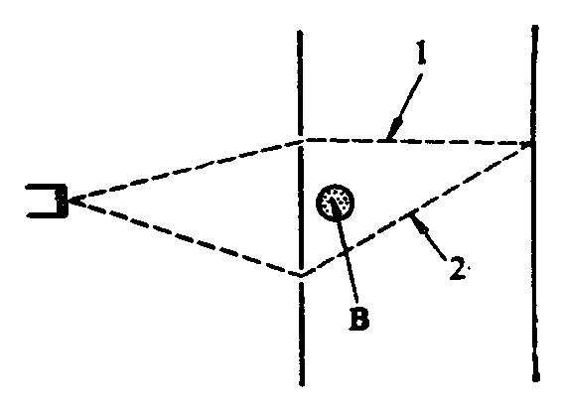
Aharonov-Bohm effect
solenoid
inside
outside

Slide 18
Aharonov-Bohm effect
Phase of the wave function is changed
Phase change along the trajectory
Change of the phase difference
magnetic flux
Interference pattern is shifted by
First experimental confirmation of the Aharonov-Bohm effect
Chambers R. G. Phys. Rev. Letters 5, 3 (1960)

Slide 19
Current density
We are interested in the effects of non-trivial topology and gravity on the vacuum expectation value (VEV) of the current
This VEV is among the most important quantities that characterize the properties of the quantum vacuum
Although the corresponding operator is local, due to the global nature of the vacuum, the VEV carries important information about the global properties of the background space-time (e.g. the lengths of the compact dimensions)
Current acts as the source in the Maxwell equations and therefore plays an important role in modeling a self-consistent dynamics involving the electromagnetic field (back reaction)

Slide 20
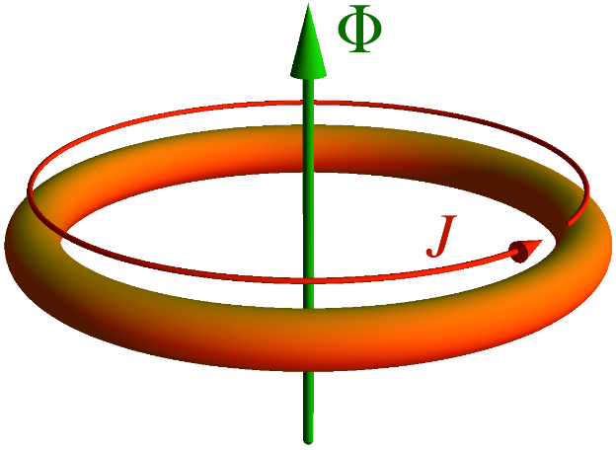
Analog from condensed matter physics: Persistent currents
Persistent currents in metallic rings are predicted in M. Büttiker, Y. Imry, R. Landauer, Phys. Lett. A 96, 7 (1983).
Existence of persistent currents in normal metal rings is a signature of phase coherence in mesoscopic systems and an example of the Aharonov-Bohm effect
Temperature must be sufficiently low to reduce the probability of inelastic scattering and the circumference of the ring short enough that the phase coherence of the electronic wave functions is preserved around the loop
Measurements of persistent currents in nanoscale gold and aluminum rings: A.C. Bleszynski-Jayich et. al., Science 326 (2009); H. Bluhm et. al., Phys. Rev. Lett. 102 (2009).

Slide 21
Induced currents in models with compact dimensions
In the problem under consideration the presence of a constant gauge field is equivalent to the magnetic flux enclosed by the compact dimension
Flux of the field strength which threads the l-th compact dimension
By the gauge transformation
the problem with a constant gauge field is reduced to the problem in the absence of the gauge field with the shifted phases in the periodicity conditions:

Slide 22
Evaluation procedure
VEV of the current density can be expressed in terms of the Hadamard function
Vacuum state
The corresponding relation
Mode sum for the Hadamard function
complete set of normalized positive- and negative-energy solutions to the field equation obeying the periodicity conditions

Slide 23
Vacuum current density
Charge density vanishes
Components of the current density along uncompact dimensions vanish
Current density along l-th compact dimension
Associated Legendre function of the second kind

Slide 24
Current density: Properties
Current density along the l-th compact dimension is an odd periodic function of the phase and an even periodic function of the phases , with the period
In particular, the current density is a periodic function of the magnetic fluxes with the period equal to the flux quantum
In the absence of the gauge field, the current density along the l-th compact dimension vanishes for untwisted and twisted fields along that direction
Charge flux through (D -1)-dimensional hypersurface
Normal to the hypersurface
Charge flux depends on the coordinate lengths of the compact dimensions in the form of
= proper length of the compact dimension, measured
in units of the AdS curvature radius
proper length of the compact dimension

Slide 25
Limiting cases
Large values of the curvature radius
MacDonald function
Leading term coincides with the current in Minkowski spacetime with toroidally compactified dimensions
Large values of the proper length compared with the AdS curvature radius:
At least one of the phases is not equal to zero

Slide 26
Limiting cases
Small values of the proper length compared with the AdS curvature radius:
Coincides with the VEV of the current density for a massless scalar field in (D + 1)-dimensional Minkowski spacetime compactified along the direction
Near the AdS boundary,
Near the AdS horizon, :
Current density in Minkowski spacetime for a massless scalar field

Slide 27
Numerical example
D=4 minimally (full curves) and conformally (dashed curves) coupled fields
Single compact dimension

Slide 28
Numerical example

Slide 29



Geometry with a brane
Brane at
Boundary condition on the brane
Constant
Normal to the brane
Robin boundary condition
Special cases: Dirichlet ( ) and Neumann ( )
$$β=0$$
$$β=∞$$
$$β$$
There is a region in the space of the parameter in which the vacuum becomes unstable
Critical value for the Robin coefficient depends on the lengths of the compact dimensions, on the phases in periodicity conditions and on the mass of the field

Slide 30


Geometry with a brane
Properties of the vacuum are different in L- and R-regions
L-region Region between the brane and AdS boundary
R-region Region between the brane and horizon
L-region
R-region
For both L- and R-regions the Hadamard function is decomposed into pure AdS and brane-induced contributions
z
$${z=z}_{0}$$
Current density along the l-th compact dimension
$${z=0}_{}$$
Brane
AdS boundary
Pure AdS (in the absence of the brane)
Brane-induced

Slide 31

Brane-induced current density
Brane-induced current density in the R-region
modified Bessel functions
Barred notation for a given function F(x)
Brane-induced current density in the L-region by the replacements

Slide 32
Asymptotics of the brane-induced current density in R-region
At large distances from the brane compared with the AdS curvature radius
Near the horizon the boundary-free part dominates
When the location of the brane tends to the AdS boundary, , the VEV vanishes as
An important result is that the VEV of the current density is finite on the brane
For Dirichlet boundary condition both the current density and its normal derivative vanish on the brane

Slide 33
Finiteness of the current density on the brane
Finiteness of the current density is in clear contrast to the behavior of the VEVs for the field squared and the energy-momentum tensor which suffer surface divergences
Feature that the VEV of the current density is finite on the brane could be argued on the base of general arguments
In quantum field theory the ultraviolet divergences in the VEVs of physical observables bilinear in the field are determined by the local geometrical characteristics of the bulk and boundary
On the background of standard AdS geometry with non-compact dimensions the VEV of the current density in the problem under consideration vanishes by the symmetry
Compactification of the part of spatial dimensions to torus does not change the local bulk and boundary geometries and does not add new divergences compared with the case of trivial topology

Slide 34
Asymptotics of the brane-induced current density in L-region
On the AdS boundary the brane-induced contribution vanishes as ,
Near the AdS boundary the boundary-free part in the VEV of the current density behaves in a similar way
On the AdS boundary the ratio of the brane-induced and
boundary-free contributions tend to a finite limiting value
For a fixed value of z, when the brane location tends to the AdS horizon, the brane-induced contribution is exponentially suppressed

Slide 35
Applications to Randall-Sundrum 1-brane model
From the results for the R-region one can obtain the current density in - symmetric braneworld models of the Randall-Sundrum type with a single brane
In the original RS 1-brane model the universe is realized as a -symmetric positive tension brane in 5D AdS and the only contribution to the curvature comes from the negative cosmological constant in the bulk
Most scenarios motivated from string theories predict the presence of other bulk fields, such as scalar fields
In addition, string theories also predict small compact dimensions originating from 10D string backgrounds

Slide 36
Generalized RS 1-brane model with compact dimensions
Background geometry:
Topology
Background geometry contains two patches of the AdS glued by the brane and related by the -symmetry identification
Brane
Spatial geometry in the case D = 2, embedded into a 3D Euclidean space
For fields even under the reflection with respect to the brane
(untwisted scalar field) the boundary condition is of the Robin type with , with c being the brane mass term
For fields odd with respect to the reflection (twisted fields) the boundary condition is reduced to the Dirichlet one

Slide 37
Vacuum current as a function of the Robin coefficient
D = 4 AdS space with a single compact dimension

Slide 38
Vacuum current: Dirichlet BC

Slide 39
Vacuum current: Neumann BC

Slide 40
Vacuum current: Dirichlet BC
Region between the AdS boundary and the brane

Slide 41
Vacuum current: Neumann BC
Region between the AdS boundary and the brane

Slide 42
Conclusions
VEV of the current density for a massive scalar field, with arbitrary curvature coupling in the geometry of a brane, is investigated in the background of AdS spacetime with spatial topology R^{p}×(S¹)^{q}
The presence of a gauge field flux enclosed by compact dimensions is assumed. On the brane the field obeys Robin boundary condition and along compact dimensions periodicity conditions with general phases are imposed.
There is a range in the space of values for the coefficient in the boundary condition where Poincare vacuum is unstable. This range depends on the brane location. In models with compact dimensions the stability condition is less restrictive than for AdS bulk with trivial topology.

Slide 43
Conclusions
Charge density and the components along the uncompactified dimensions vanish
Current density along compactified dimensions is a periodic function of the gauge field (magnetic) flux with the period of the flux quantum
VEV of the current density along compact dimensions is decomposed into the boundary-free and brane-induced contributions. The asymptotic behavior of the latter is investigated near the brane, AdS boundary and horizon.
In contrast to VEVs of the field squared and energy-momentum tensor, current density is finite on brane and vanishes for the special case of Dirichlet boundary condition
Current density (both boundary-free and brane-induced contributions) vanishes on the AdS boundary

Slide 44
Conclusions
Near the horizon the effects induced by the background curvature are small.
Brane-induced contribution vanishes on the horizon and for points near the horizon the current is dominated by the boundary-free part. In the near-horizon limit, the latter is connected to the corresponding quantity for a massless field in the Minkowski bulk by a simple conformal relation.
Depending on the value of the Robin coefficient, the presence of the brane can either increase or decrease the vacuum currents.
Applications are given for a higher-dimensional version of the Randall-Sundrum 1-brane model.
In Kaluza-Klein-type models the current with the components along compact dimensions is a source of cosmological magnetic fields

Slide 45
Thank you

